Slide 1
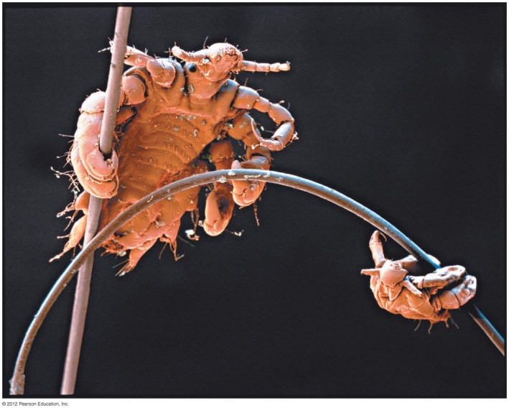

Sexually Transmitted Diseases (STDs): Worldwide Problem
Transmitted by sexual contact, including
  Genital, oral-genital, anal-genital
Bacterial
  Gonorrhea, syphilis, chlamydia
Other
  Yeasts (Candida), protozoan (Trichomonas), arthropod (pubic lice)

Slide 2
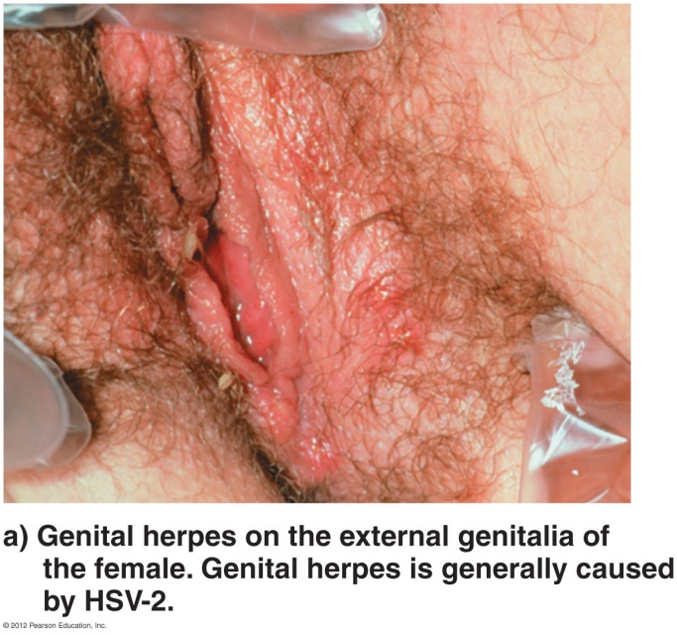
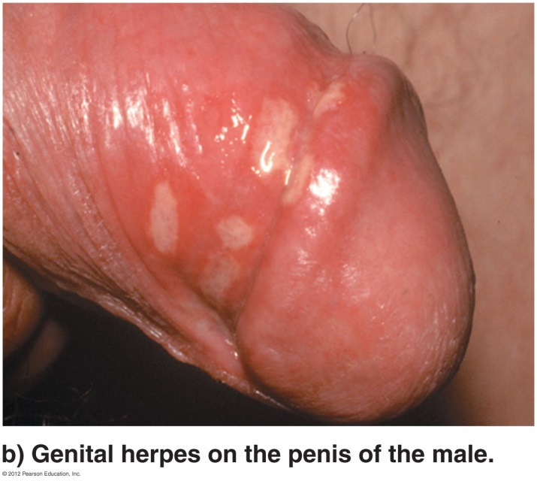
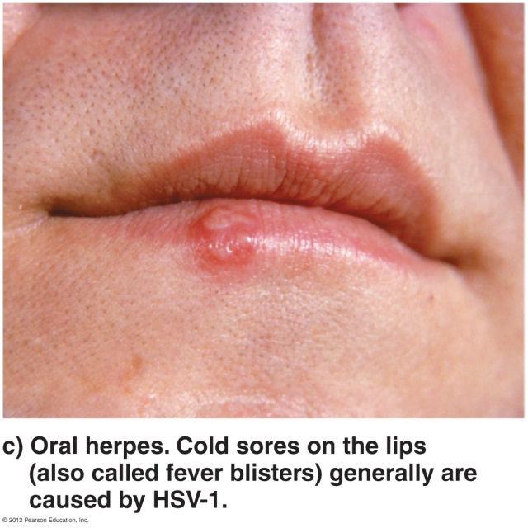
Sexually Transmitted Diseases (STDs): Worldwide Problem
Viral
  HIV, hepatitis B, genital herpes, HPV

Slide 3
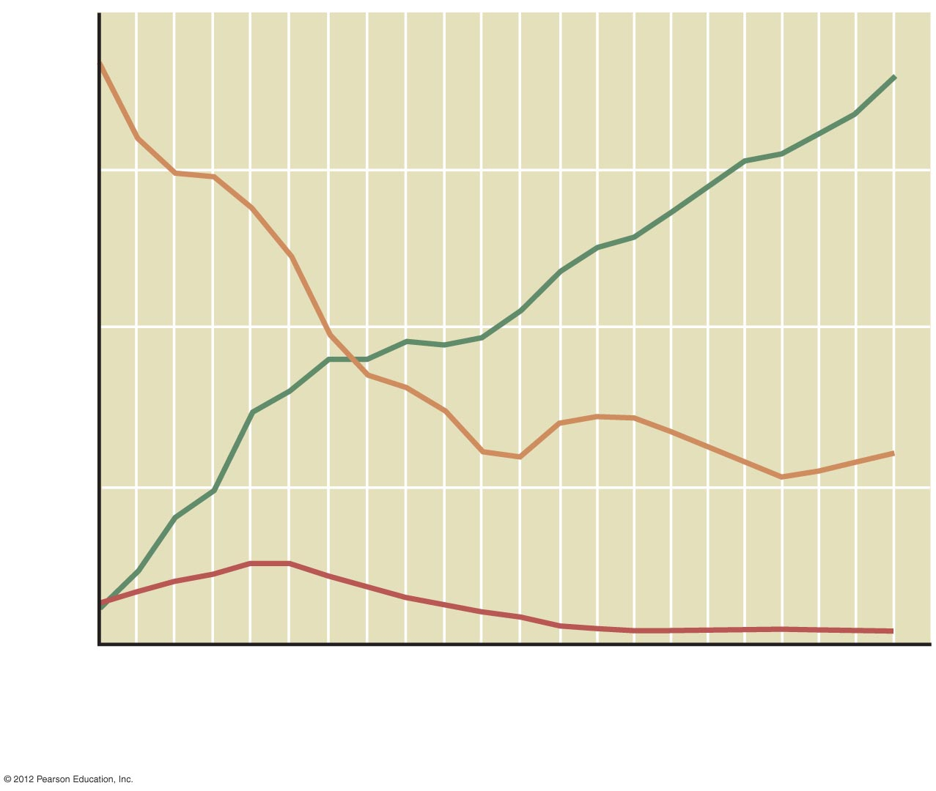
400
Gonorrhea
300
200
Rate (per 100,000 population)
Chlamydia
100
Syphilis
0
1986
1988
1990
1992
1994
1996
1998
2000
2002
2004
2006
2008
Year

Slide 4
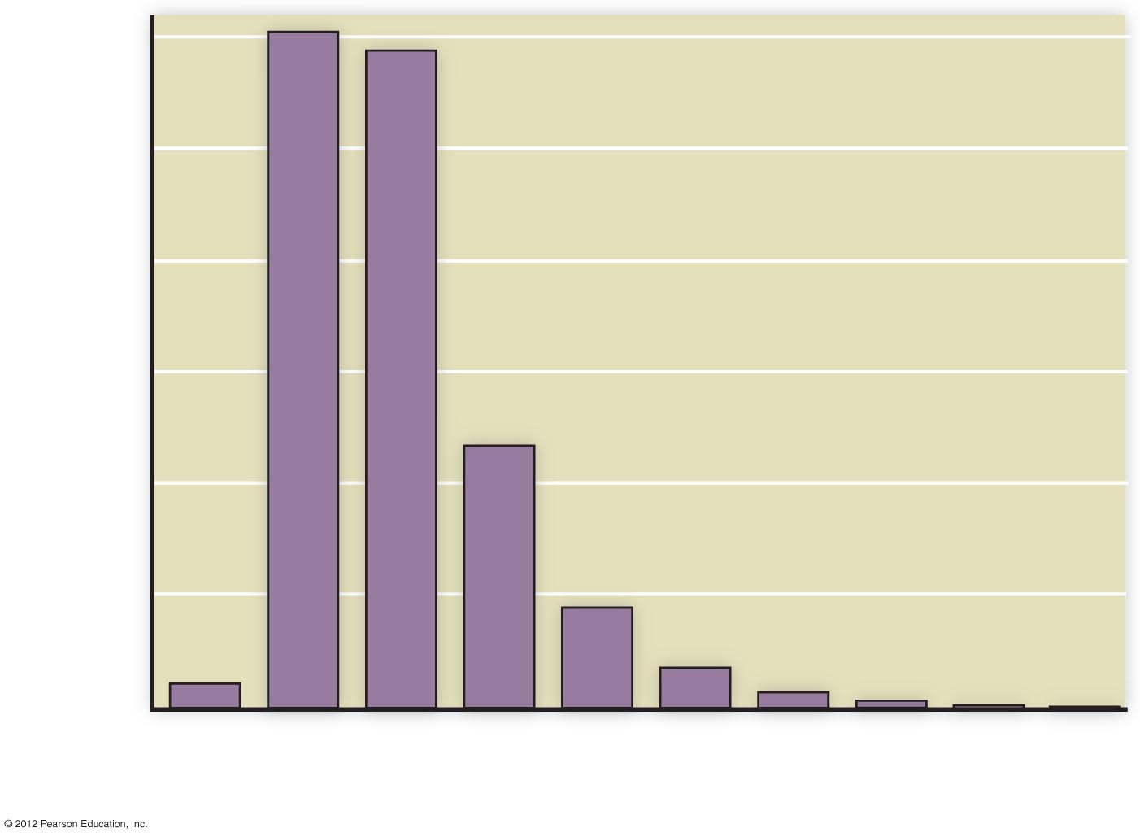
3000
2500
2000
Cases per 100,000 population
1500
1000
500
0
10-14
15-19
20-24
25-29
30-34
35-39
40-44
45-54
55-64
65+
Age group

Slide 5
Sexually Transmitted Diseases (STDs): Worldwide Problem
Prevention strategies
  Choose partner wisely
  Communicate
  Use suitable barriers
  Get tested and treated
  Get vaccinated

