Slide 1

Human Sexual Response, Intercourse, and Fertilization
Human sexual response
  Excitement, plateau, orgasm, resolution
    Male sexual response
      orgasm, marked by ejaculation, refractory period
    Female sexual response
      orgasm, marked by rhythmic muscular contractions

Slide 2
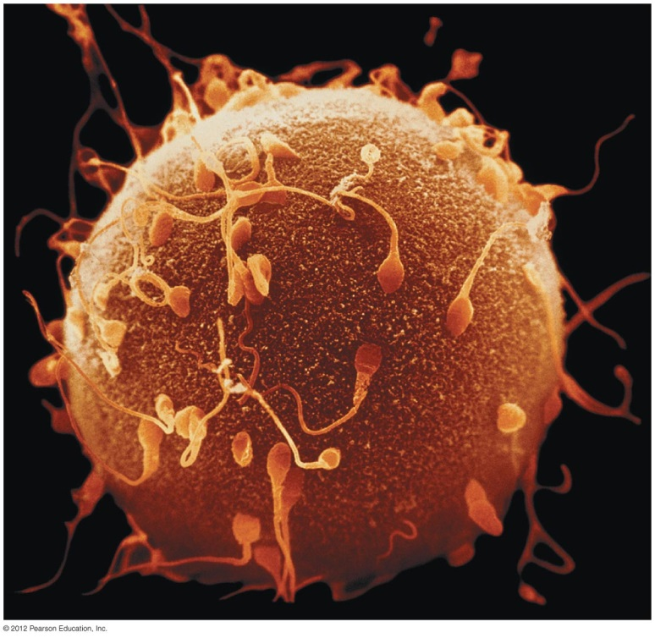
Human Sexual Response, Intercourse, and Fertilization
Fertilization
  Ejaculate may contain several hundred million sperm
  One sperm penetrates egg

Slide 3
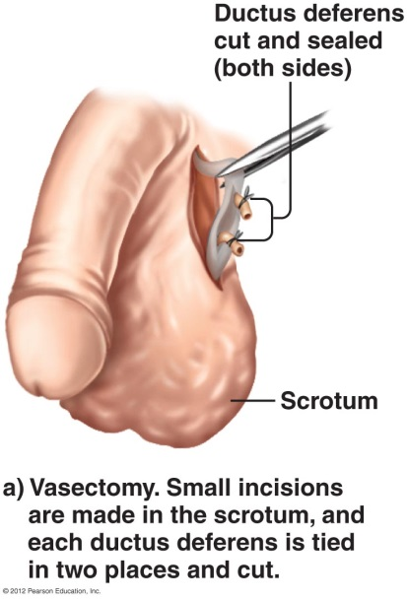
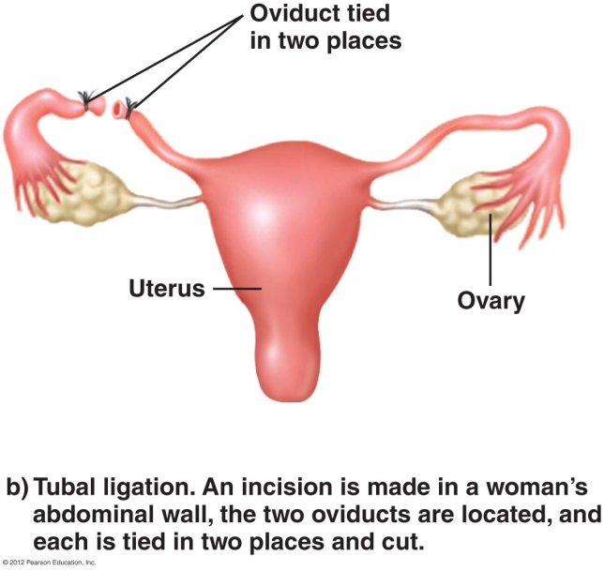
Birth Control Methods: Controlling Fertility
Abstinence
  not having intercourse
Surgical sterilization
  Vasectomy in males: cut and tie off both ductus deferens
  Tubal ligation in females: cut and tie off both oviducts
  Hysteroscopy in females: cauterize the oviducts to seal them

Slide 4
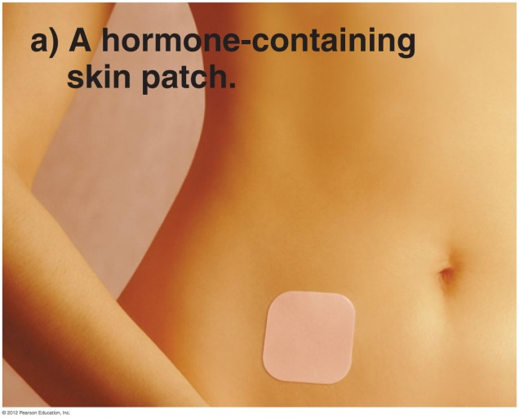
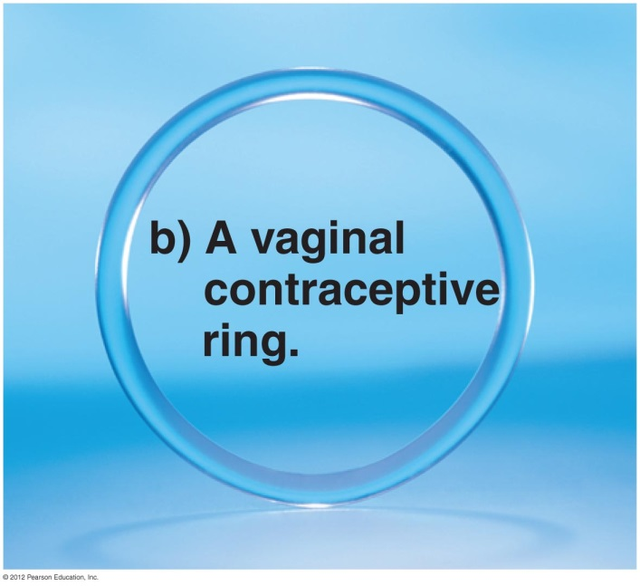
Birth Control Methods: Hormonal Methods
Birth control pills (oral contraceptives)
  Combination of synthetic progesterone and estrogen
  Inhibit release of FSH and LH
  Block ovulation
Hormone injections
  DepoProvera, Lunelle
Hormone patch
  Ortho Evra
Vaginal ring
  NuvaRing

Slide 5
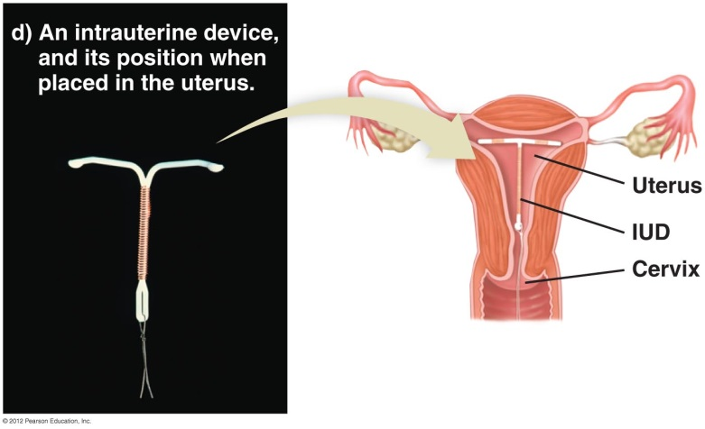
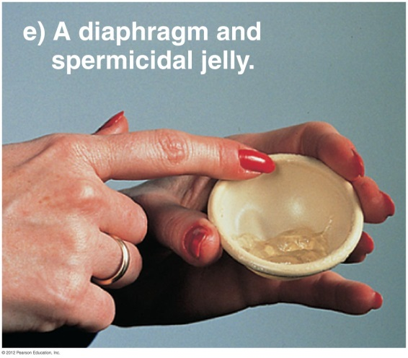
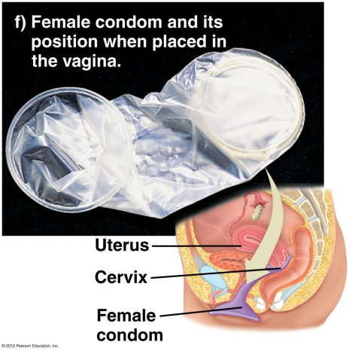
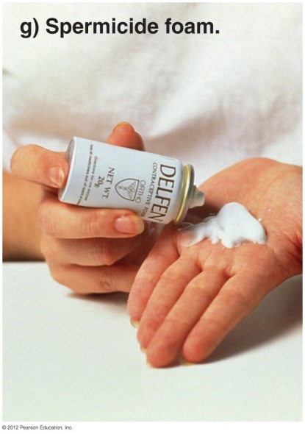
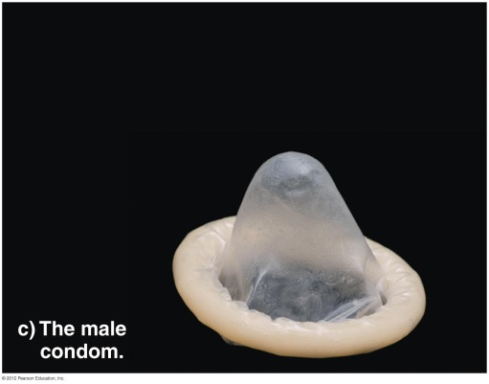
Birth Control Methods: Other
IUDs (Intrauterine devices)
  Small plastic or metal piece inserted into uterus
  Create mild chronic inflammation that prevents fertilization or implantation
Diaphragms and cervical caps
  Prevent sperm from entering the cervix
Chemical spermicides
  Kill sperm cells
Condoms
  Trap ejaculated sperm

Slide 6
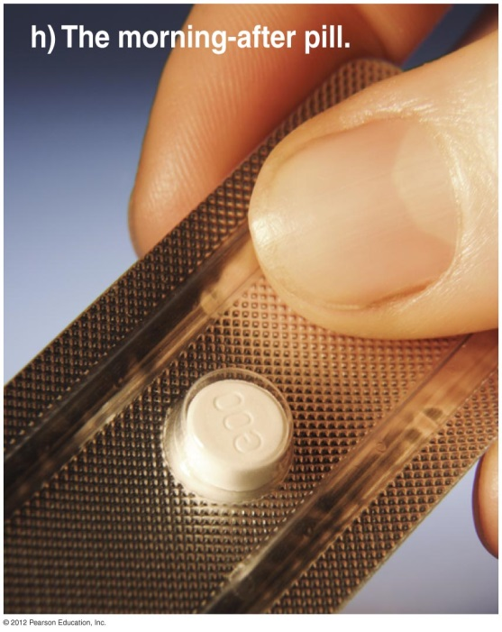
Birth Control Methods: Other
Natural alternatives
  Rhythm method, withdrawal
Morning-after pills
  Prevent pregnancy from continuing
  Preven, Plan B, Mifeprex (RU-486)
Abortion
  Terminates pregnancy
The future
  Male birth control pill
  Vaccines for women

Slide 7
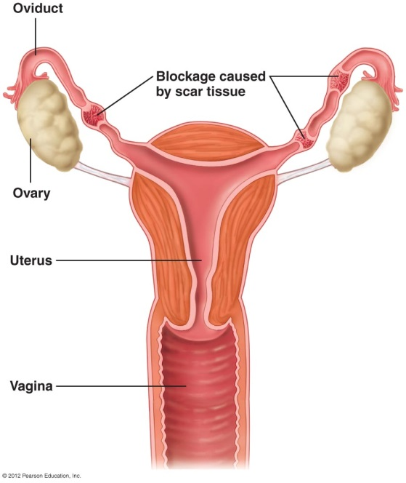
Infertility: Inability to Conceive
Many causes of infertility
  Number and quality of sperm
    < 60 million/ejaculation is considered infertile
  Pelvic inflammatory disease (PID)
    Scarred, blocked oviducts
  Abnormal production of FSH, LH
  Irregular menstrual cycles
  Endometriosis
  Decreased reproductive capacity with age
  Miscarriage (spontaneous abortion)

Slide 8
Enhancing Fertility
Artificial insemination
In vitro fertilization (IVF)
  Fertilization in test tube outside of the body
GIFT (gamete intrafallopian transfer)
  Unfertilized eggs and sperm placed directly in oviduct

Slide 9
Enhancing Fertility (cont.)
ZIFT (zygote intrafallopian transfer)
  Fertilized egg is placed in oviduct
Fertility-enhancing drugs
  Boost production of developing eggs
Surrogate motherhood

