Slide 1

Menstrual Cycle
Consists of two linked cycles
  Ovarian cycle
    Series of changes in ovaries associated with oocyte maturation
    Controlled by FSH and LH
  Uterine cycle
    Changes in the endometrial lining of the uterus
    Controlled by estrogen and progesterone

Slide 2
Ovarian Cycle: Oocytes Mature and are Released
Immature follicle of primary oocyte and granulosa cell develops; FSH and LH increase
Antrum develops within follicle; some estrogen and progesterone secreted
Secondary oocyte and polar body produced; follicle matures (Graafian follicle)
Increasing estrogen causes surge of LH; ovulation occurs
Corpus luteum formed from follicle; large amounts of estrogen and progesterone secreted

Slide 3
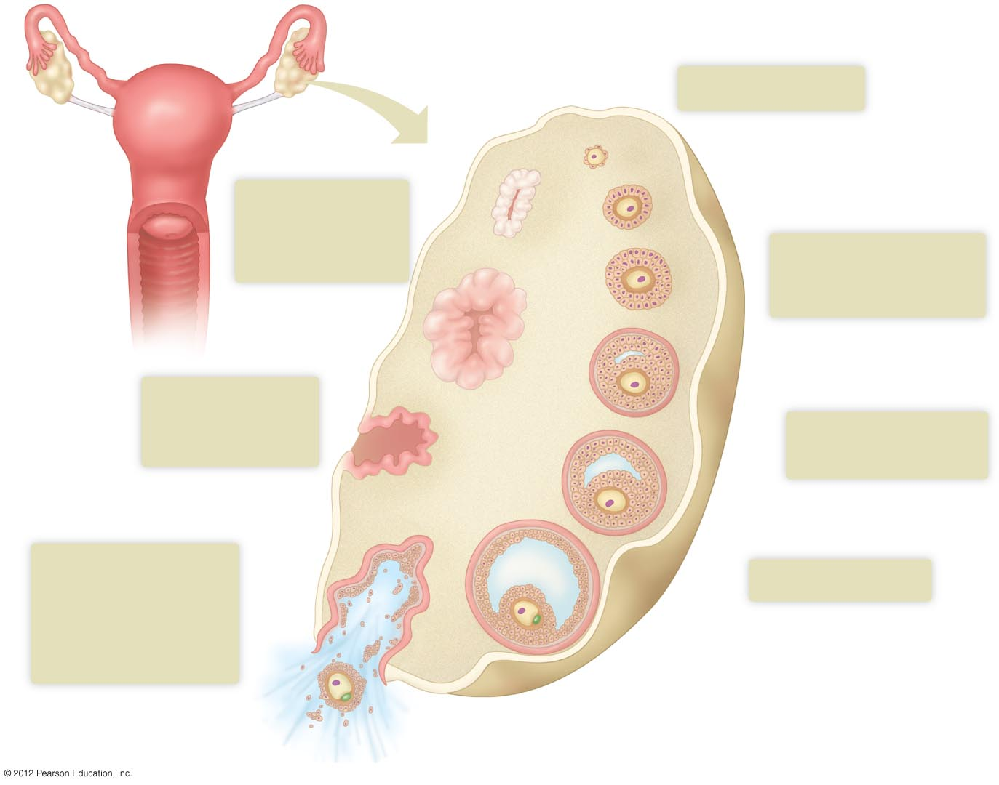
Oviduct
1
Immature follicle
Ovary
Primary oocyte
Granulosa cells
Uterus
7
Corpus luteum
degenerates if
pregnancy does
not occur
Primary Follicle
2
Zona pellucida
develops around
the primary oocyte
Vagina
Secondary Follicle
6
Corpus luteum
forms from
ruptured follicle
3
Fluid-filled antrum
develops
5
Ovulation.
Follicle ruptures,
releasing the
secondary oocyte
with its polar body
and granulosa cells
4
Follicle matures
Polar body
Secondary oocyte
Ovarian connective tissue

Slide 4
Ovarian Cycle: Oocytes Mature and are Released
If fertilization and pregnancy occurs
  Chorion (embryonic tissue) secretes human chorionic gonadotropin (hCG)
    hCG is detected by pregnancy tests
  hCG causes corpus luteum to continue to produce estrogen and progesterone for another 9–10 weeks
  After 9–10 weeks, the placenta takes over progesterone and estrogen production
  High levels of estrogen and progesterone prevent ovulation during pregnancy

Slide 5
Uterine Cycle Prepares Uterus for Pregnancy
Series of changes that occur in endometrium as it prepares for the possibility of a fertilized egg
Menstrual phase
  Days 1–5
  Estrogen and progesterone decrease
  Endometrial lining degenerates
  Menstruation occurs
Proliferative phase
  Days 6–14
  Estrogen and progesterone increase
  Endometrial lining proliferates

Slide 6
Uterine Cycle Prepares Uterus for Pregnancy
Ovulation
  Day 14
Secretory phase
  Days 15–28
  Corpus luteum produces progesterone and estrogen
  Endometrium continues to proliferate
  Uterus is prepared to accept and nourish a fertilized egg

Slide 7
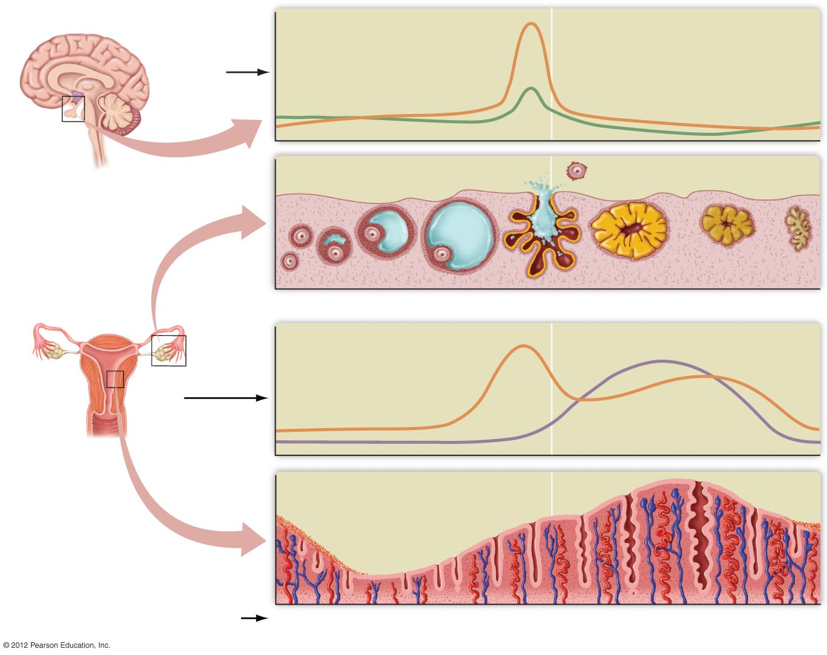
LH surge
(triggers ovulation)
FSH
LH
LH
FSH
Hypothalamus
Ovarian Cycle
Growth of follicle
Ovulation
Corpus luteum
Ovary
Progesterone
Endometrium
of uterus
Estrogen
Estrogen
Progesterone
Uterine Cycle
Days of one menstrual
cycle (28 days, average)
1
Menstrual
phase
5
Proliferative
phase
14
Secretory
phase
28

Slide 8
Cyclic Changes in Hormone Levels Produce Menstrual cycle
Cycles of hormones
  Positive feedback
    Causes an event to continue
    In proliferative phase, increasing estrogen causes surge in LH, which in turn causes ovulation
  Negative feedback
    Causes an event to be stopped / reversed
    In secretory phase, steady levels of estrogen and progesterone inhibit LH and FSH release

Slide 9
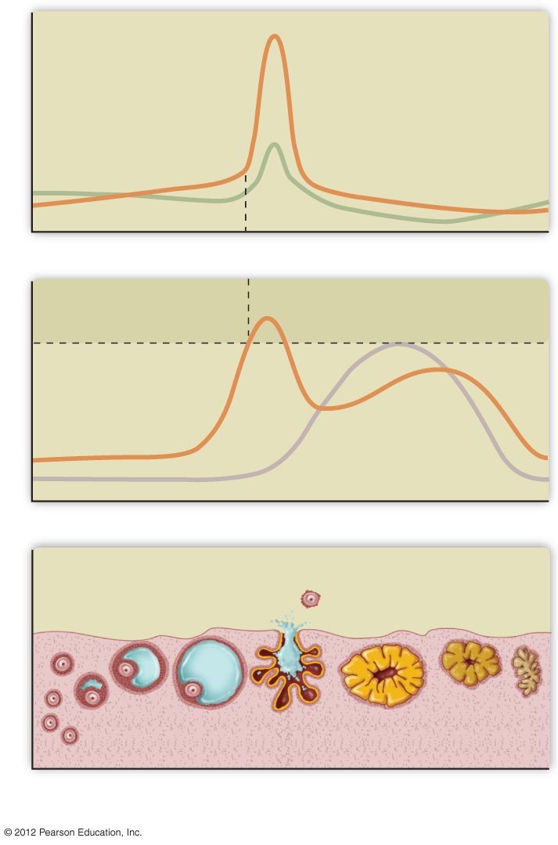
LH surge
triggers ovulation
Anterior Pituitary Hormones
Estrogen triggers
LH surge
FSH
Estrogen stimulates LH
Estrogen inhibits LH
Ovarian Hormones
Estrogen
Progesterone
Follicles
Ovulation
Corpus luteum
Ovary
1
14
28
Days of Cycle

