Slide 1

Female Reproductive System Produces Eggs and Supports Pregnancy
Ovaries
  Release oocytes (immature eggs) and secrete the hormones estrogen and progesterone
Uterine Tube (oviduct / fallopian tube)
  Leads from the ovary to the uterus
  Fertilization occurs in the upper third of the uterine tube

Slide 2
Female Reproductive System Produces Eggs and Supports Pregnancy
Uterus
  the hollow, pear-shaped organ where fertilized egg grows and develops
Layers
  Endometrium: supports fertilized egg, part of it sloughs off during menstrual flow
  Myometrium: smooth muscle, expands during pregnancy, constricts during labor
  Cervix: the narrow opening in the lower part of the uterus that permits sperm to enter the uterus and allows the fetus to exit during birth

Slide 3
Female Reproductive System Produces Eggs and Supports Pregnancy
Vagina
  Organ of sexual intercourse and birth canal
External genitalia
  Labia majora and minora
  Clitoris

Slide 4
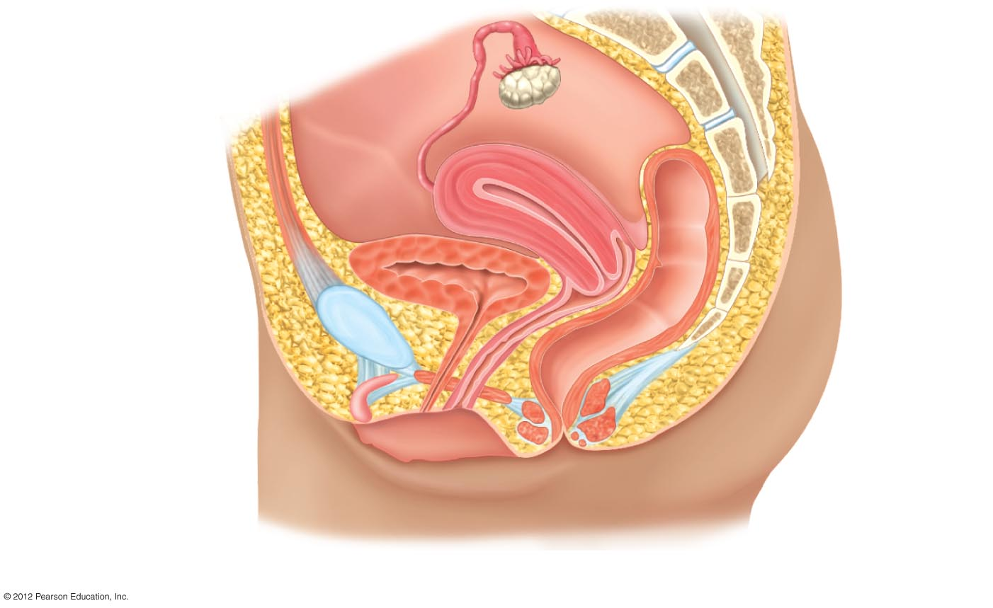
Uterine Tube
Fimbriae
Vertebral
column
Ovary
Uterus
Rectum
Urinary bladder
Cervix
Pubic bone
Urethra
Vagina
Clitoris
Labium minora
Anus
Labium majora
Sagittal section showing the components of the system in relation to other structures.

Slide 5
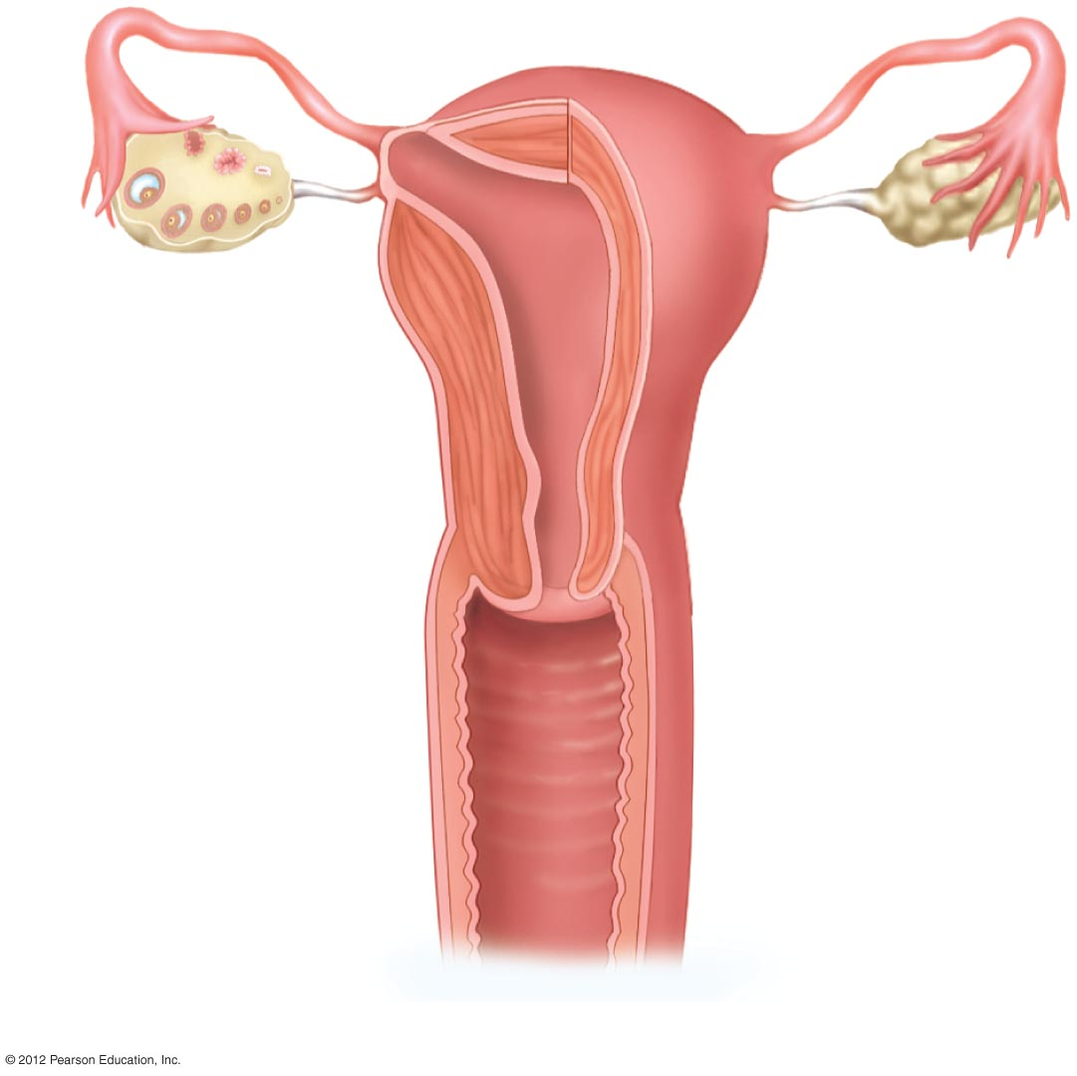
Uterine
Tube
Fimbriae
Ovary
Endometrium
Uterus
Myometrium
Cervical canal
Cervix
Vagina
Anterior view of internal organs.

Slide 6
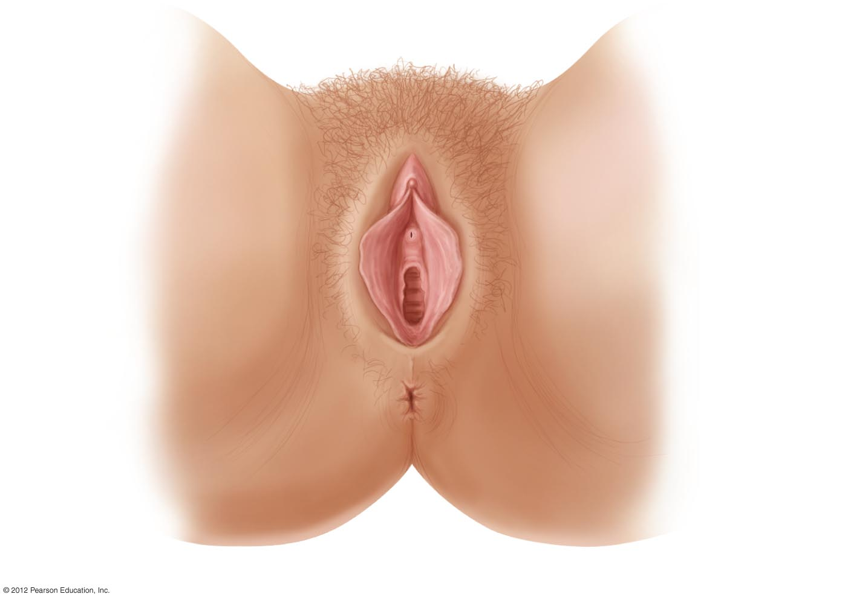
Mons
pubis
Clitoris
Labium majora
Urethral opening
Labium minora
Vaginal opening
Anus
Vulva: The female external genitalia.

Slide 7
Mammary Glands Nourish the Infant
Breasts contain mammary glands
Technically, mammary glands are modified sweat glands, part of the integumentary system
Specialized for lactation (production of milk)
Hormonal control of lactation:
  Prolactin (anterior pituitary hormone) – stimulates milk production
  Oxytocin (posterior pituitary hormone) – stimulates contractions that eject milk

Slide 8
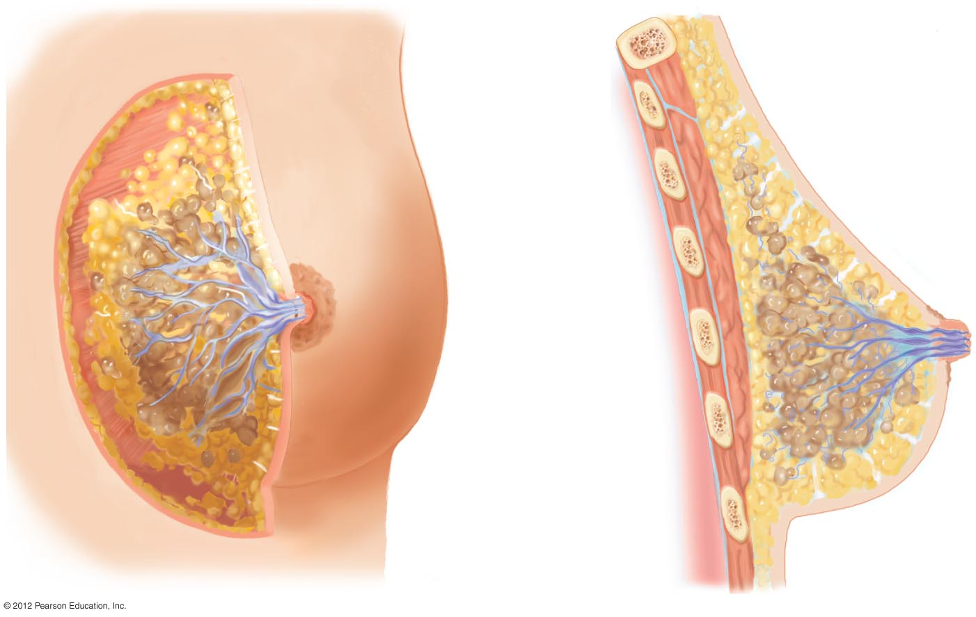
Skin (cut)
Muscle
Fatty tissue
Ducts
Areola
Nipple
Milk-producing
lobules
Connective tissue
Rib
Lung
Mammary gland
Front view.
b) Side view.

