Slide 1

Sperm Production Requires Several Cell Divisions
Several cell divisions (mitosis and meiosis) in seminiferous tubules
Purpose
  Produce a large number of sperm with half the number of chromosomes of somatic cells (haploid)
Sequence of cell types, leading to sperm
  Spermatogonia (2n), primary spermatocyte (2n), secondary spermatocyte (n), spermatids (n), sperm (n)
Sertoli cells provide support, nourishment

Slide 2
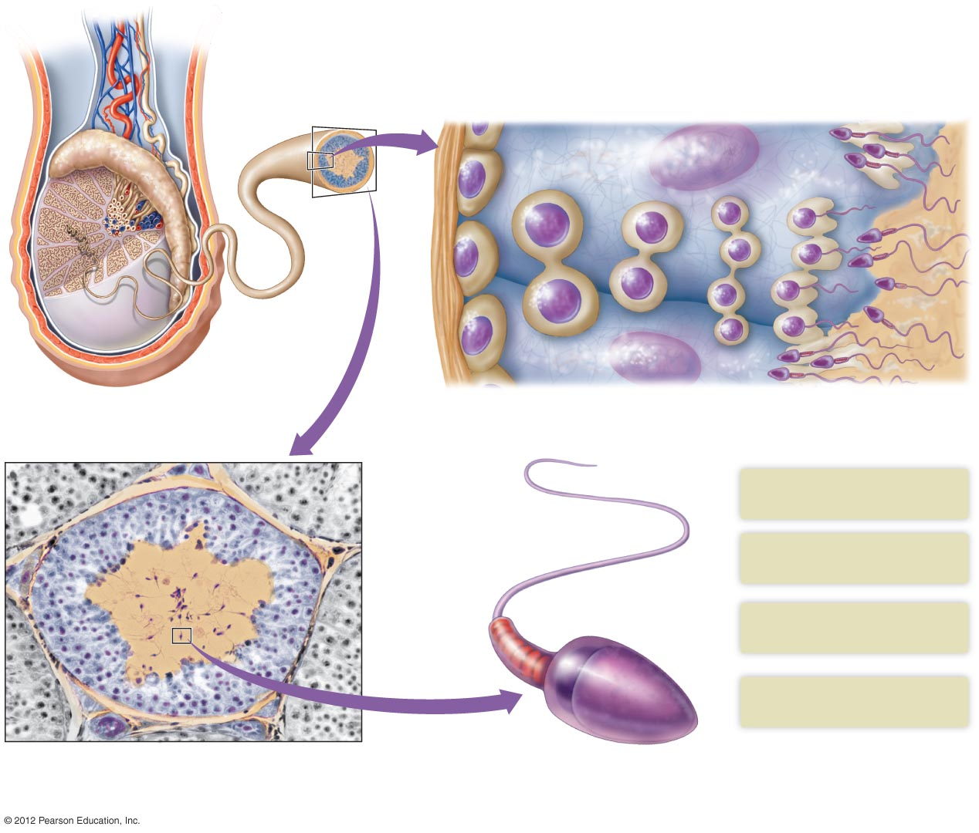
Ductus deferens
Primary
spermatocyte
Early spermatids
(haploid)
Immature sperm
(haploid)
Epididymis
Spermatogonium
(diploid)
Secondary
spermatocyte
Late
spermatids
Tubule
lumen
Sertoli
cell
Uncoiled
seminiferous
tubule
Mitosis
Meiosis I
Meiosis II
Partial cross section of a testis showing
the coiled seminiferous tubules.
Sperm originate from undifferentiated spermatogonia located near the
outer surface of a seminiferous tubule. The production of sperm is supported
by Sertoli cells.
Tail whiplike movements
propel the sperm
Interstitial cells
Midpiece contains mitochondria
that produce energy for the sperm
Tubule lumen
Head contains the male’s
chromosomes
Acrosome contains the enzymes
that assist fertilization
A cross section through a seminiferous tubule
(×100) showing the location of the testosterone-
producing interstitial cells between the tubules.
Mature sperm are visible within the lumen of tubule.
Illustration of a sperm, showing the head, midpiece, and tail.

Slide 3
Testosterone Affects Male Reproductive Capacity
Testosterone
  Steroid hormone produced by interstitial cells in testes (between seminiferous tubules)
  Function
    controls growth and function of male reproductive tissues
    stimulates aggression and sexual behavior
    secondary sexual characteristics
  Determines rate of sperm formation

Slide 4
Testosterone Affects Male Reproductive Capacity
Hormones that regulate testosterone and sperm production
  Gonadotropin-releasing hormone (GnRH) from hypothalamus
  LH (from anterior pituitary) stimulates production of testosterone
  FSH (from anterior pituitary) may enhance sperm formation with Sertoli cells
  Inhibin: produced by Sertoli cells, inhibits secretion of FSH

Slide 5
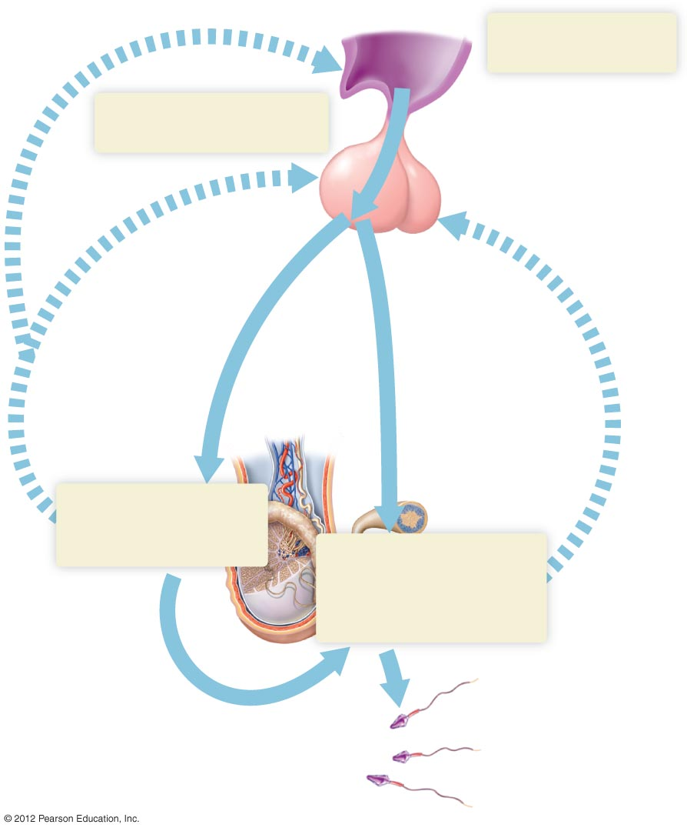
Hypothalamus −
secretes GnRH
Anterior pituitary −
secretes LH and FSH
GnRH
LH
FSH
Testosterone
Inhibin
Testes − Interstitial
cells produce
testosterone
Testes − Sertoli cells
produce inhibin and
stimulate sperm
production.
Testosterone
Sperm

