Slide 1
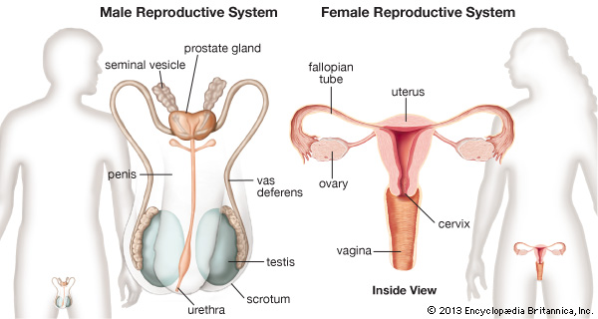

The Reproductive System

Slide 2
Male Reproductive System Delivers Sperm
Testes produce sperm
  Scrotum
    sac of skin and smooth muscle that holds the testes
    Maintains testes at a slightly lower temperature
  Seminiferous tubules within testes
    produce sperm
Epididymis and ductus deferens
  sperm become motile and are stored here
Ductus deferens
  transports sperm to where it becomes the ejaculatory duct

Slide 3
Male Reproductive System Delivers Sperm
Route of sperm through male reproductive structures
  Seminiferous tubules
  Epididymis
  Ductus deferens
  Ejaculatory duct
  Penis

Slide 4
Accessory Glands Help Sperm Survive
Seminal vesicles
  Secrete fructose (provides source of energy for sperm) and most of seminal fluid
Prostate gland
  Secretes watery alkaline fluid to raise vaginal pH
Bulbourethral gland
  Secretes lubricating mucus
  Cleanses urethra

Slide 5
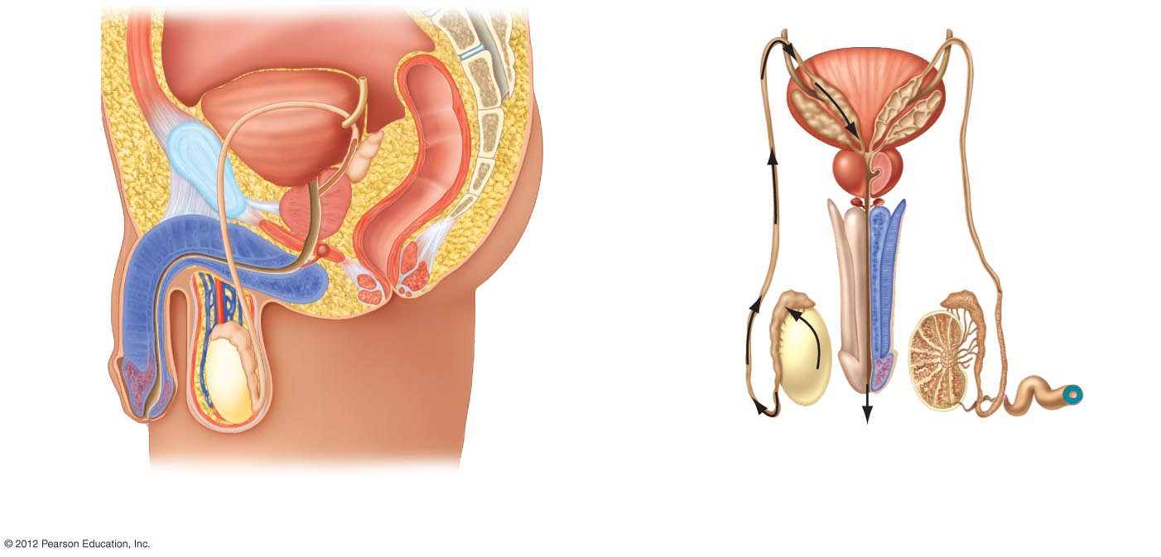
Vertebral
column
Urinary
bladder
Pubic
symphysis
Ureter
Ductus
deferens
Seminal
vesicle
Rectum
Ductus
deferens
Prostate gland
Seminal
vesicle
Bulbourethral
gland
Penis
Ejaculatory
duct
Urethra
Erectile
tissue
Prostate
gland
Anus
Urethra
Bulbourethral
gland
Epididymis
Testis
Scrotum
Testis
Penis
Uncoiled semi-
niferous tubule
A sagittal cutaway view.
A posterior view of the reproductive organs and bladder.

