Slide 1

Disorders of the Urinary System
Kidney stones
  Crystallized minerals
  Block urine flow
Urinary tract infections (UTI)
  Usually caused by bacteria
  More common in women than men because of shorter urethra
  If untreated, bladder infections may ascend to involve kidneys

Slide 2
Disorders of the Urinary System
Acute renal failure
  Short-term impairment, may be reversible
  Potential causes: sustained very low blood pressure, large kidney stones within renal pelvis, infections, transfusion reactions, severe injury, toxin exposure, drug reactions
Chronic renal failure
  Also known as end stage renal disease (ESRD)
  >60% reduction in functioning nephrons
  See causes of acute renal failure above
  40% of people with Type I diabetes will develop renal failure

Slide 3
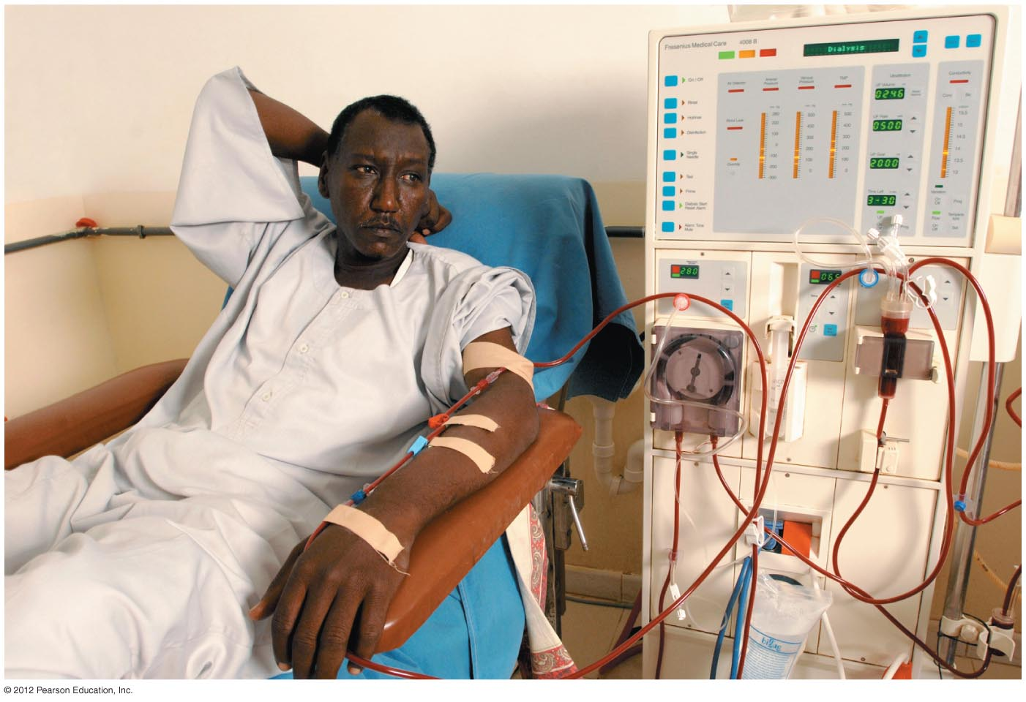
Treatment of Irreversible Kidney Failure
Dialysis
Kidney transplant

Slide 4
Dialysis Cleanses Blood Artificially
CAPD: continuous ambulatory peritoneal dialysis
  Can be done at home
  Uses peritoneal cavity for waste, ion removal
  Risk of infection
Hemodialysis
  Requires several visits/week to a dialysis center
  Blood is circulated through a kidney machine

Slide 5
Dialysis Cleanses Blood Artificially
Problems with dialysis
  Dialysis cannot achieve complete homeostasis of ions and wastes
  Dialysis does not replace renal hormones

Slide 6
Kidney Transplants Are a Permanent Solution to Renal Failure
Best hope for many chronic renal failure patients
>65,000 people on waiting list for kidneys
Improvements in transplant protocols/processes have improved outcomes
  Better tissue-matching techniques
  Improved anti-rejection medications
  National data banks

