Slide 1

Kidneys Maintain Homeostasis in Many Ways
Maintain water balance
  Adjust blood volume and blood pressure
Aldosterone and renin help maintain salt balance in order to control blood volume
Maintain acid-base balance and blood pH
Regulate red blood cell production via erythropoietin (hormone)
Activate an inactive form of vitamin D

Slide 2
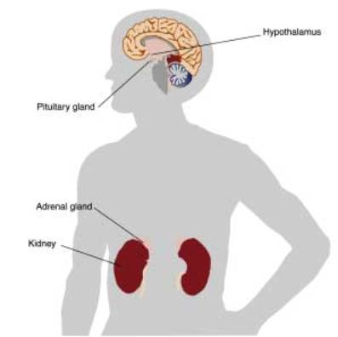
Water Balance Determines Blood Volume and Blood Pressure
Involves the kidneys, hypothalamus, and posterior pituitary gland
Negative feedback loop regulates solute concentration of the blood
  Involves increasing or reducing ADH secretion, which will modify water reabsorption of kidneys
  Involves increasing or decreasing thirst

Slide 3
Water Balance Determines Blood Volume and Blood Pressure
Diruretic: increases the formation and excretion of urine
  Lasix (furosemide)
    medication that reduces blood volume and blood pressure
  Caffeine
    inhibits sodium reabsorption
  Alcohol
    inhibits ADH release

Slide 4
Aldosterone & Renin Control Blood Volume
Aldosterone release is stimulated indirectly by decreased blood volume or blood pressure
  Decreased blood volume/blood pressure cause release of renin
  Renin is eventually converted to angiotensin II
  Angiotensin II stimulates adrenal cortex to release aldosterone
  Aldosterone increases sodium reabsorption by distal tubules and collection ducts

Slide 5
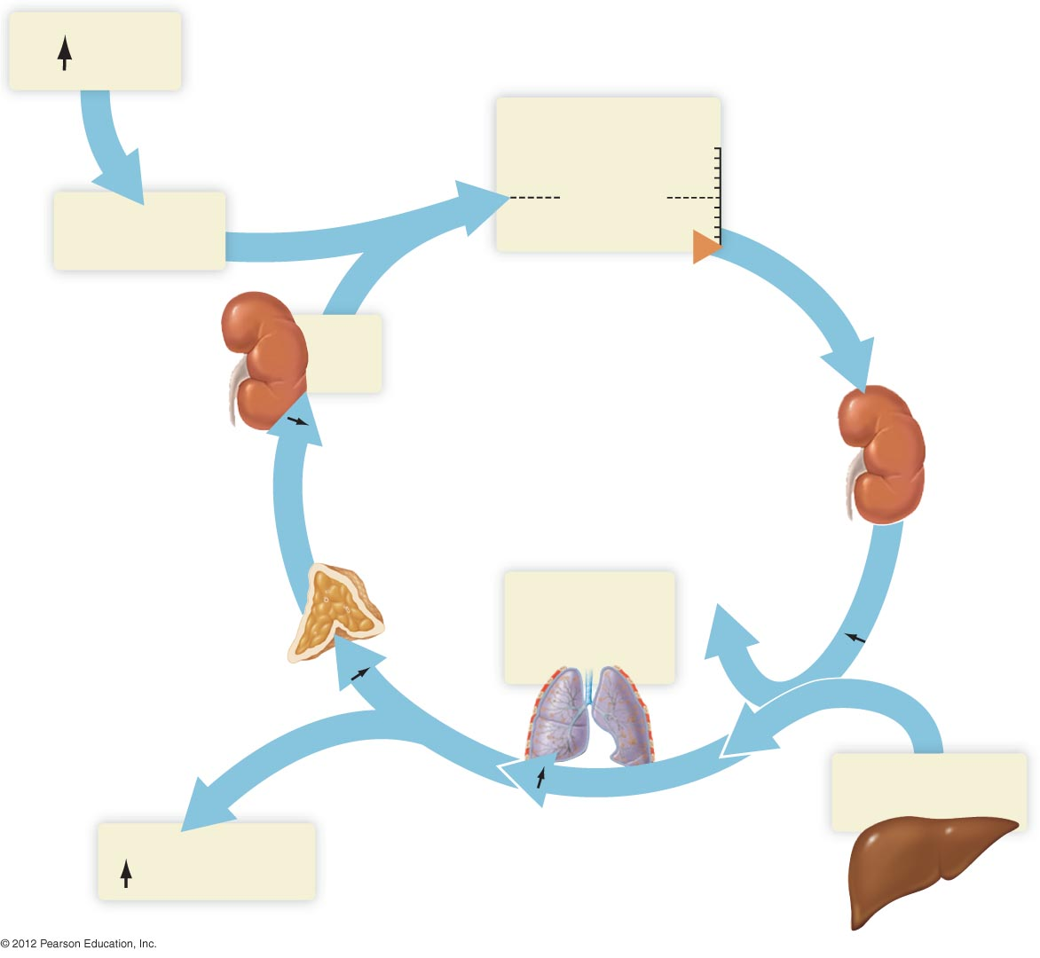
ADH
Blood volume
Increase
Set point
Save water
Decrease
Kidneys
Save
salt
Kidneys
Aldosterone
Adrenal
cortex
Angiotensin-
converting
enzyme
Renin
Angiotensin II
Lungs
Angiotensin I
Angiotensinogen
Vasoconstriction,
blood pressure
Liver

Slide 6
Kidneys Help Maintain Acid-Base Balance and Blood pH
Blood pH must stay between 7.35 and 7.45
pH regulated by kidneys, buffers, lungs
Role of kidneys in pH maintenance
  Reabsorption of filtered bicarbonate
  Excretion of acid

Slide 7
Erythropoietin Stimulates Production of Red Blood Cells
Decrease in amount of oxygen is detected by certain cells throughout the kidney
Erythropoietin is secreted in response to decrease in oxygen
Erythropoietin triggers increase in red blood cell production in the bone marrow

Slide 8
Kidneys Activate Vitamin D
Exposure of skin to sunlight causes production of an inactive form of vitamin D
  But only about 30 minutes of exposure
Inactive form of vitamin D is transported to liver, where it is modified
Inactive form of vitamin D is then converted to active form by kidneys

