Slide 1

Producing Dilute Urine: Excreting Excess Water
Kidneys respond to excess water by excreting it
Mechanism
  Distal tubule is impermeable to water
  NaCl is reabsorbed without the concurrent reabsorption of water

Slide 2
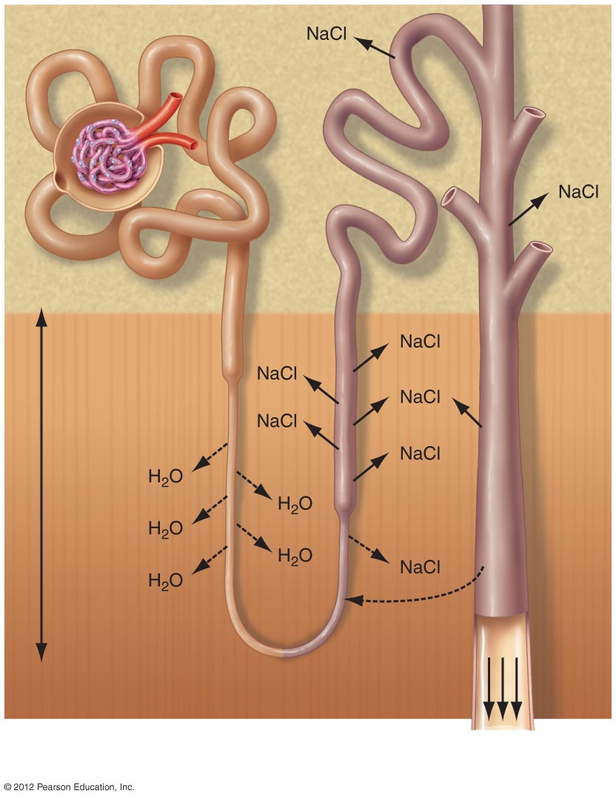
Isotonic
Cortex
Medulla
Urea
Very
concentrated
Large volume
of dilute urine

Slide 3
Producing Concentrated Urine: Conserving Water
Too little water can lead to lower blood volume, declining blood pressure, risk of dehydration of body cells
Kidneys respond by conserving water and producing a more concentrated urine
Mechanism
  Mediated by ADH (antidiuretic hormone) from the posterior pituitary gland
  ADH increases permeability of the collecting ducts to water and increases conservation of water

Slide 4
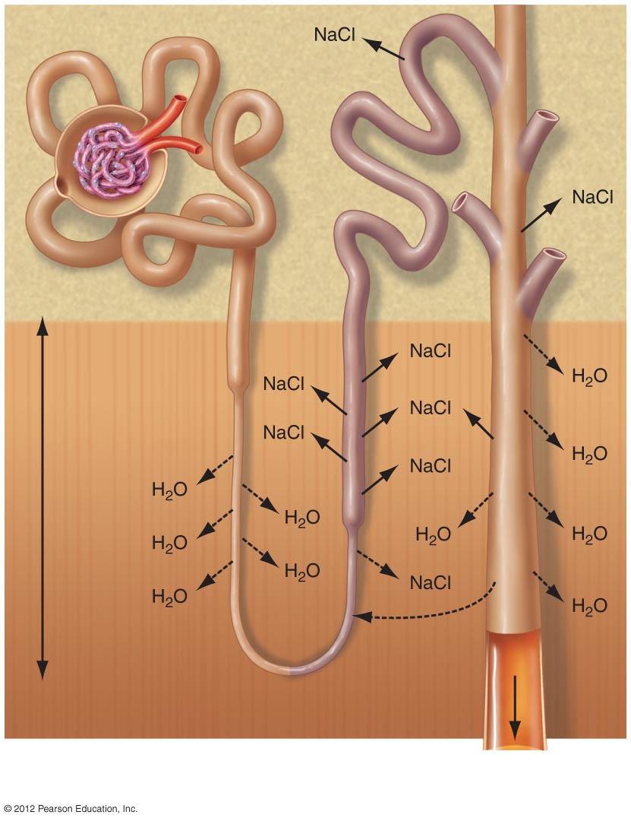
Isotonic
Cortex
Medulla
Urea
Very
concentrated
Low volume of
concentrated urine

Slide 5
Urination Depends on a Reflex
Micturition reflex
  Responds to stretch receptors in bladder wall
  Internal urethral sphincter
    Smooth muscle
  External urethral sphincter
    Skeletal muscle, under voluntary control
Brain can override the micturition reflex and control the timing of urination
Voluntary control becomes increasingly difficult as the bladder gets very full

