Slide 1

Formation of Urine: Three Basic Processes
Glomerular filtration
  movement of protein-free solution of fluid and solutes from blood into the glomerular capsule
Tubular reabsorption
  return of most of the fluid and solutes into the blood
Tubular secretion
  addition of certain solutes from the blood into the tubule

Slide 2
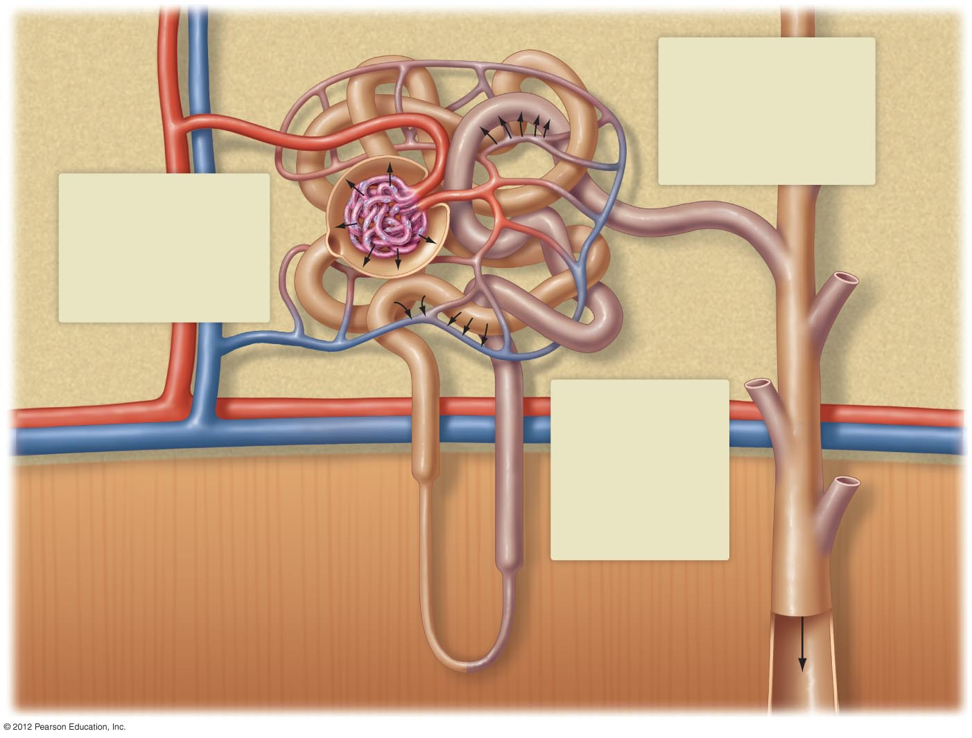
Glomerular
capsule
Afferent
arteriole
Efferent
arteriole
3
Glomerulus
Tubular secretion:
Some drugs, waste products,
and ions (primarily hydrogen,
ammonium, and potassium)
are actively secreted from the
peritubular capillaries primarily
into the distal tubule but also
in other nephron segments.
1
Glomerular filtration:
Water, ions, glucose,
amino acids, bicarbonate,
and waste products
(urea, creatinine) are
filtered from the glomerular
capillaries into the space
within the glomerular capsule.
Proximal tubule
Distal tubule
2
Collecting duct
Tubular reabsorption:
Water, amino acids,
glucose, most ions
(including bicarbonate),
and some urea are
reabsorbed back into the
peritubular capillaries,
primarily in the proximal
tubule but also in other
nephron segments.
Artery
Vein
Urine

Slide 3
Glomerular Filtration Filters Fluid from Capillaries
Filters protein-free plasma fluid from capillaries into glomerular capsule
Large volume filtration, yet highly selective
  Impermeable to large proteins and cells
Filtration is driven by high blood pressure in glomerular capillaries
Rate of filtration
  Resting rate under local chemical control

Slide 4
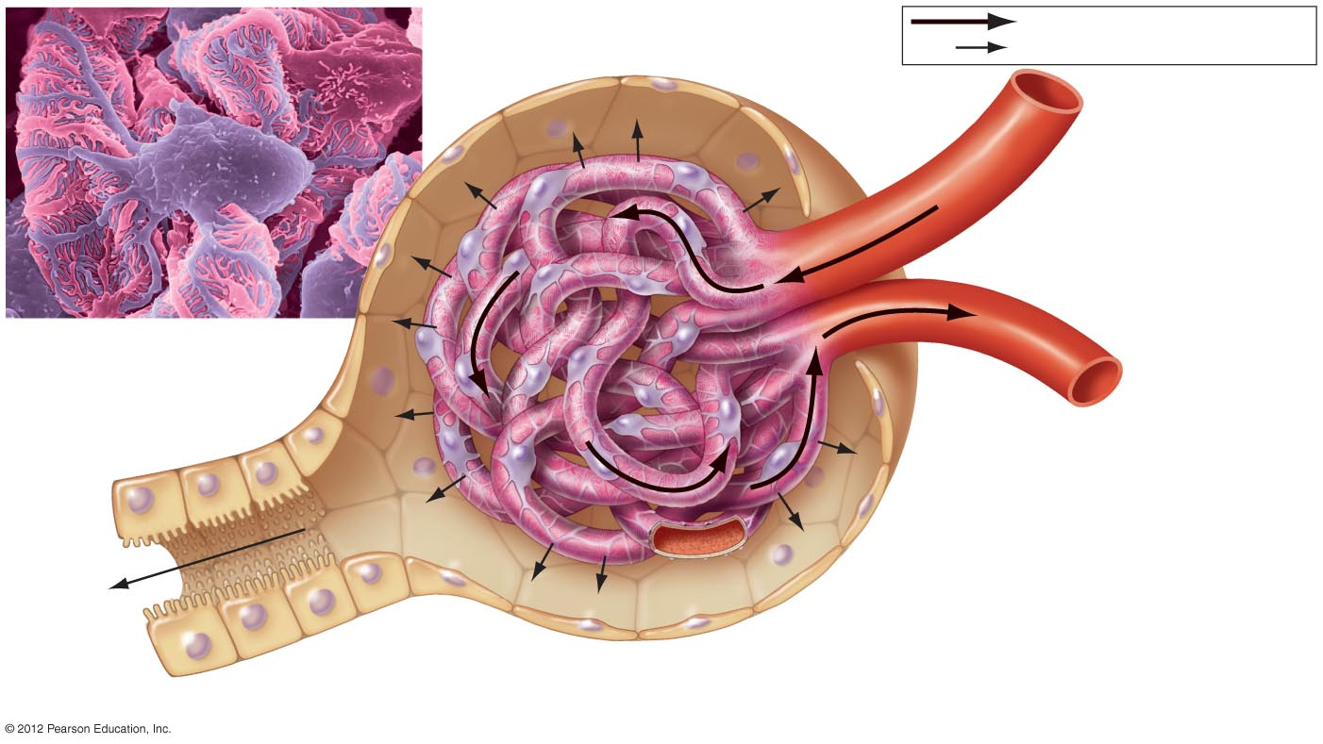
Glomerular
capsule
Glomerular
space
Glomerulus
Blood flow
Movement of glomerular filtrate
Afferent arteriole
Efferent arteriole
The outer surface of
several glomerular
capillaries.
Podocyte
Filtrate
Proximal tubule
Capillary wall

Slide 5
Tubular Reabsorption Returns Filtered Water and Solutes to Blood
100% of filtered glucose, amino acids, and bicarbonate and 50% of urea are reabsorbed
Most tubular reabsorption occurs in proximal tubule
Reabsorption of sodium begins the process
  Sodium moved by active transport from tubule cells to interstitial fluid and diffuses to capillaries
  Movement of sodium provides energy to transport glucose and amino acids into renal tubule
  Water reabsorbed with salts

Slide 6
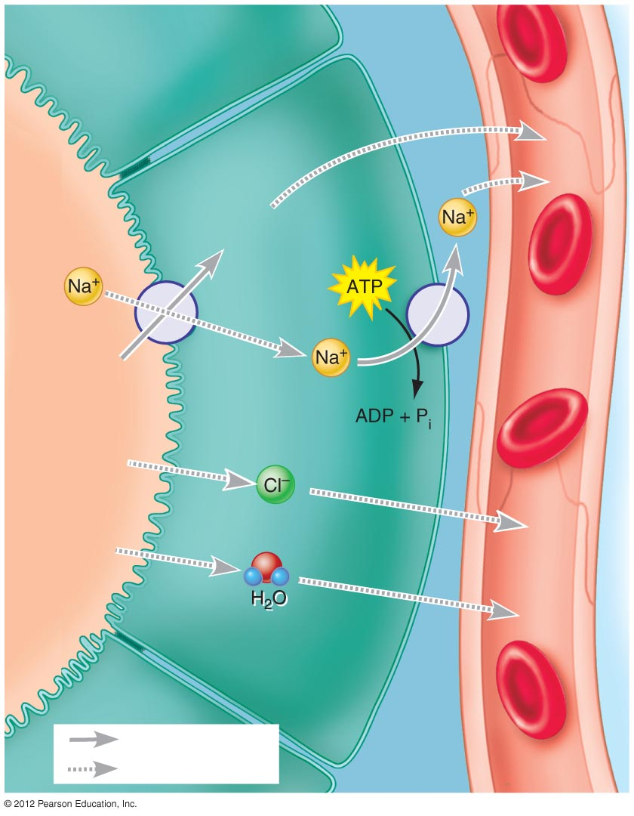
Proximal tubule cell
Interstitial
fluid
Capillary
Glucose,
amino acids
Glucose,
amino acids
Tubule
lumen
Active transport
Diffusion

Slide 7
Tubular Secretion Removes Other Substances from Blood
Involves the movement of materials from the peritubular capillaries or vasa recta to the tubule
Purpose
  Regulation of chemical levels in body
  Excretion of harmful chemicals
Substances secreted
  Penicillin, cocaine, marijuana, pesticides, preservatives, hydrogen ions, ammonium, potassium

