Slide 1

Nephrons Produce Urine
Nephron: functional unit of the kidney
~1 million nephrons per kidney
Each nephron consists of a long thin hollow tube (tubule) plus associated blood supply
Role of nephrons
  remove approximately 180 liters of fluid from the blood daily
  return most of the fluid, minus the wastes that are excreted

Slide 2
Tubule Filters Fluid and Reabsorbs Substances
Nephron structure
Glomerular capsule
  cuplike end of nephron tubule surrounding glomerulus (network of capillaries)
  This is where filtration occurs
Proximal tubule
  extends from glomerular capsule to renal medulla
Loop of Henle
Distal tubule
Collecting duct
  shared by several nephrons, empties into renal pelvis

Slide 3
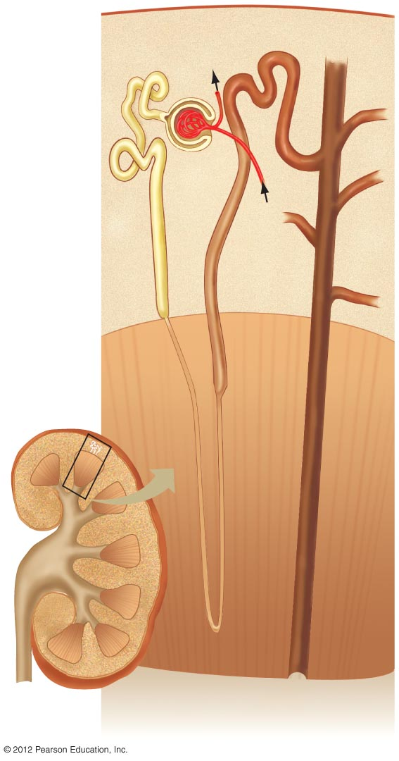
Distal tubule
Efferent arteriole
Glomerular
capsule
Glomerulus
Proximal tubule
Afferent
arteriole
Cortex
Medulla
Descending
limb
Loop of
Henle
Ascending
limb
Collecting
duct
Renal pelvis

Slide 4
Special Blood Vessels Supply the Tubule
Renal artery supplies the kidney
  Arterioles
    Afferent: enters the glomerular capsule
    Efferent: leaves the glomerular capsule
  Capillaries
    Glomerular: network within the glomerular capsule
    Peritubular: surround proximal and distal tubule
    Vasa recta: parallels the loop of Henle

Slide 5
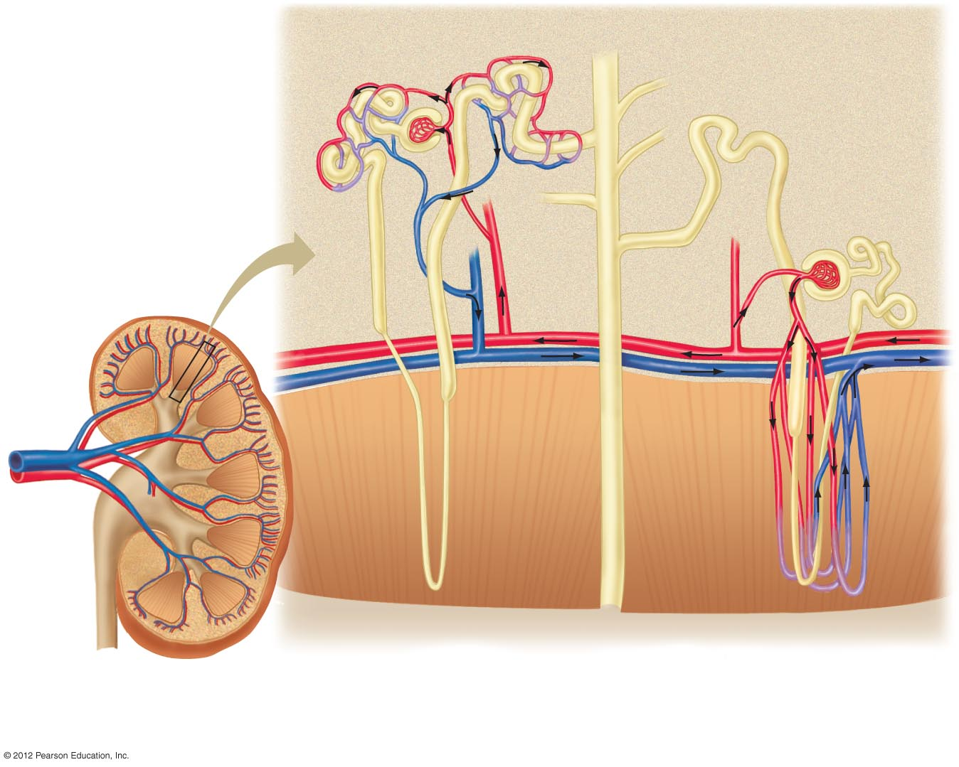
Collecting
duct
Efferent arteriole
Glomerulus
Afferent arteriole
Afferent
arteriole
Peritubular
capillaries
Cortex
Efferent
arteriole
Renal
vein
Medulla
Renal
artery
Vasa recta
Pelvis
Main blood vessels in the kidney.
The renal artery and renal vein
branch many times to deliver
blood to each glomerulus.
Post-glomerular blood vessels. The efferent arteriole of most nephrons, such as the one shown here
on the left, divides to become the peritubular capillaries, which supply proximal and distal tubules in
the cortex. In a few nephrons, such as the one on the right, the efferent arteriole descends into the
medulla to become the vasa recta, which supply loops of Henle.

