Slide 1
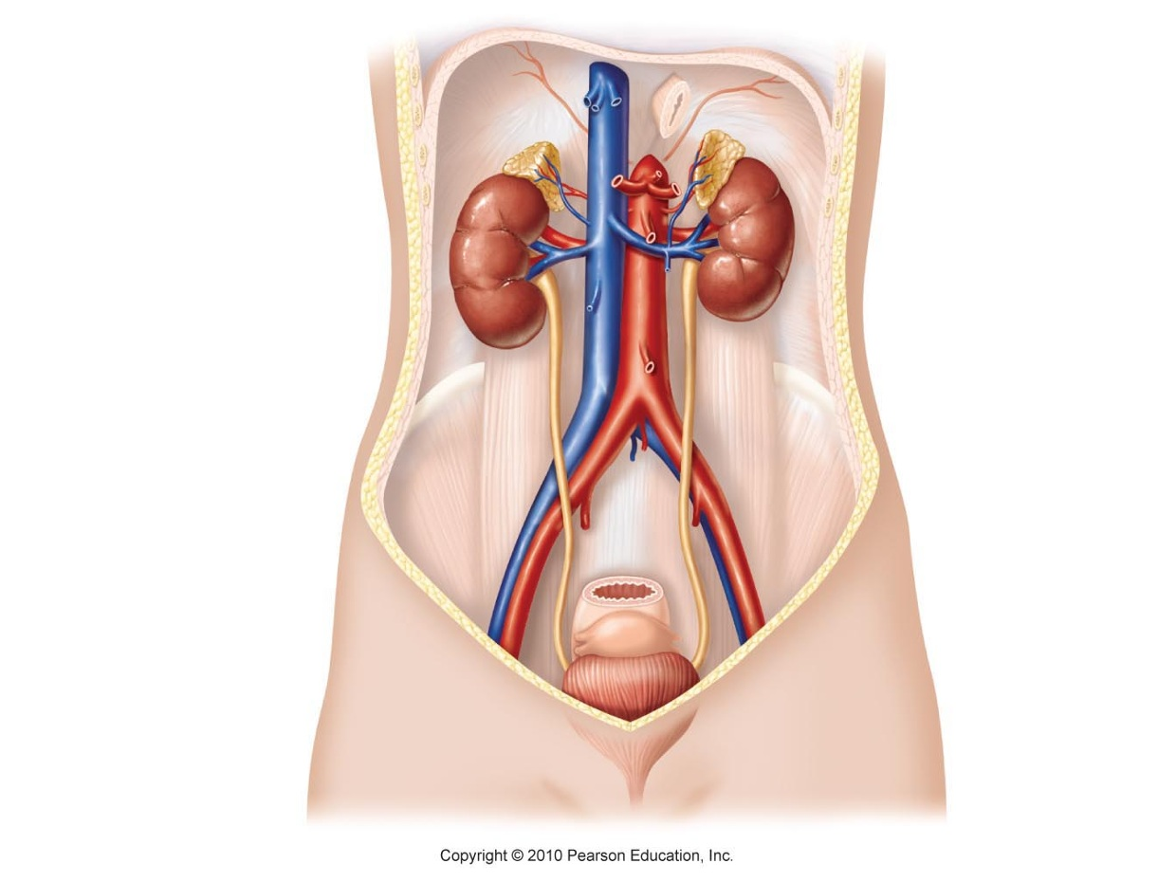

The Urinary System

Slide 2
Urinary System Contributes to Homeostasis
Excretion: processes that remove wastes and excess materials from the body
  Digestive system: excretes food residues and wastes produced by the liver
  Respiratory system (lungs): excrete carbon dioxide
  Integumentary system (skin): excretes water, salt
  Urinary system (kidneys): excrete nitrogenous wastes, excess solutes, and water

Slide 3
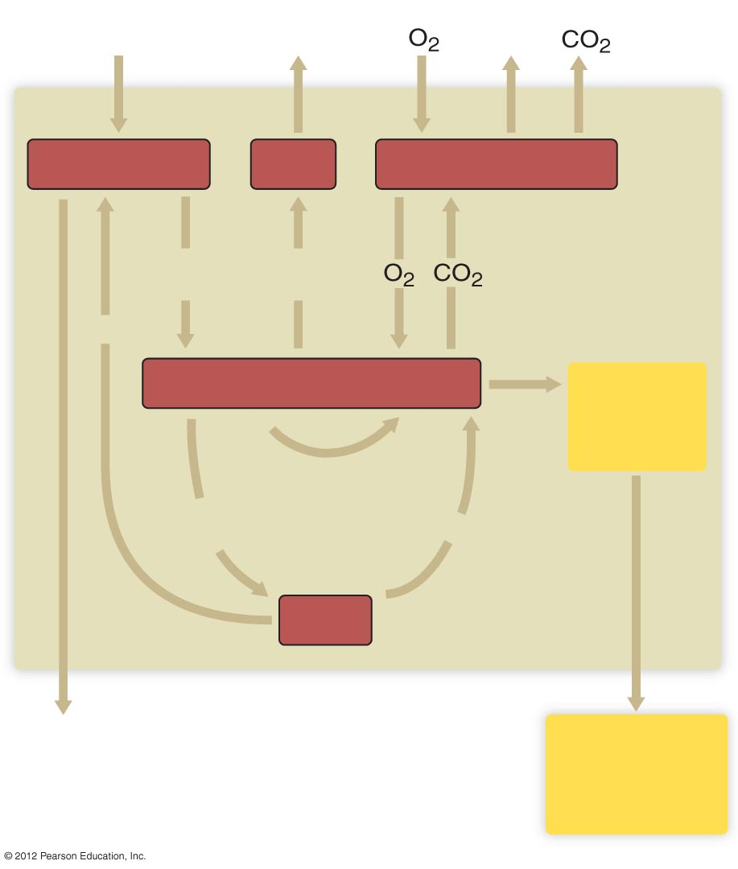
Food,
water
Water,
salt
Water
Digestive tract
Skin
Respiratory system
Nutrients,
water
Water,
salt
Waste
Water, solutes,
wastes
Circulatory system
Transport to all cells
Urinary
system
Metabolic
products, toxins
Waste
Liver
Elimination
of food
residues
Elimination of
waste, excess
solutes, and
water

Slide 4
Urinary System Contributes to Homeostasis
Kidneys regulate body water levels
  Excess water is excreted
  Output varies from 2-1/2 liter/day to 1 liter/hour
Kidneys regulate nitrogenous wastes and other solutes
  Nitrogen from amino acids is made into urea in liver and transported to kidney as waste
  Other solutes regulated by kidneys
    Sodium, chloride, potassium, calcium, hydrogen ions, creatinine

Slide 5
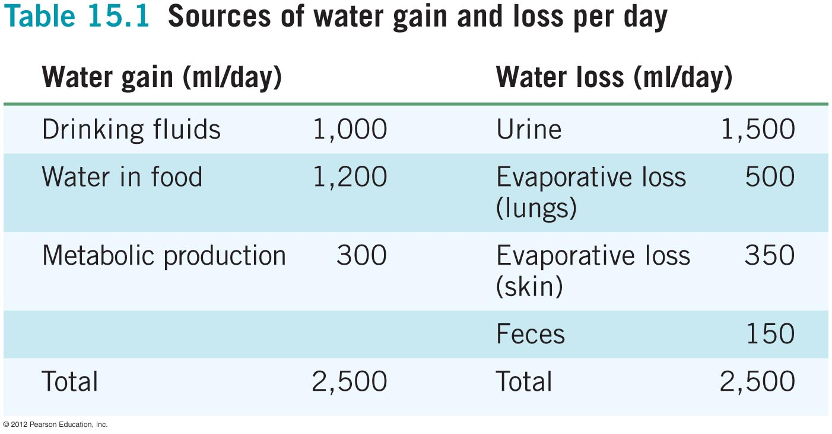

Slide 6
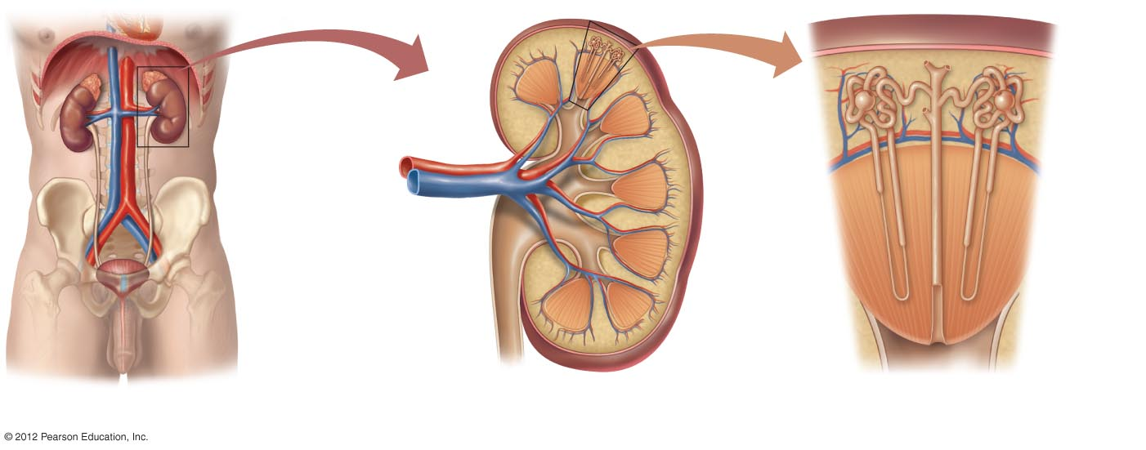
Organs of the Urinary System
Kidneys
  Principal organ of urinary system
    Cortex
      outer portion of the kidney
    Medulla
      inner region of the kidney
Renal artery
Renal vein
Cortex
Renal
pelvis
Medulla
Ureter
b) Internal structure of the kidney.

Slide 7
Kidney
Cortex
Renal artery
Renal vein
Nephrons
Aorta
Inferior
vena cava
Cortex
Medulla
Renal
pelvis
Medulla
Collecting
duct
Ureter
Bladder
Ureter
Urethra
a) The components of the urinary system.
b) Internal structure of the kidney.
c) The cortex and medulla of the kidney
are composed of numerous nephrons.

Slide 8
Organs of the Urinary System
Ureters
  Transport urine from kidneys to bladder
Urinary bladder
  Stores urine (600–1,000 ml)
Urethra
  Carries urine from body
  Two sphincters control urination

Slide 9
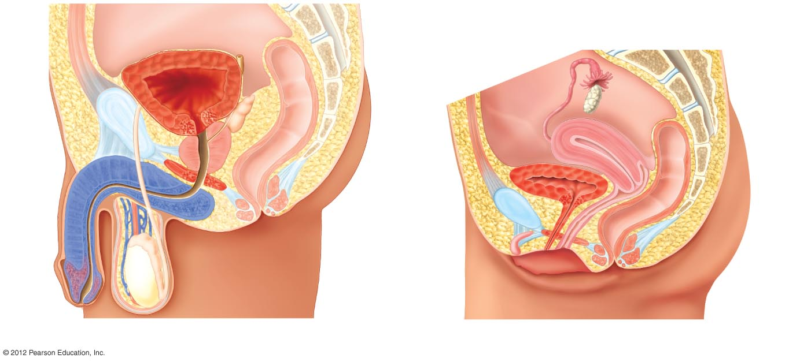
Urinary
bladder
Rectum
Internal
urethral
sphincter
Uterus
Prostate
gland
Vagina
Penis
External
urethral
sphincter
Rectum
Urethra
Testis
a) The male.
b) The female.

