Slide 1

Disorders of the GI Tract
Lactose intolerance
  difficulty digesting milk
Peptic ulcers
  caused by infection with H. pylori bacteria
Celiac disease
  gluten (wheat protein) intolerance
Diverticulosis
  weakness in wall of small intestine
Colon polyps
  noncancerous growths on mucosa

Slide 2
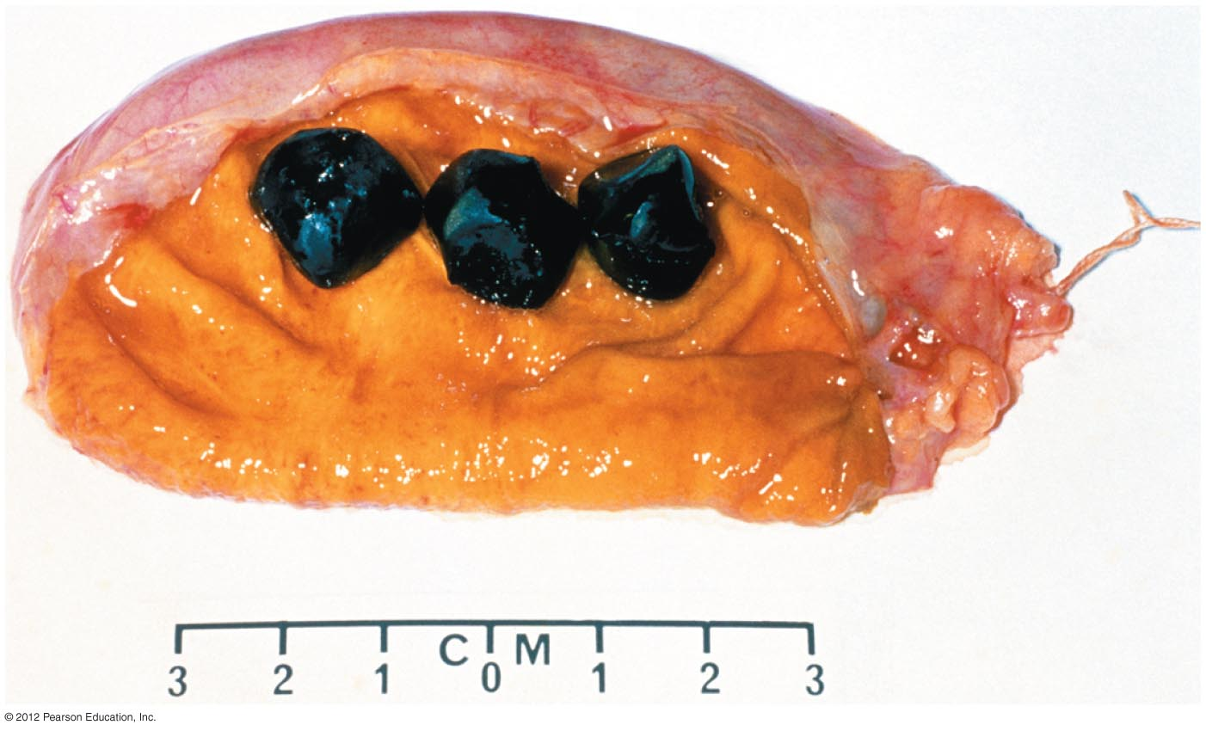
Disorders of Accessory Organs
Hepatitis
  Inflammation of the liver
  Three common types caused by viruses
    Hepatitis A: transmitted by food, water
    Hepatitis B: transmitted by body fluids, blood
    Hepatitis C: transmitted by infected blood
Gallstones
  crystals may form in gallbladder and obstruct flow of bile

Slide 3

Disorders of the Digestive System
Malnutrition
  too many or too few nutrients
  13% of the world’s population is undernourished
Obesity

Slide 4

Disorders of the Digestive System
Eating disorders
  Anorexia nervosa
    excessive dieting
  Bulimia
    binge eating followed by purging behaviors

