Slide 1

Vitamins Are Essential for Normal Function
At least 13 different vitamins
Two groups
  Fat soluble
    Vitamins A, D, E & K
    Absorbed with fats and stored in adipose tissue
  Water soluble
    Vitamins B complex & C
    Stored only briefly
    Must be consumed on a regular basis

Slide 2
Minerals: Essential Elements for Body Processes
21 essential minerals
Roles
  Ions in blood plasma and cell cytoplasm
    sodium, potassium, chloride, etc.
  Chemical structure of bone
    calcium, phosphorus
  Nerve and muscle activity
    sodium, potassium, calcium

Slide 3
Fiber Benefits the Colon
Vegetables, fruits, grains
Indigestible material
  contributes bulk to feces
Problems with a low-fiber diet
  Contributes to chronic constipation & hemorrhoids
  May be associated with higher risk of colon cancer

Slide 4
Weight Control: Energy Consumed Versus Energy Spent
Basic metabolic rate (BMR)
  Number of calories needed
    Excess intake leads to increased storage (weight)
  Influencing factors
    Gender and body composition
    Age
    Health
    Stress
    Food intake
    Genetics

Slide 5
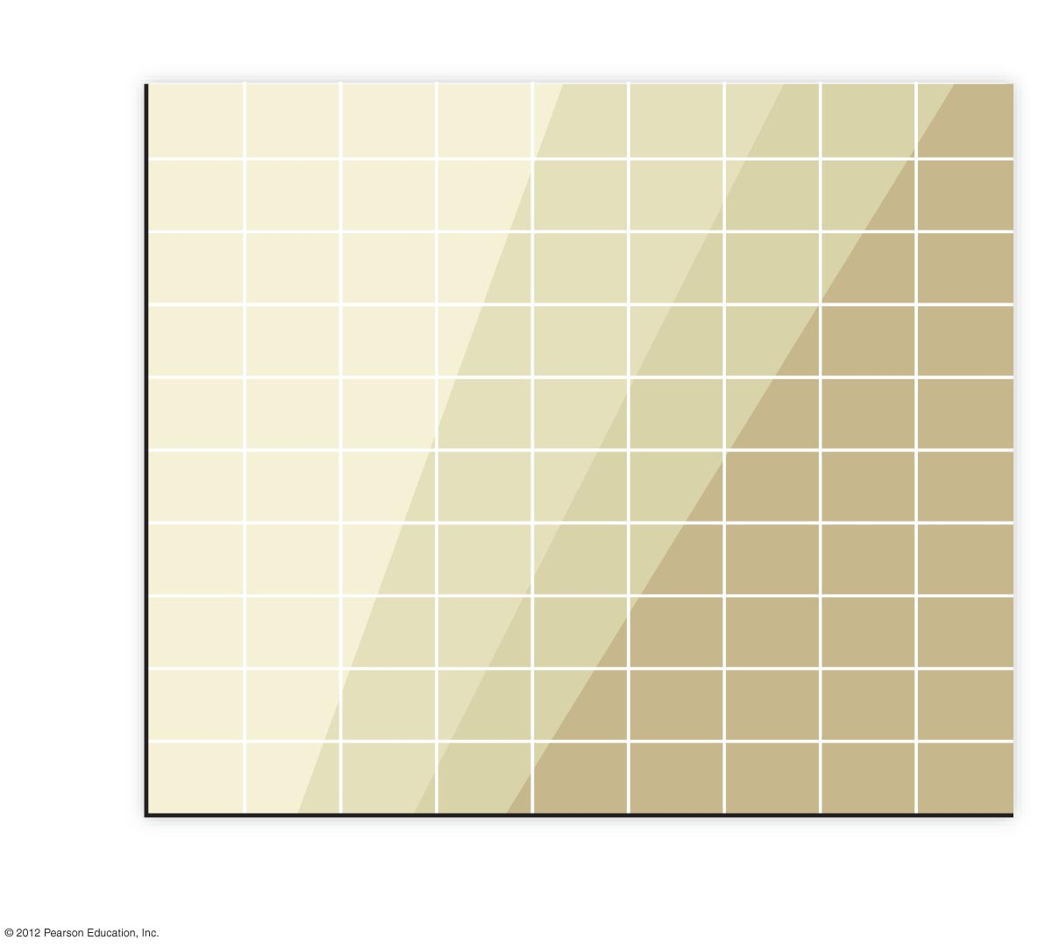
Body mass index (BMI)
18.5
25
30
6‘6"
6‘4"
Underweight
Healthy weight
Overweight
Obese
6‘2"
6‘0"
5‘10"
Height
5‘8"
5‘6"
5‘4"
5‘2"
5'0"
4'10"
50
75
100
125
150
175
200
225
250
275
Weight in pounds

