Slide 1

Nutrition: You Are What You Eat
Recommendations for a healthy diet include
Eat a variety of foods
Maintain a healthy weight
Eat plenty of fruits, vegetables and whole grains
Choose a diet low in cholesterol and saturated fat
Use sugar only in moderation
Consume salt and sodium in moderation
If consuming alcohol, drink in moderation

Slide 2
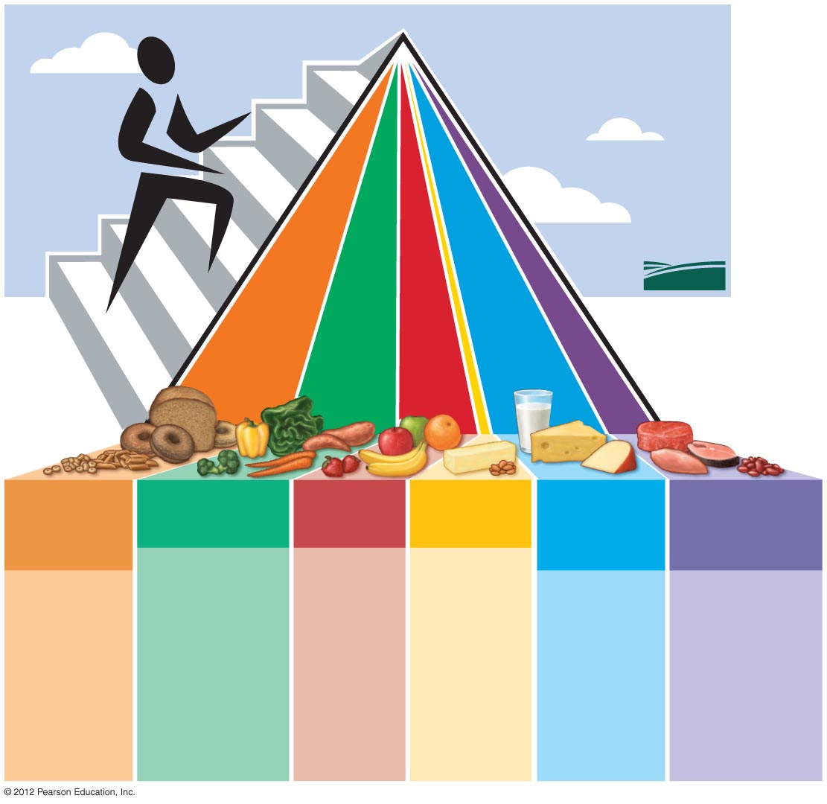
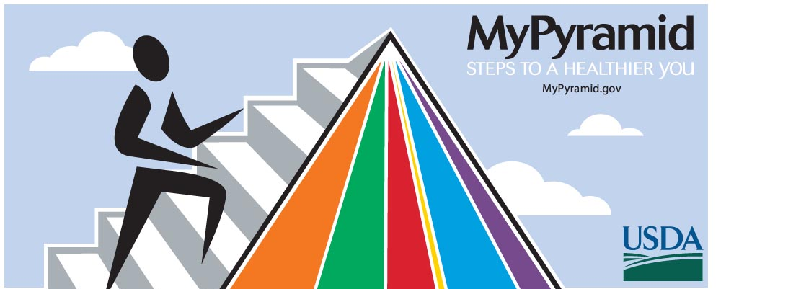
FRUITS
Focus on fruits
GRAINS
Make half your
grains whole
VEGETABLES
Vary your veggies
FRUITS
Focus on fruits
OILS
Know your fats
MILK
Get your calcium-
rich foods
MEAT &
BEANS
Go lean on protein
Eat more dark- green veggies.
Eat more orange veggies.
Eat more dry beans and peas.
Eat a variety of fruits.
Choose fresh, frozen, canned, or dried fruit.
Go easy on fruit juices.
Make the most of your fat sources from fish, nuts, and vegetable oils.
Limit your solid fats like butter, stick margarine, shortening, and lard.
Eat at least 3 oz.
of whole-grain breads, cereal, crackers, rice, or pasta every day.
Look for “whole” before the grain name on the list of ingredients.
Go low-fat or fat-free.
If you don't or can't consume milk, choose lactose-free products or other
calcium-rich sources.
Choose low-fat or lean meats and poultry.
Bake it, broil it, or grill it.
Vary your choices— with more fish, beans, peas, nuts, and seeds.

Slide 3
Carbohydrates: A Major Energy Source
Body’s primary source of energy
45–65% of caloric intake should be carbohydrates
Simple carbohydrates
  sugars
Complex carbohydrates
  starch, glycogen, fiber

Slide 4
Lipids: Essential Cell Components and Energy Sources
Saturated fats
  Meat, dairy products, palm kernel oil
  Tend to raise LDL (“bad”) cholesterol
Unsaturated fats
  Plant sources, olive, safflower, corn, canola oils
  Certain cold water fish (omega-3 fatty acids)
  Tend to lower LDL (“bad”) cholesterol
Trans fats
  Produced by hydrogenation of vegetable oils
  Raise LDL cholesterol

Slide 5
Proteins: Bodies Building Blocks
20 different amino acids
  12 can be made by the human body
  8 essential amino acids must be ingested in foods
Complete proteins
  Contain all 20 amino acids
  Most animal proteins
  Soy protein
Incomplete proteins
  Lack one or more essential amino acids
  Many plant proteins

