Slide 1

Accessory Organs Aid Digestion and Absorption
Pancreas
  Secretes digestive enzymes and sodium bicarbonate
  Digestive enzymes include
    Trypsin & Chymotrypsin
      Helps break down protein
    Pancreatic amylase
      Helps break down carbohydrates
    Lipase
      Helps break down lipids

Slide 2
Accessory Organs: Aid Digestion and Absorption
Liver
  Produces bile, which emulsifies lipids
    Emulsify = separating lipid molecules to increase surface area
  Hepatic portal system
    Drains blood from the digestive tract to the liver
Gallbladder
  Concentrates and stores bile

Slide 3
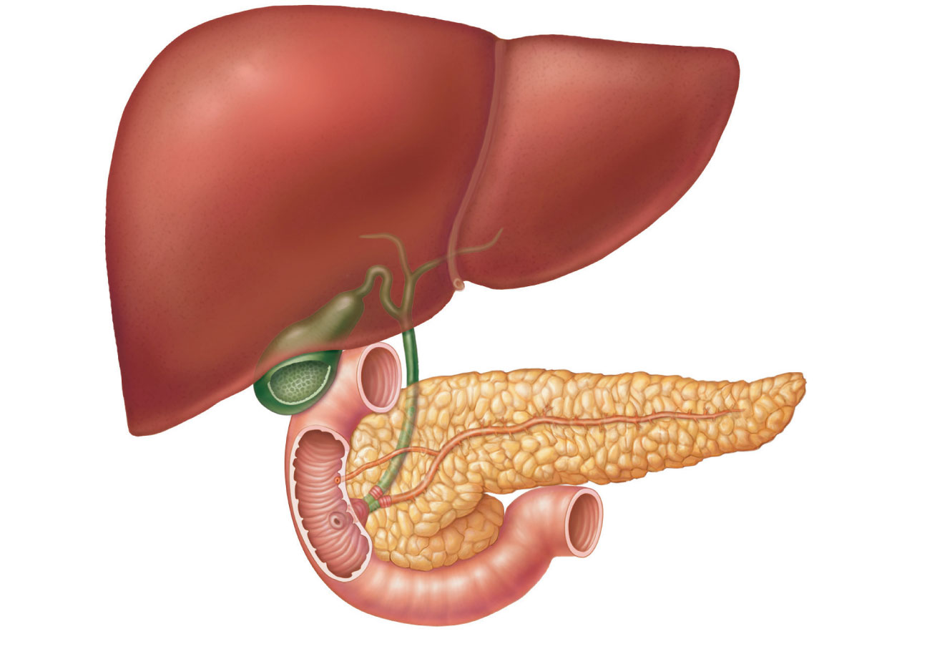
Liver
Cystic duct
Gallbladder
Pancreas
Jejunum
Duodenum

Slide 4
Large Intestine Absorbs Nutrients and Eliminates Wastes
Functions
  Absorbs nutrients and water
  Temporarily stores and eliminates waste

Slide 5
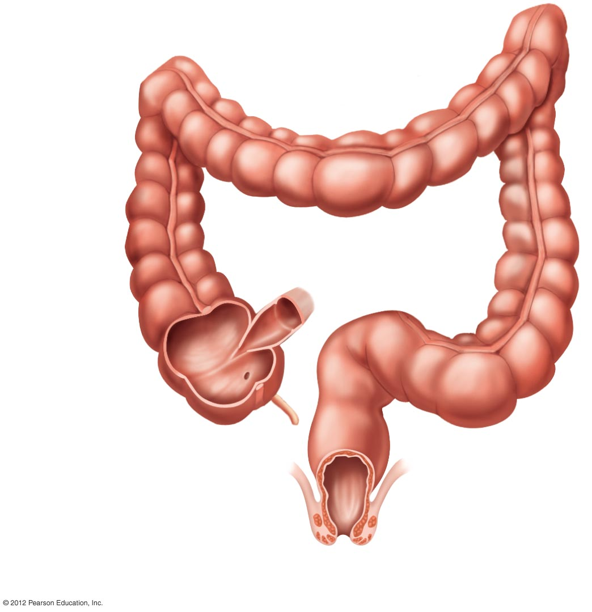
Transverse
colon
Ascending
colon
Descending
colon
Small
intestine
Ileocecal
valve
Cecum
Appendix
Sigmoid colon
Rectum
External anal
sphincter
(skeletal muscle)
Internal anal
sphincter
(smooth muscle)
Anus
Anal canal

