Slide 1

Stomach Functions
Food storage
Regulation of delivery of partially digested food into the small intestine
Digestion of proteins

Slide 2
Gastric Juice Breaks Down Proteins
Specific cells secrete gastric juice, which contains
  Hydrochloric acid
    Produces a pH of about 2; breaks down large bits of food
  Intrinsic factor
    Needed to absorb vitamin B₁₂
  Mucus
    Protects stomach lining from acid
  Pepsinogen
    Converted to pepsin by acid
    Begins protein breakdown

Slide 3
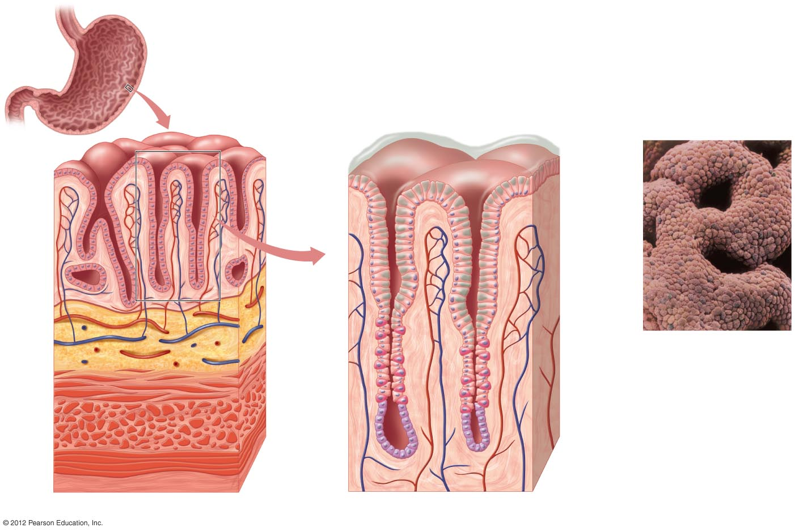
Mucus
Gastric pits
Mucosa
Mucus-
secreting
cells
Submucosa
Acid-
secreting
cell
c) Gastric pits.
Oblique
layer
Muscularis
Circular
layer
Serosa
Longi-
tudinal
layer
Pepsinogen-
secreting
cell
a) Stomach wall.
b) Gastric glands.

Slide 4
Stomach Contraction
Stomach contractions
  blend food and propel it forward
Chyme
  watery mixture of partially digested food and gastric juice that is delivered to the small intestine
Requires 2–6 hours for stomach to empty completely after a meal
Stomach DOES NOT absorb nutrients

Slide 5
Small Intestine Digests Food and Absorbs Nutrients and Water
Functions
  Digestion
    Neutralizes acid from stomach
    Adds digestive enzymes and bile
    Breaks down proteins, carbohydrates, and lipids to absorbable materials
  Absorption
    90% of food absorbed in small intestine

Slide 6
Small Intestine Has Large Surface Area for Absorption
Three regions increase surface area
  Duodenum: most digestion occurs here
  Jejunum: absorption
  Ileum: absorption

Slide 7
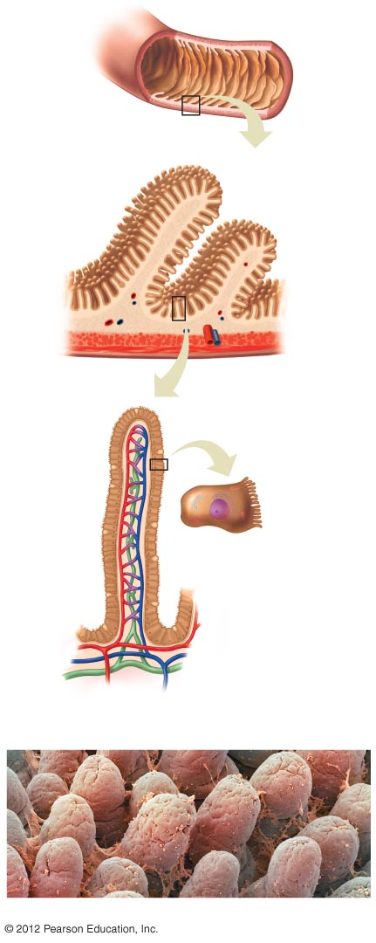
Small Intestine Has Large Surface Area for Absorption
Folds
The wall of the small intestine contains
numerous folds that increase
its surface area.
Mucosa lining adaptations increase surface area
  Large folds
  Villi
    microscopic projections
  Microvilli
    cytoplasmic projections of epithelial cells of the villi
Villi
Mucosa
Submucosa
Muscularis
Serosa
b) Each fold is covered
with smaller folds
called villi.
Epithelial
cell
Lacteal
Microvilli
d) A single cell with its outer
membrane of microvilli.
Mucus-
producing cell
Arteriole
Venule
Lymph
vessel
c) A close-up view of a villus showing the single layer of mucosal
cells covering the surface and the centrally located lymph vessel
(lacteal) and blood vessels.
e) Human intestinal villi (× 270).

