Slide 1

The Mouth Processes Food for Swallowing
Teeth: bite and chew food
  Types: incisors, canines, premolars, molars
      Children: 20 teeth
      Adults: 32 permanent teeth
Tongue: positions and tastes food
    Skeletal muscle
    Moves food in mouth
    Taste
    Important for speech

Slide 2
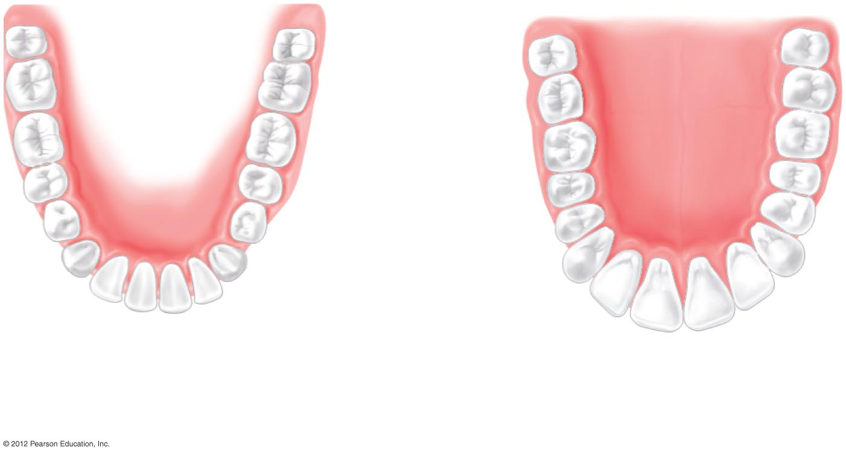
Molars
(12)
Premolars
(8)
Canines (4)
Incisors
(8)
Lower jaw
Upper jaw
a) Locations and types of adult human teeth.

Slide 3
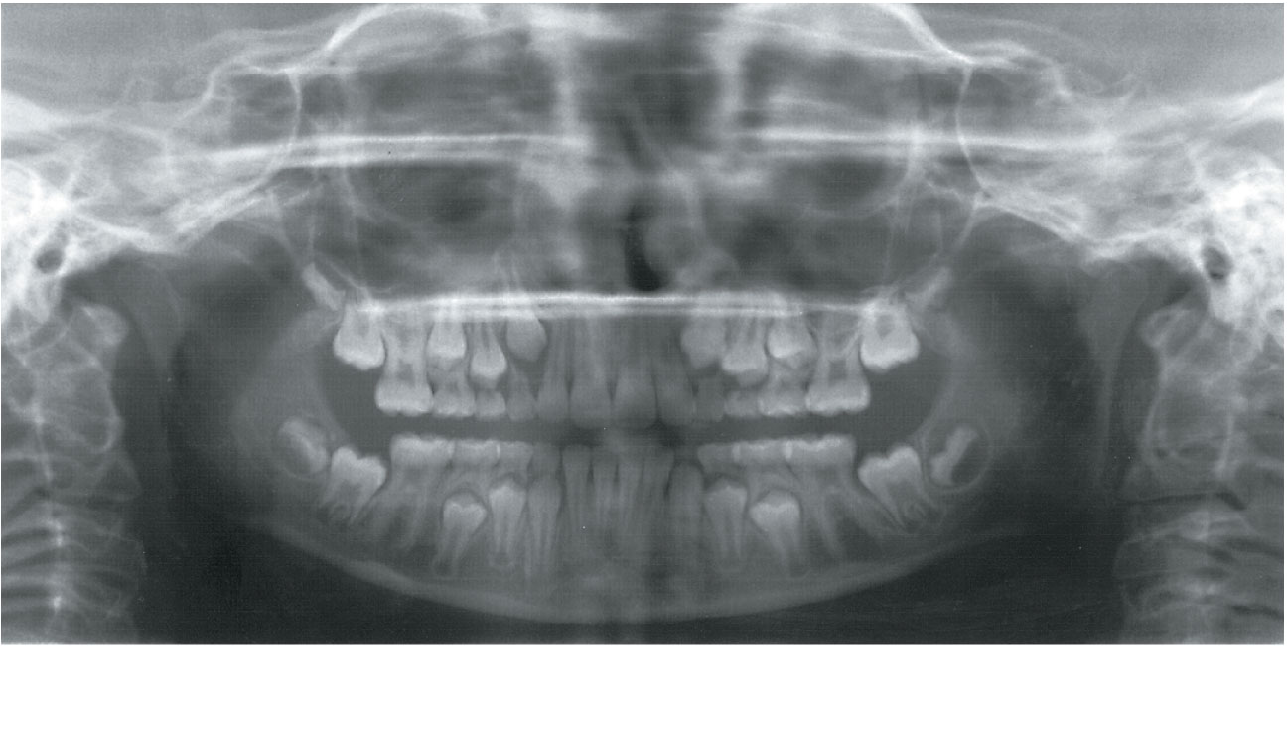
Baby Teeth pushed out by Adult Teeth
Deciduous teeth
Permanent teeth

Slide 4
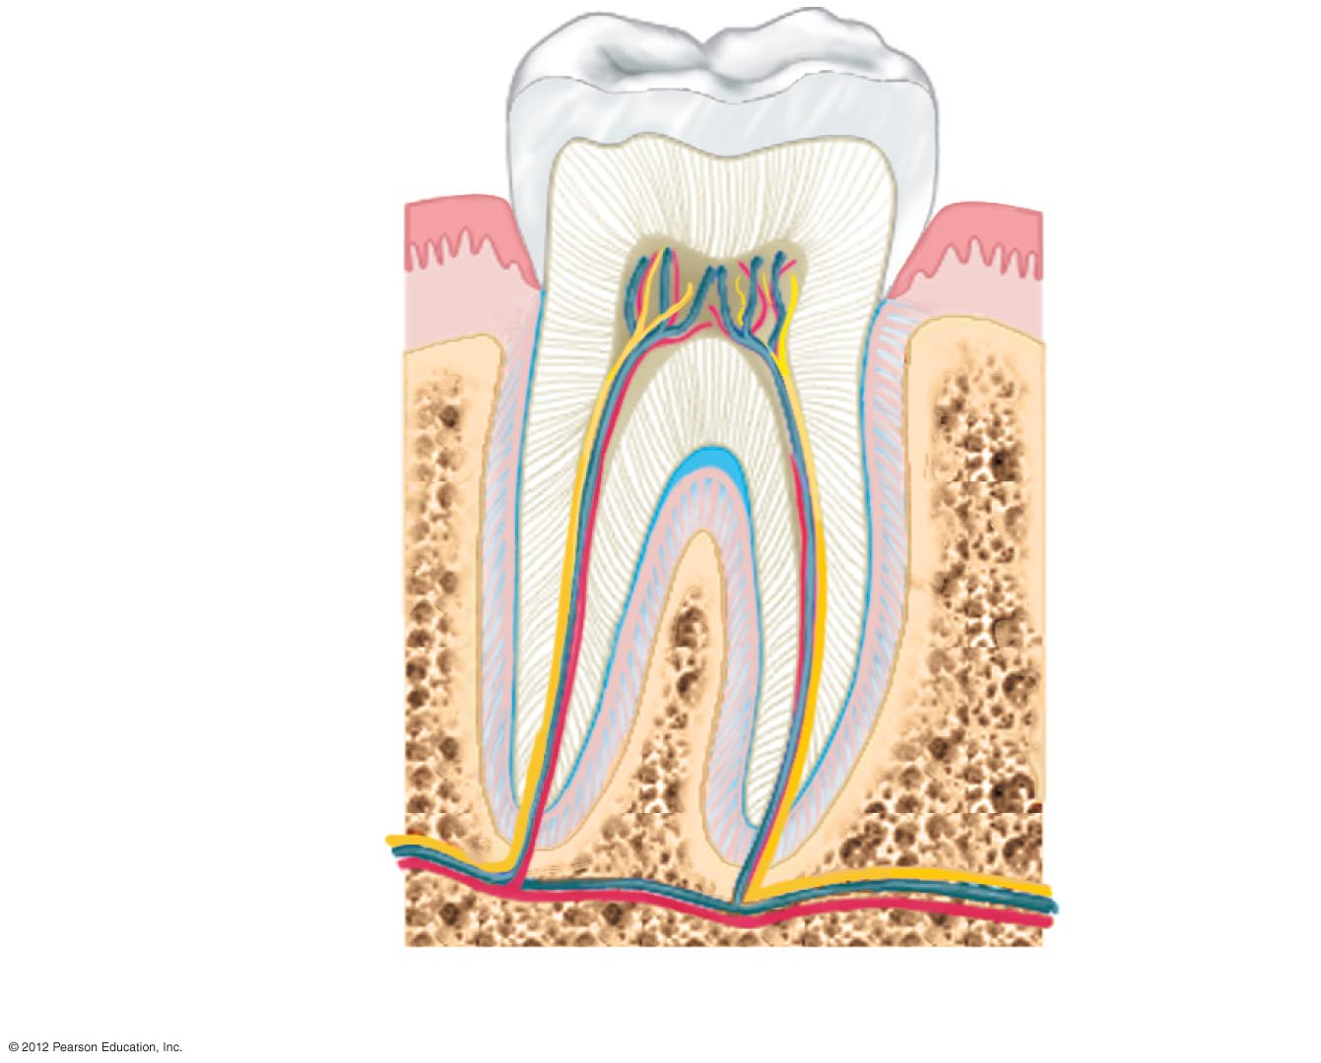
Enamel
Crown
Dentin
Gingiva (gum)
Pulp cavity
Root canal
Periodontal
membrane
Root
Bone
b) Anatomy of a tooth.

Slide 5
The Mouth Processes Food for Swallowing
Saliva
  Salivary glands
    Parotid
    Submandibular
    Sublingual
  Composition
    Mucin, salivary amylase, bicarbonate, lysozyme

Slide 6
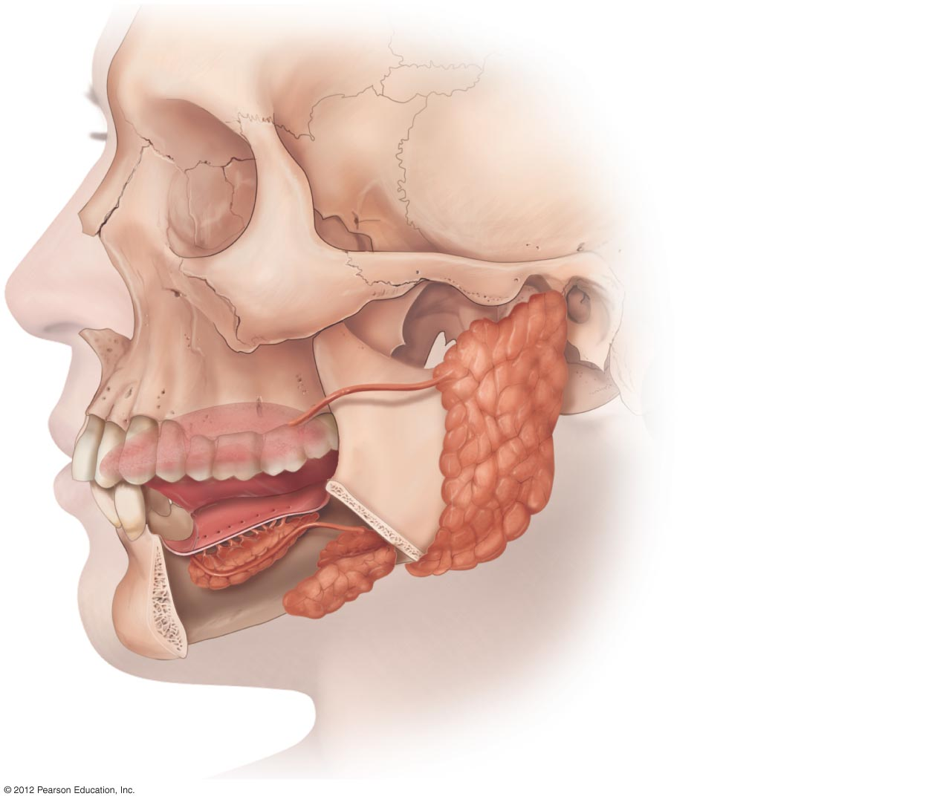
Parotid gland
Sublingual gland
Submandibular gland

Slide 7
Pharynx and Esophagus Deliver Food to the Stomach
Swallowing
  Voluntary phase
    tongue pushes bolus of food into pharynx (throat)
  Involuntary phase
    swallowing reflex
Pharynx
  common passageway for air and food
Epiglottis
  closes airway temporarily so food will not enter the trachea

Slide 8
Pharynx and Esophagus Deliver Food to the Stomach (cont.)
Food moves through esophagus with the help
of peristaltic contractions
Food passes through lower esophageal sphincter into the stomach

Slide 9
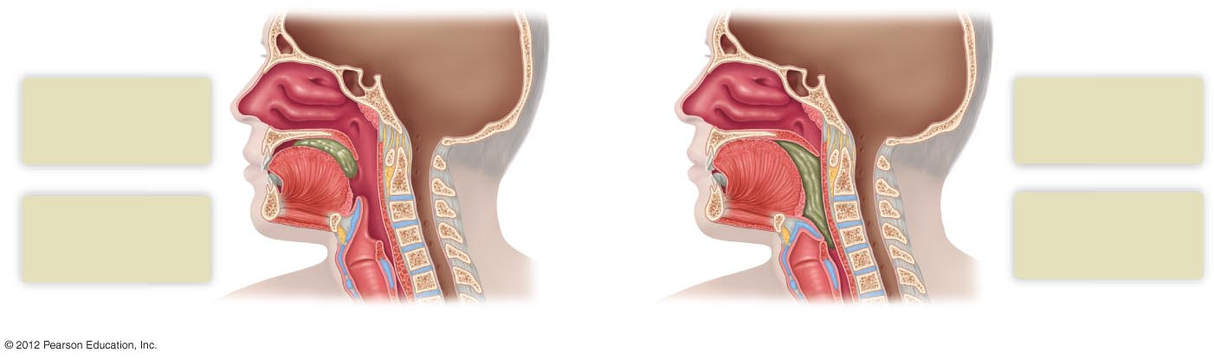
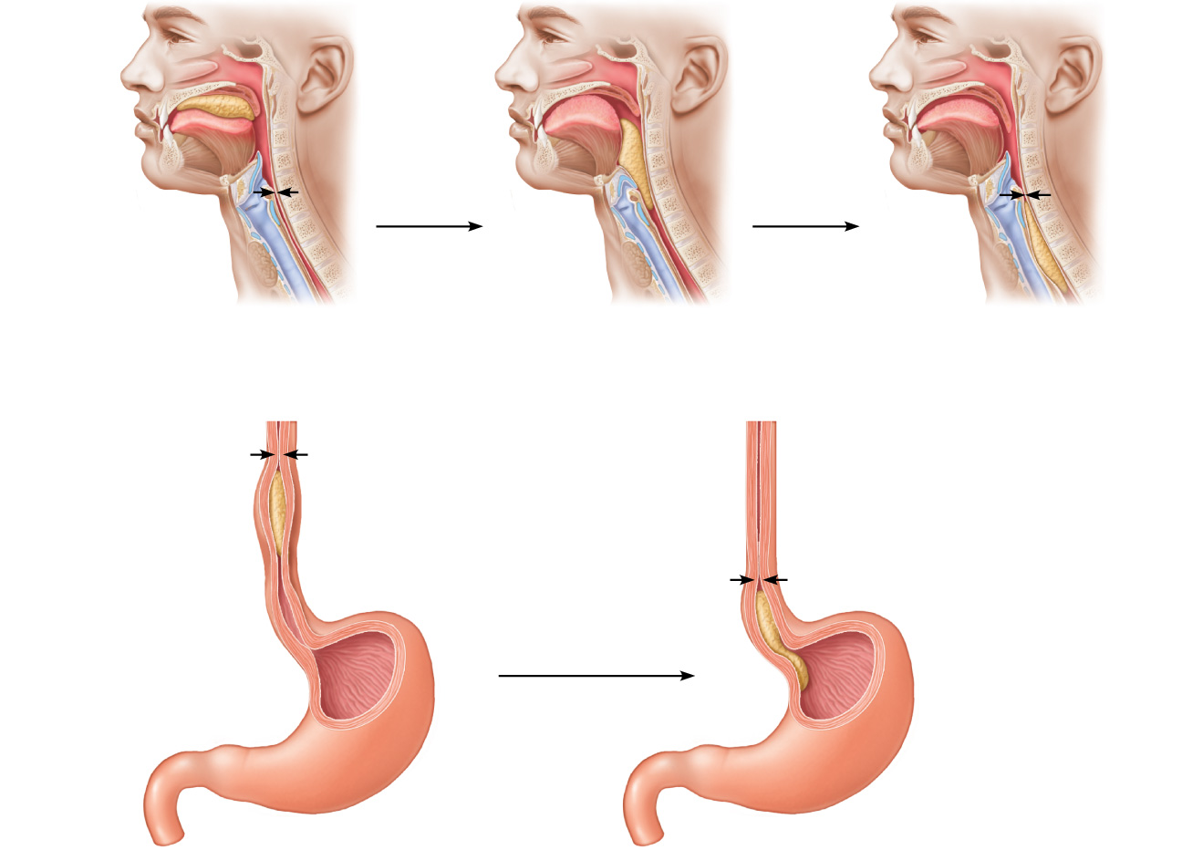
Nasal cavity
1
Swallowing begins
as tongue pushes
bolus into pharynx
Hard palate
3
Soft palate rises to
close passage to
nasal cavity
Soft palate
Bolus of food
Tongue
Pharynx
2
4
Before swallowing,
muscles keep
esophagus closed
Epiglottis
Epiglottis bends to
close off trachea
and open esophagus
Trachea
(airway) open
a) Voluntary phase.
b) Involuntary phase.
Relaxed muscles
5
6
Circular muscles
contract
Food is moved
through the esophagus
to the stomach by
peristalsis.
Relaxed
muscles
The gastroesophageal
sphincter opens, and food
enters the stomach.
Bolus of food
Longitudinal muscles
contract
Lower Esophageal
sphincter closed
Lower Esophageal
sphincter opens
Stomach

