Slide 1
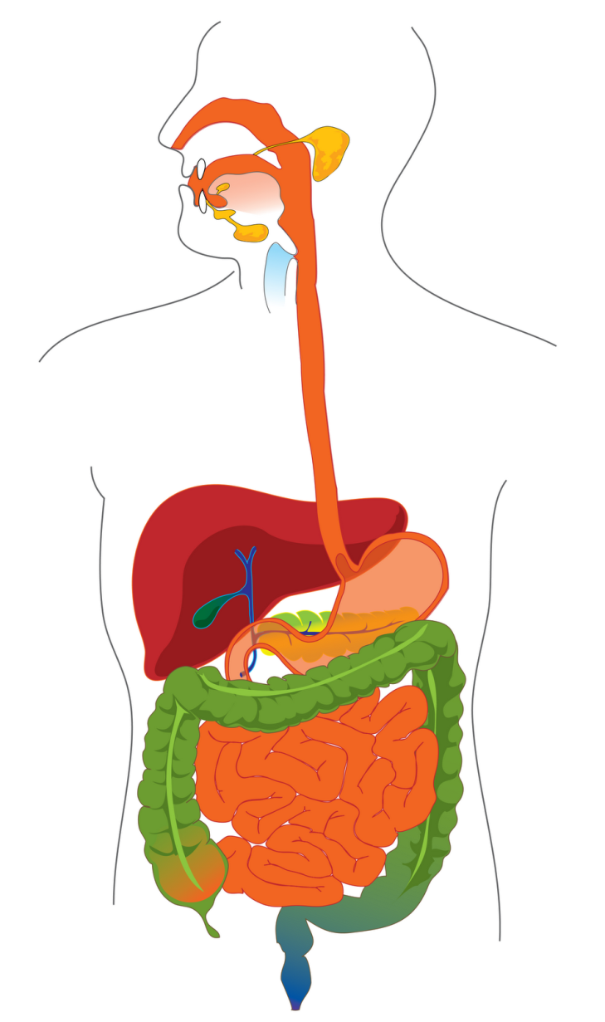

The Digestive System

Slide 2
Digestive System Brings Nutrients Into the Body
The digestive system includes
Gastrointestinal (GI) tract (hollow tube)
  Lumen: space within this tube
  Includes mouth, pharynx, esophagus, stomach, small intestine, large intestine, rectum, anus
Accessory Organs
  Salivary glands, liver, gallbladder, pancreas

Slide 3
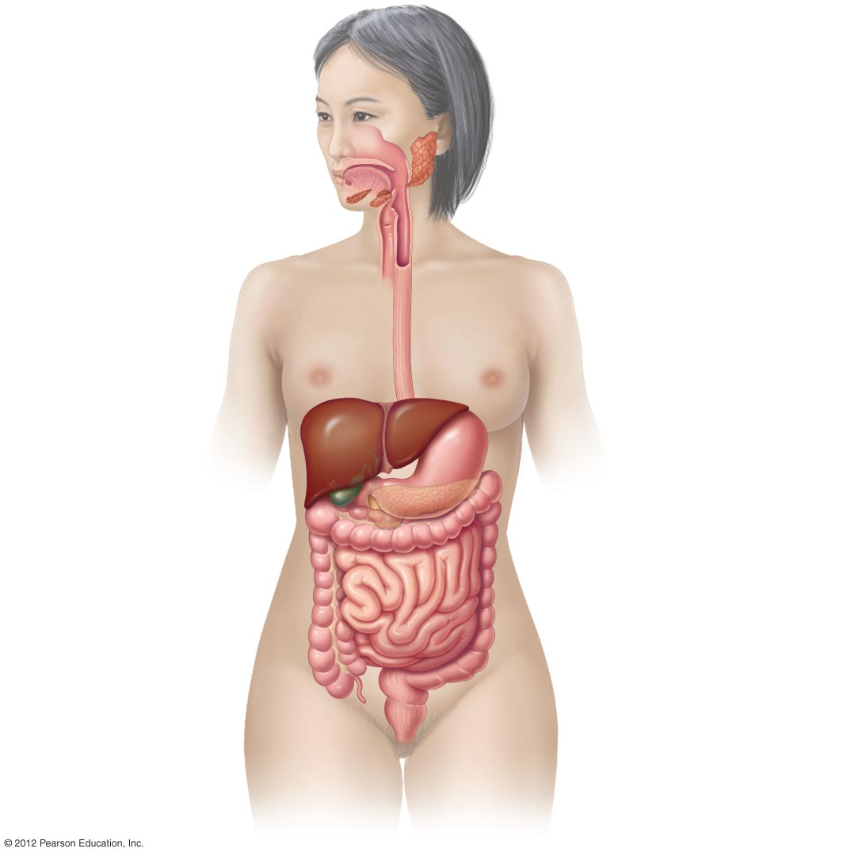
ACCESSORY ORGANS:
ORGANS:
Mouth
• Teeth chew food
• Tongue positions and
tastes food
Pharynx
• Passageway for food and air
• Participates in swallowing
Salivary glands
Esophagus
• Saliva moistens food
• Bicarbonate maintains pH
• Amylase digests starch
• Lysozyme inhibits bacteria
• Moves food from pharynx
to stomach
Stomach
Liver
• Stores and mixes food
• Begins chemical digestion of
protein by enzymes and acid
• Regulates delivery to the
small intestine
• Produces bile
• Performs various functions
associated with processing
and storing nutrients
Gallbladder
Small intestine
• Stores and concentrates bile
• Digests proteins, fats,
and carbohydrates
• Absorbs most of the water
and nutrients
• Secretes digestive hormones
and enzymes
Pancreas
• Secretes digestive enzymes
into small intestine
• Secretes bicarbonate into
small intestine to neutralize
stomach acid
Large intestine
• Absorbs the last of the water
and nutrients
• Stores waste material
Sigmoid colon
Appendix
• Stores feces
• No known digestive function
Rectum
• Passageway for feces
Anus
• Expels undigested material

Slide 4
Walls of the GI Tract Are Composed of Four Layers & ‘Stop Points’
Mucosa
  innermost layer, mucous membrane in contact with the lumen
Submucosa
  layer of connective tissue containing blood vessels, lymph vessels, nerves
Muscularis
  two or three layers of smooth muscle, responsible for movement, motility
Serosa
  outermost layer

Slide 5
Walls of the GI Tract
Sphincters
  thick muscular rings that separate some of the organs and create ‘stop points’

Slide 6
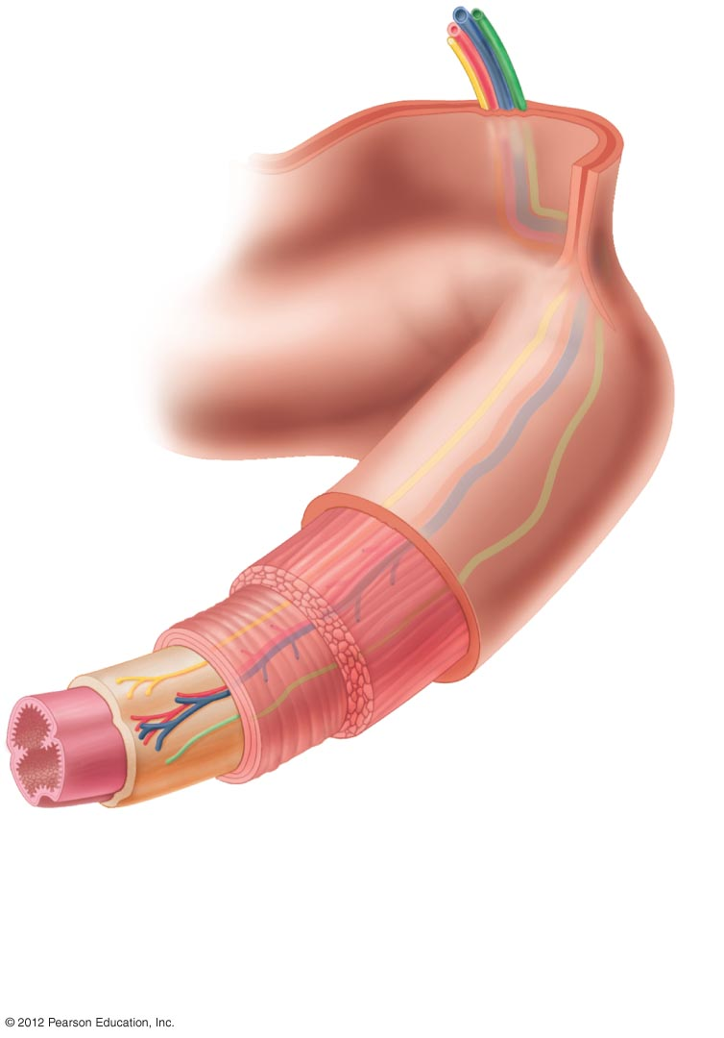
Vein
Lymph vessel
Artery
Nerve
Serosa
• Connective tissue
outer covering
• Protects and anchors
the digestive tract
Muscularis
• Two layers of smooth muscle
• Responsible for motility of the
a digestive tract
Lumen
Submucosa
• Connective tissue layer
• Contains blood vessels, lymph vessels,
and nerves
Mucosa
• Mucous membrane layer
• Lines the digestive tract

Slide 7
Five Basic Processes Accomplish Digestive System Function
  1. Mechanical processing and movement
    Chewing and mixing
  2. Secretion
    Fluid
    Digestive enzymes and hormones
    Bile, acid, alkali, mucus
  3. Digestion
    Breaking down food to smallest absorbable units
    Chemical and mechanical breakdown

Slide 8
Five Digestive System Processes (cont.)
  4. Absorption
    Through mucosa
    Into blood or lymph vessels
  5. Elimination
    Undigested material eliminated

Slide 9
Two Types of Motility Aid Digestive Processes
Motility (movement) enabled by smooth muscle in the muscularis layer
  Peristalsis
    propels food forward
  Segmentation
    mixes food

Slide 10
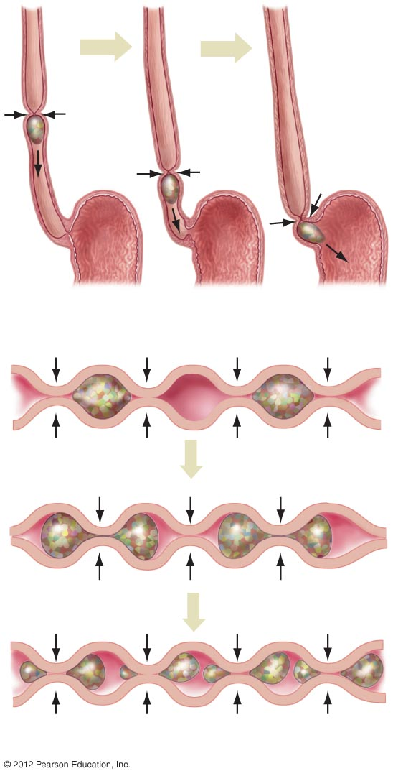
Esophagus
Bolus of food
Stomach
a) Peristalsis.
b) Segmentation.

