Slide 1

Disorders of Respiratory System:
Reduced Air Flow or Gas Exchange
Asthma: spasmodic contraction of bronchi
  Caused by episodic allergic responses
  Controlled by bronchodilators and corticosteroids
Emphysema: alveoli permanently impaired
  Breathlessness due to decreased surface area for gas exchange
  Most cases result from smoking

Slide 2
Disorders of Respiratory System:
Reduced Air Flow or Gas Exchange
Bronchitis: inflammation of bronchi
  May be acute or chronic
  Most cases related to smoking or air pollution
Cystic Fibrosis: an inherited condition
  Abnormally thick mucus in lungs impedes air flows
  Frequent pulmonary infections
  Other organ systems may be affected

Slide 3
Disorders of Respiratory System:
Respiratory Infections
Upper respiratory infections
  Colds and flu
    Caused by viruses
    Antibiotics not effective
  Pneumonia: infection of the lungs
    May be caused by bacteria or viruses
    One of the top 10 causes of death in the United States
    Treatment depends on cause

Slide 4
Disorders of Respiratory System:
Respiratory Infections and Intoxications
Tuberculosis: bacterial infection that scars the lungs
  May be active infection with symptoms, or dormant infection that will reactivate later
  Diagnosis: tuberculin skin test and chest X-ray
  Treatment: antibiotics

Slide 5
Disorders of Respiratory System:
Lung Cancer
Cancer
  uncontrolled growth of abnormal cells
Impairs air flow, gas exchange, blood flow
1/3 of all U.S. cancer deaths
Causes
  90% of cases associated with smoking
  Radon gas
  Workplace chemicals such as asbestos

Slide 6
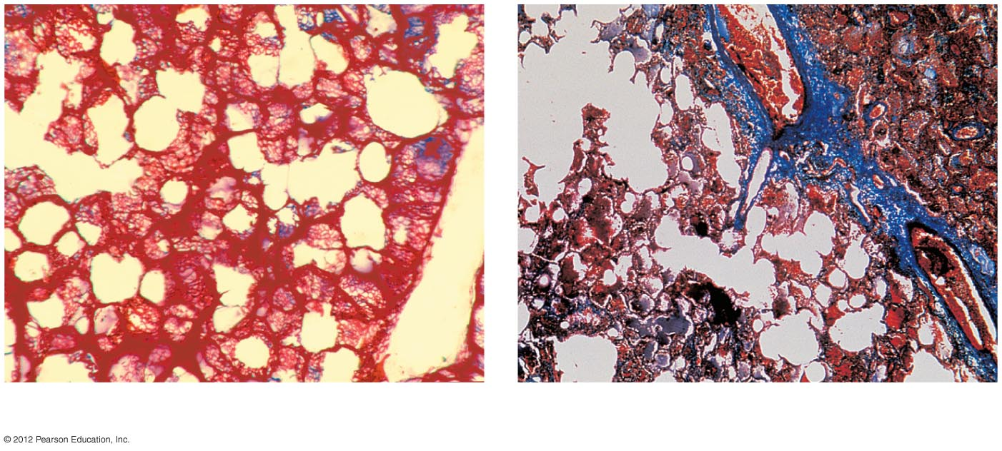
Normal lung.
Cancerous lung.

Slide 7
Pneumothorax and Atalectasis
Pneumothorax: collapse of one or more lobes of the lungs
  Most often due to penetrating wound
  Inability to inflate the lung→ poor gas exchange
  Treatment: remove air from pleural cavity

Slide 8
Congestive Heart Failure Impairs Lung Function
Congestive heart failure
  heart becomes a less efficient pump
Failure of left side of heart
  Blood pressure increases within pulmonary capillaries
  Fluid build-up occurs in pulmonary interstitial spaces and alveoli
  Impaired gas exchange
Treatment: improve pumping action of heart and remove fluid

