Slide 1

The Nervous System Regulates Breathing
Respiratory center is located in the medulla oblongata (brain stem)
  Establishes basic breathing pattern
  Neurons in medulla generate impulses every 4 – 5 seconds
  Stimulates intercostal muscles and diaphragm

Slide 2
Chemical Receptors Monitor
CO₂, H+, and O₂ levels
Monitoring of CO₂ levels
  Receptors in medulla oblongata monitor CO₂ levels indirectly
  ↑ P_{CO2} in arterial blood will cause ↑ in H+ in cerebrospinal fluid, which will signal medulla oblongata to ↑ respiratory rate
  This is the primary regulator of respiration under normal conditions

Slide 3
Chemical Receptors Monitor
CO₂, H+, and O₂ levels
Monitoring P_{O2}
  Aortic and carotid bodies monitor P_{O2}
    Become activated if P_{O2} falls by at least 20%
    Will increase rate and depth of breathing in response to sufficiently lowered arterial P_{O2}
The rate and depth of normal breathing is determined by the need to get rid of CO₂ rather than the need to obtain O₂

Slide 4
We Can Exert Some Conscious Control
Conscious control resides in the cerebral cortex
  Able to modify breath to speak and sing
  Able to hold breath temporarily, but can’t override automatic controls located in medulla oblongata indefinitely

Slide 5
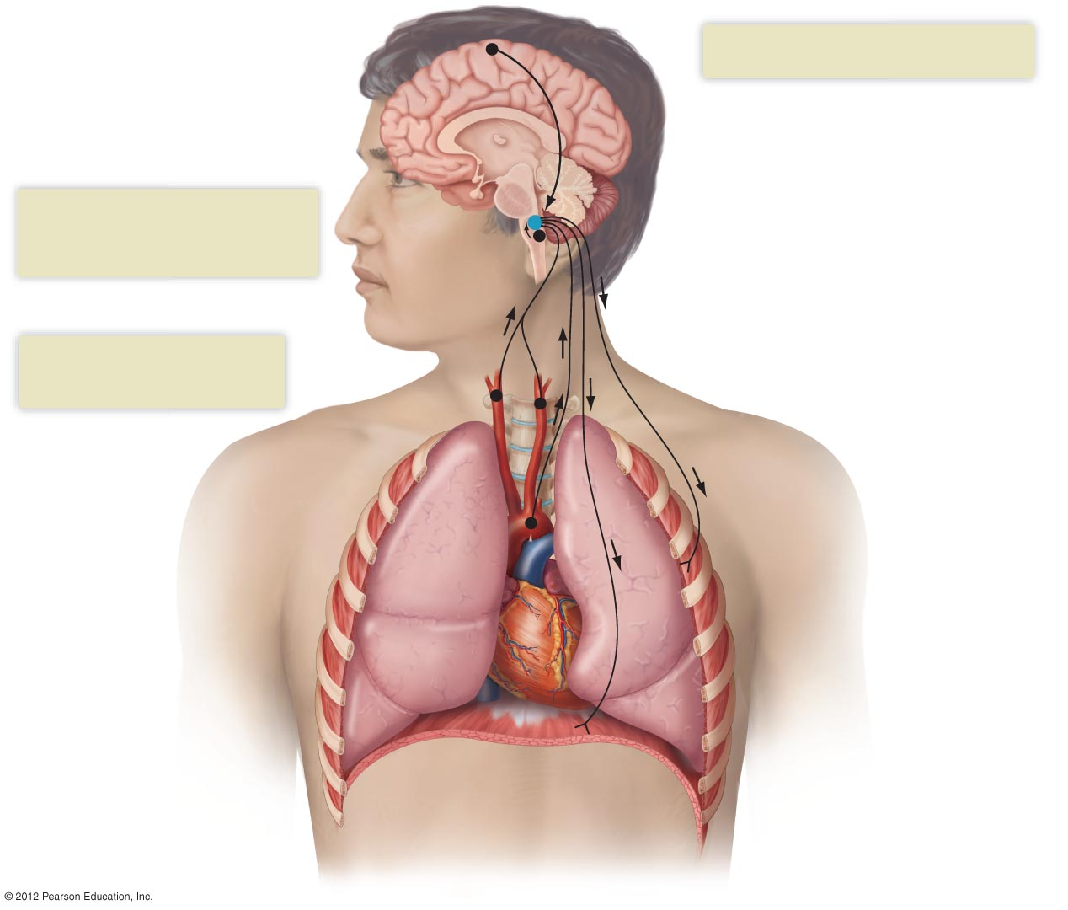
3
Higher centers in the cortex can exert
conscious control over respiration.
The respiratory center: establishes
a regular pattern of breathing
1
Receptor cells near the respiratory
center respond to changes in
cerebrospinal fluid H⁺ caused by
increases in arterial CO₂.
Medulla oblongata
2
Receptor cells in the carotid
and aortic bodies respond to
large decreases in arterial O₂.
Carotid bodies
Aortic bodies
Intercostal muscles
Diaphragm

