Slide 1

Gas Exchange and Transport Occur Passively: Partial Pressure
Partial Pressure: The pressure exerted by one particular gas in a mixture of gases
Partial pressure of a gas is proportional to its percentage of the total gas composition
A gas always diffuses down its partial pressure gradient, from higher to lower partial pressure

Slide 2
External Respiration: Exchange of Gases Between Air and Blood (in lungs)
O₂ diffuses from alveoli (P_{O2}: 104 mmHg) into blood (P_{O2}: 40 mmHg), down its partial pressure gradient
CO₂ diffuses from blood (P_{CO2}: 46 mmHg) into alveoli (P_{CO2}: 40 mmHg), down its partial pressure gradient

Slide 3
Internal Respiration: The Exchange of Gases with Tissue Fluids (in body tissues)
O₂ diffuses down its pressure gradient from capillaries to interstitial fluid and then to cells
CO₂ diffuses down its pressure gradient from cells to interstitial fluid to capillaries

Slide 4
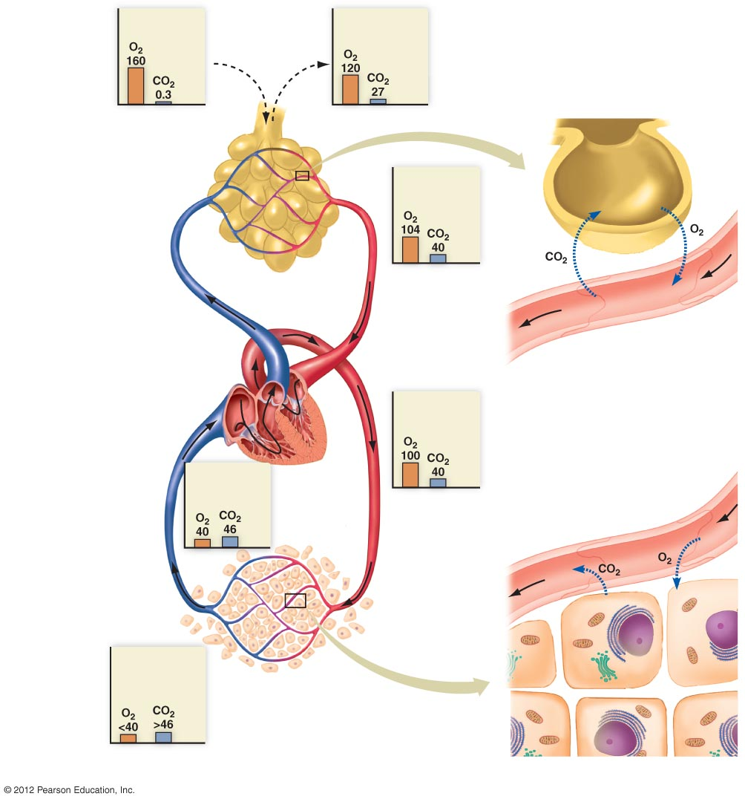
Dry inhaled air
Moist exhaled air
Breathing
Alveolar air
Alveolus
Pulmonary
circulation
40
104
Lung
capillaries
46
100
Capillary
External respiration
Transport
Pulmonary vein
and aorta
Systemic veins
and pulmonary
artery
Internal respiration
100
46
>46
<40
Systemic
circulation
Interstitial fluid
surrounding cells
Capillary networks
in head, limbs, torso,
and internal organs
Cells of tissues

Slide 5
Hemoglobin Transports Most O₂
98% of O₂ in blood is carried bound to hemoglobin molecules in red blood cells
Hb + O₂ → HbO₂
hemoglobin + oxygen → oxyhemoglobin
2% of O₂ is dissolved in plasma

Slide 6
Most CO₂ Is Transported in Plasma as Bicarbonate
70% of CO₂ is converted to and transported in the plasma as bicarbonate
10% of CO₂ is dissolved in plasma
20% of CO₂ binds to hemoglobin for transport

Slide 7
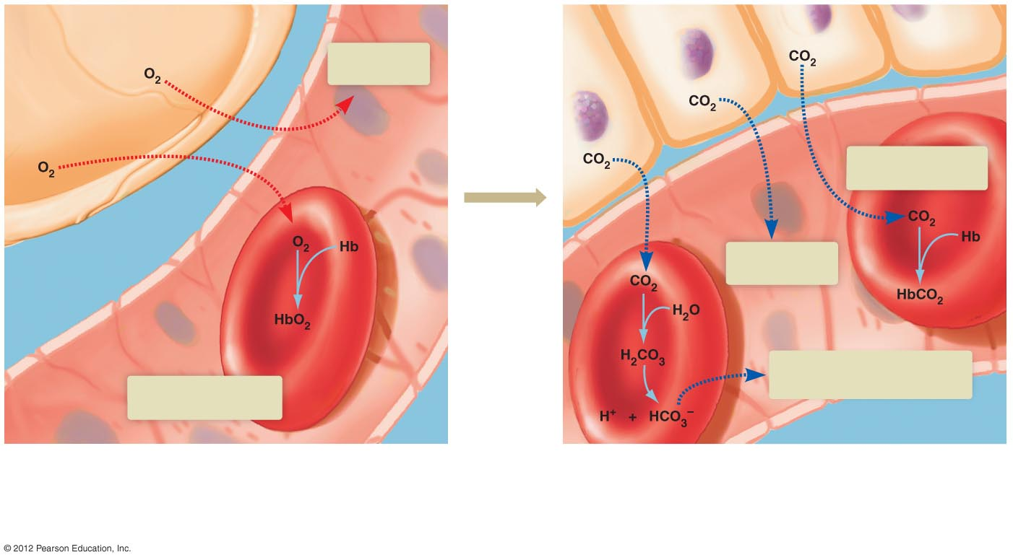
Oxygen transport in arterial blood
Tissue cells
Carbon dioxide transport in venous blood
Alveolus
2% dissolves
in plasma
20% combines with
hemoglobin (Hb)
Blood is
transported
from lungs
to tissue
10% dissolves
in plasma
Enzyme
Capillary
Red blood cell
70% is converted to HCO₃–.
HCO₃– diffuses into plasma
98% combines
with hemoglobin (Hb)
Approximately 98% of all the O₂ transported to the tissues
by arterial blood is bound to hemoglobin (Hb) within red
blood cells.
Most of the CO₂ transported to the lungs by venous blood is
converted to bicarbonate (HCO₃–) within red blood cells and
then carried in plasma as dissolved HCO₃–. The rest is either
dissolved in plasma as CO₂ or transported within the red blood
cells bound to hemoglobin.

