Slide 1

Lung Volumes and Vital Capacity
Measure Lung Function
Tidal volume
  Volume of air inhaled and exhaled in a single breath
Dead space volume
  Volume of air that remains in the airways and does not participate in gas exchange
Vital capacity
  Maximal volume that can be exhaled after maximal inhalation

Slide 2
Lung Volumes and Vital Capacity Measure Lung Function
Inspiratory reserve volume
  Volume of air that can be inhaled beyond the tidal volume
Expiratory reserve volume
  Volume of air that can be forcibly exhaled beyond the tidal volume
Residual volume
  Volume of air remaining in the lungs, even after a forceful maximal expiration
Measured by spirometer

Slide 3
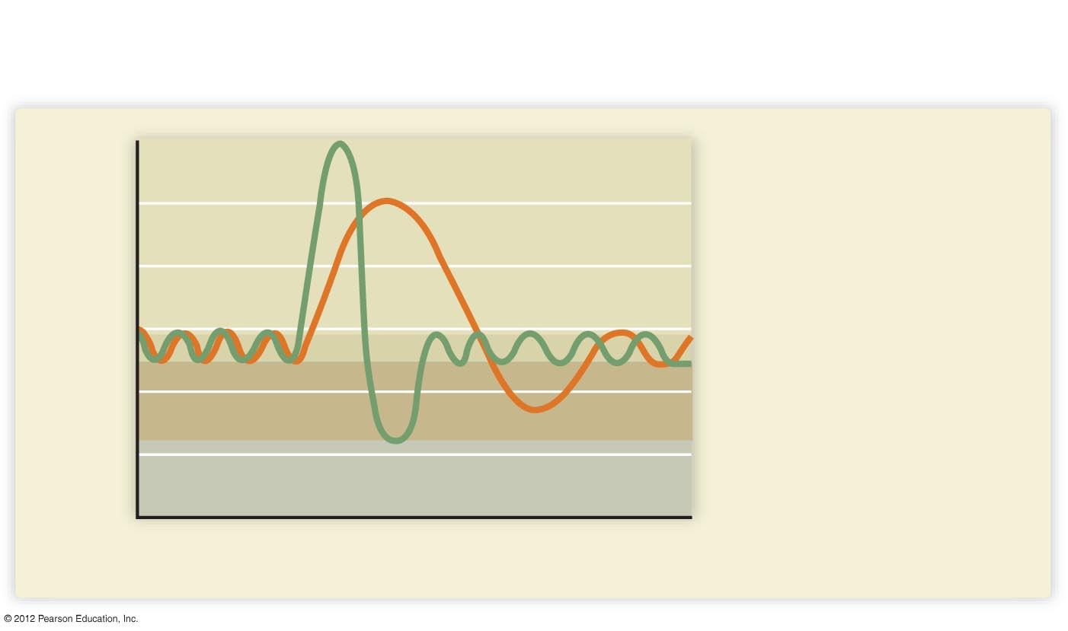
A recording of lung capacity. After several normal breaths, the person inhales
and then exhales maximally. The volumes indicated by the green line are for a
normal person. The orange line is typical of a patient with emphysema.
6000
Normal person
5000
Person with
emphysema
Inspiratory
reserve
4000
Vital
capacity
Lung volumes (ml)
3000
Tidal volume
2000
Expiratory
reserve
1000
Residual volume
0
Time

