Slide 1

The Lungs Are Organs of Gas Exchange
Located within thoracic cavity
Surrounded by pleural membranes
Bronchioles terminate in clusters of alveoli
Alveoli
  Tiny air-filled sacs
  Gas exchange occurs here
Pulmonary capillaries in alveolar walls – bring blood and air into close contact

Slide 2
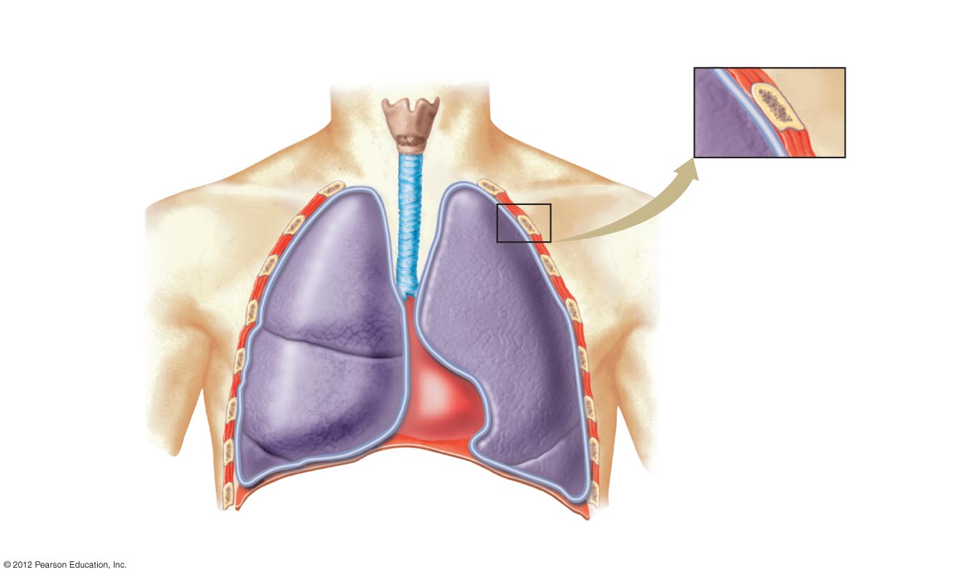
Pleural membrane
lining thoracic
cavity
Rib
Muscle
Trachea
Pleural cavity
Pleural membrane
attached to lung
The three
lobes of the
right lung
The two
lobes of the
left lung
Diaphragm
Heart (enclosed in pericardium)

Slide 3
The Lungs Are Organs of Gas Exchange
Pulmonary capillaries in alveolar walls – bring blood and air into close contact

Slide 4
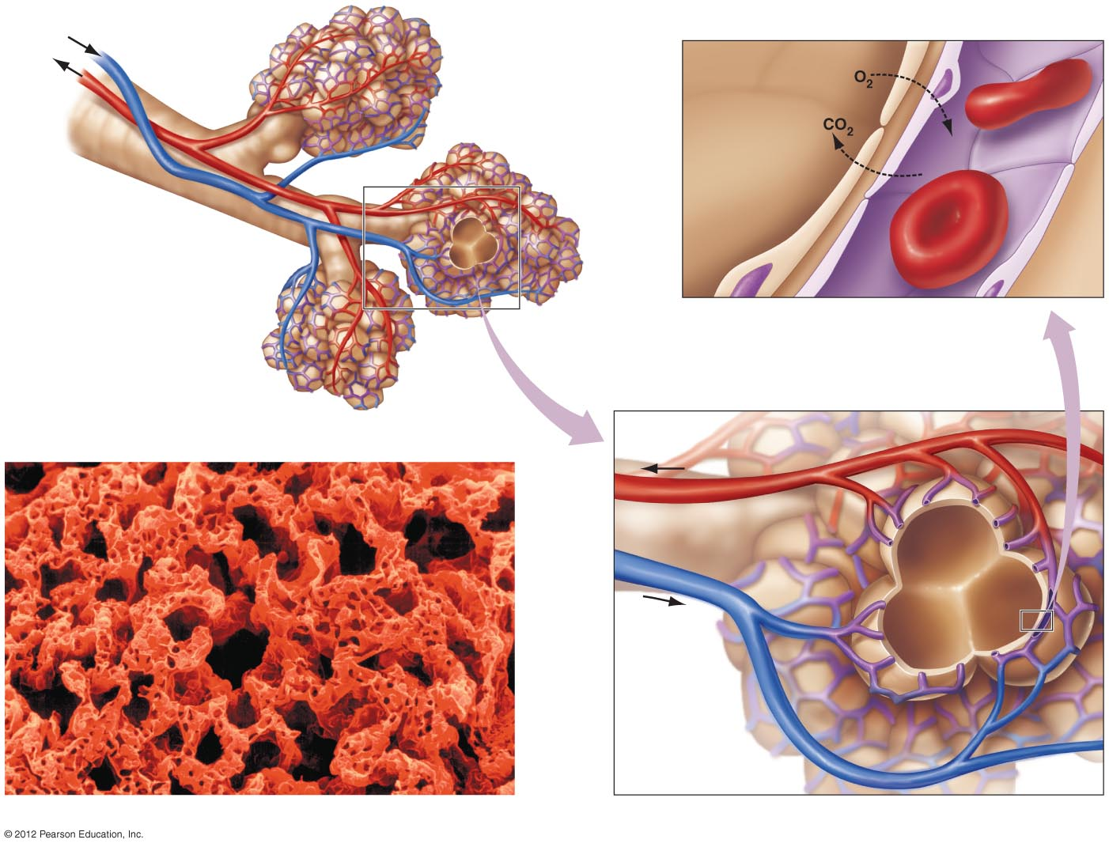
Blood flow
Capillary
Air in alveolus
Bronchiole
Small pulmonary vein
Small pulmonary artery
a) Bronchioles end in clusters
of alveoli, each surrounded
by capillaries. CO₂ and O₂
are exchanged across the
capillary and alveolar walls
by diffusion.
Epithelial cell of alveolus
Pulmonary venule
Blood flow
Blood flow
Pulmonary
arteriole
Capillary
network
on surface
of alveolus
b) Photo of the surface of alveoli covered with capillaries.

Slide 5
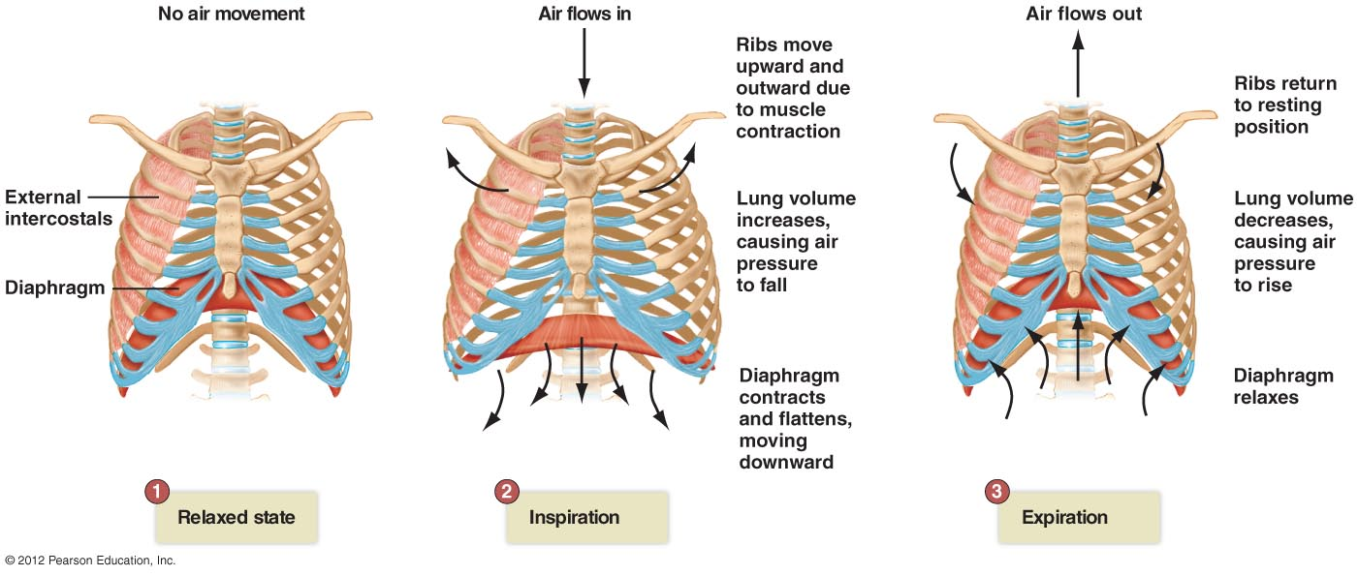
The Process of Breathing Involves a Pressure Gradient
Inspiration/expiration: air in/air out cycle
  Relaxed state
    Diaphragm and intercostal muscles relaxed

Slide 6
The Process of Breathing Involves a Pressure Gradient
  2. Inspiration (inhale)
    Diaphragm contracts, pulling muscle down; intercostal muscles contract, elevating chest wall and expanding volume of chest, lowering pressure in lungs, pulling in air

Slide 7
The Process of Breathing Involves a Pressure Gradient
  3. Expiration (exhale)
    Muscles relax; diaphragm resumes dome shape; intercostal muscles allow chest to lower, resulting in increase of pressure in chest and expulsion of air

