Slide 1
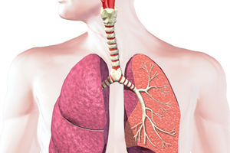

The Respiratory System

Slide 2
Respiration
Breathing: movement of air into
and out of the lungs
External respiration: O₂ and CO₂
exchange between the lungs
and the blood
Transport: O₂ and CO₂ in the blood
Internal respiration: O₂ and CO₂
exchange between systemic blood
vessels and tissues
Cellular respiration: oxygen use to produce ATP, carbon dioxide as waste
Respiratory
system
Circulatory
system

Slide 3
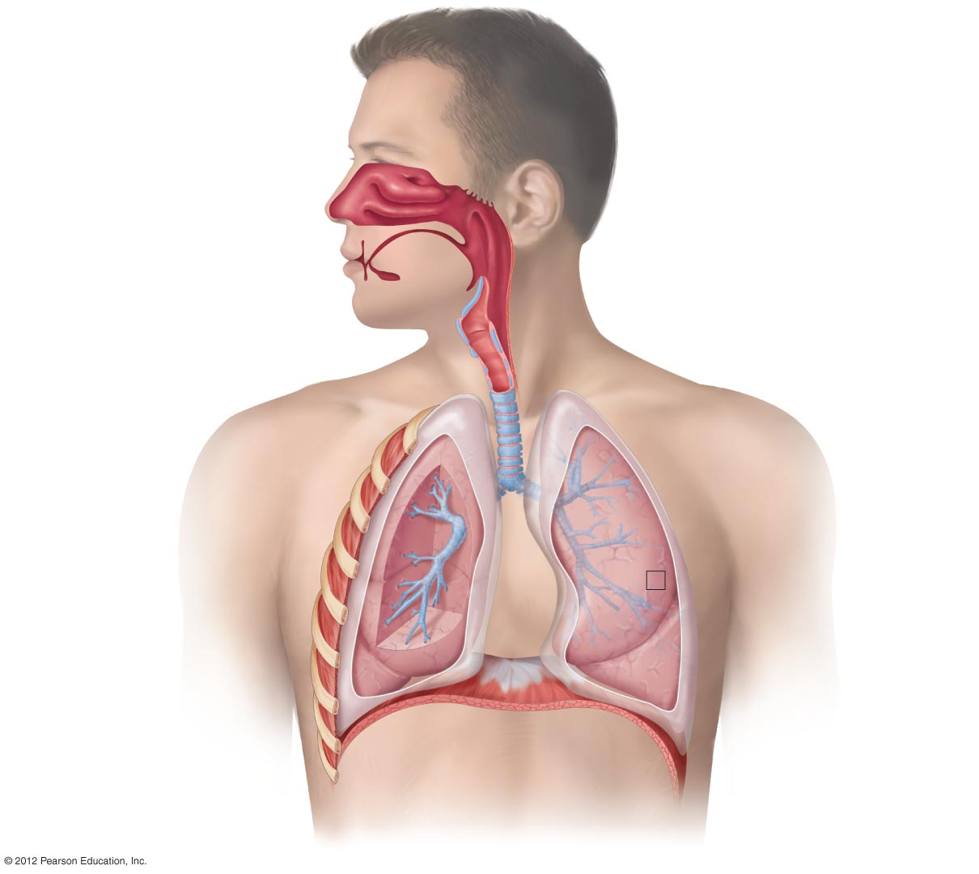
Nose
Passageway for air
Nasal cavity
Filters, warms, and
moistens air
UPPER RESPIRATORY TRACT
Mouth Passageway
for food and air
Pharynx (Throat)
Common passageway
for air, food, and liquid
Epiglottis
Covers larynx
during swallowing
Larynx (Voice box)
Production of sound
Pleural membranes
Cover the lungs and line
the chest cavity
Trachea (Windpipe)
Main airway
Lung
Organ of gas
exchange
LOWER RESPIRATORY TRACT
Bronchi
Branching airways
Intercostal muscle
Moves ribs during
respiration
Alveoli
Air sacs for
gas exchange
Rib
Right lung
Left lung
Diaphragm
Skeletal muscle
of respiration

Slide 4
Upper Respiratory Tract
Functions
  Acts as passageway for respiration
  Has receptors for smell
  Filters larger foreign material from incoming air, inhaled microorganisms are entrapped in mucus
  Moistens and warms incoming air
  Has resonating chambers for voice

Slide 5
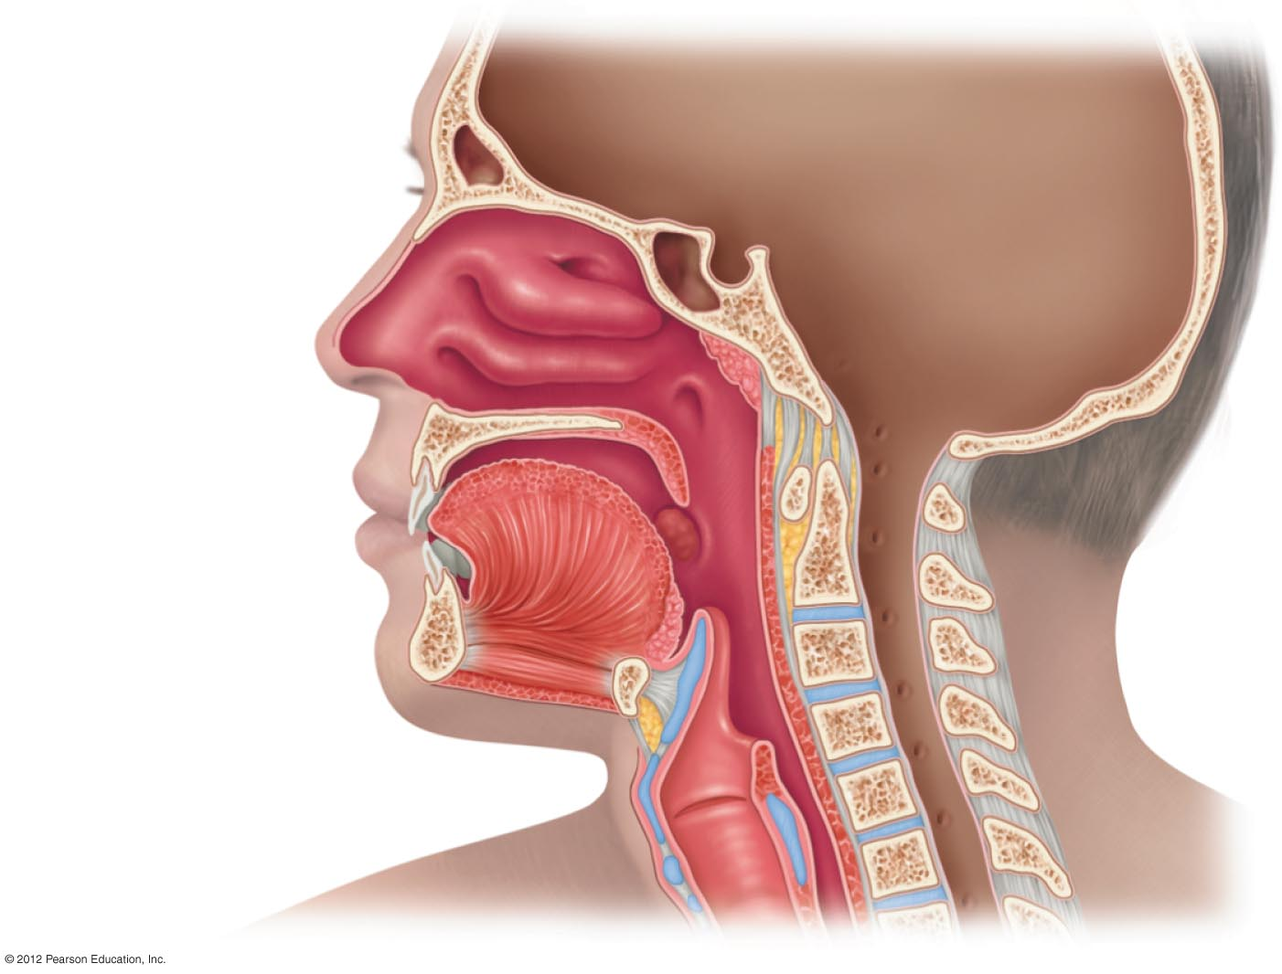
Sinuses
Nasal cavity
External nose
Opening of the
auditory tube
Nostril
Pharynx
Tongue
Epiglottis
Glottis
Larynx
Trachea
Esophagus

Slide 6
Lower Respiratory Tract
Functions
  Larynx
    Maintains an open airway
    Routes food and air appropriately
    Assists in sound production
  Trachea
    transports air to and from lungs
  Bronchi
    branch into lungs
  Lungs
    transport air to alveoli for gas exchange

Slide 7
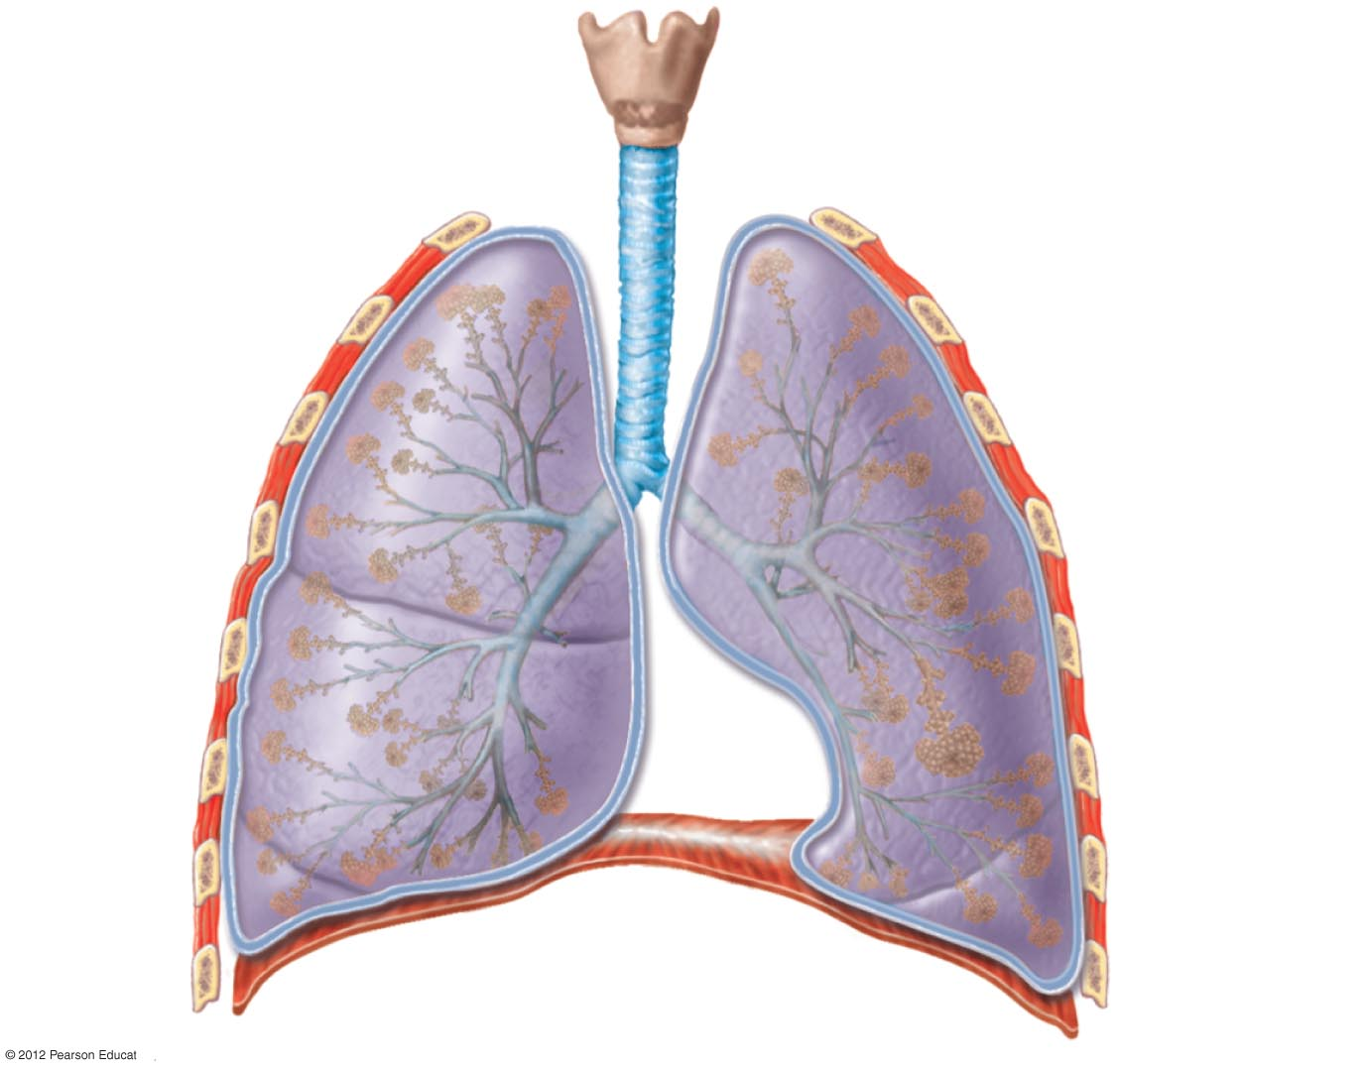
Larynx
Trachea
Left
bronchus
Right
bronchus
Bronchioles
Clusters
of alveoli

Slide 8
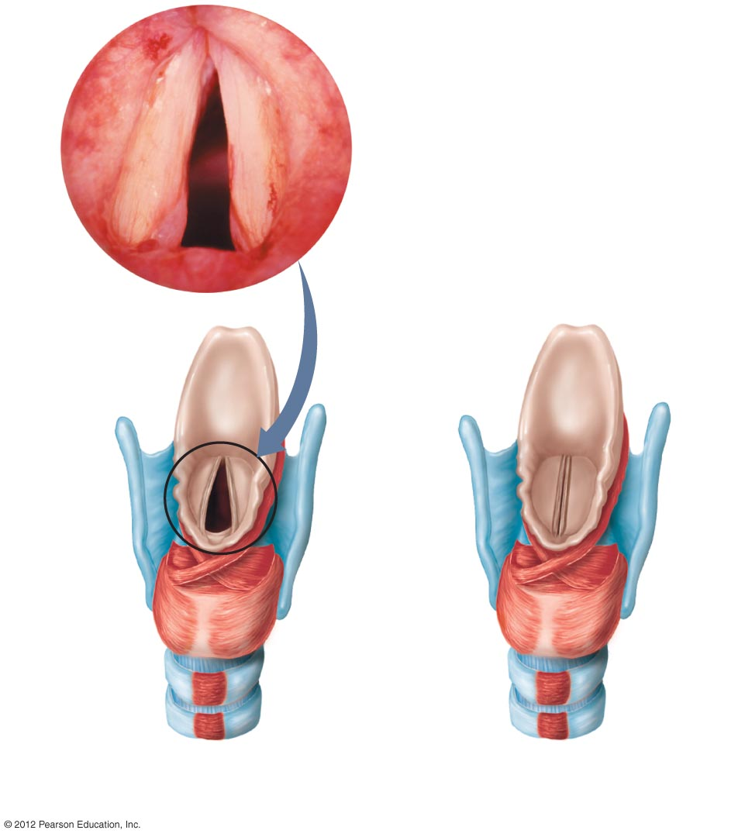
Epiglottis
Larynx
Vocal
cords
Opening
into larynx
(glottis open)
Closed glottis
Upper
trachea
a) Position of the vocal cords
during quiet breathing.
b) Position of the vocal cords
during sound production.

Slide 9
Defenses of the Respiratory Tract
Mucus – entraps microorganisms
Cilia – push microorganisms and mucus up and out of respiratory tract
  Smoking – damages cilia, impairs this defense
Cough reflex

Slide 10
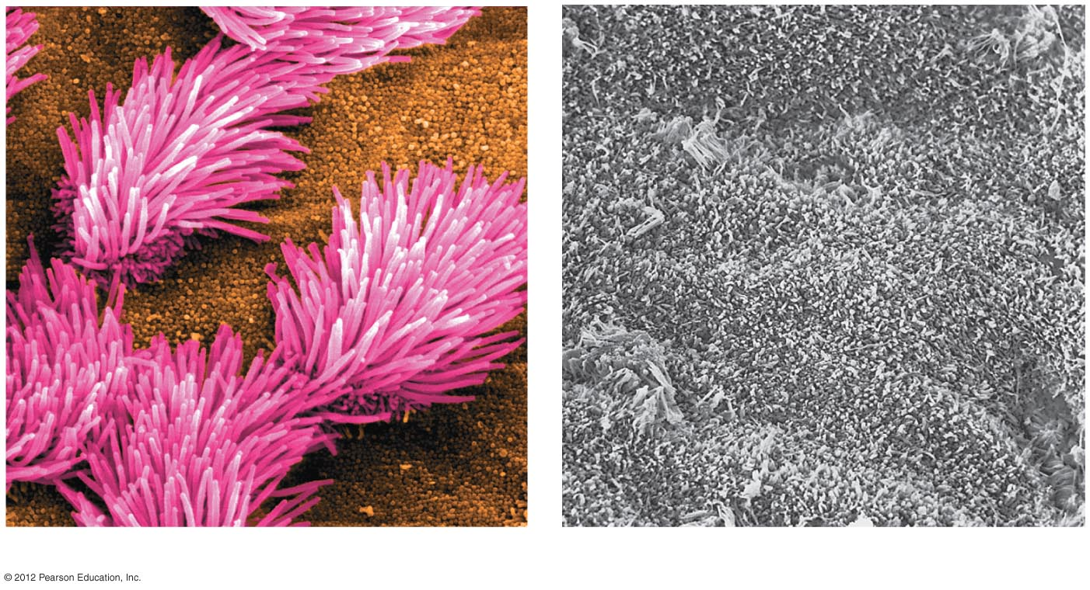
a) Healthy airway.
b) Smoker’s airway.

