Slide 1

Immune Deficiency: The Special Case of AIDS
AIDS
  Acquired Immune Deficiency Syndrome
Caused by infection with HIV (Human Immunodeficiency Virus)
HIV targets helper T cells
Transmission via body fluids (blood, semen, breast milk, vaginal secretions)

Slide 2
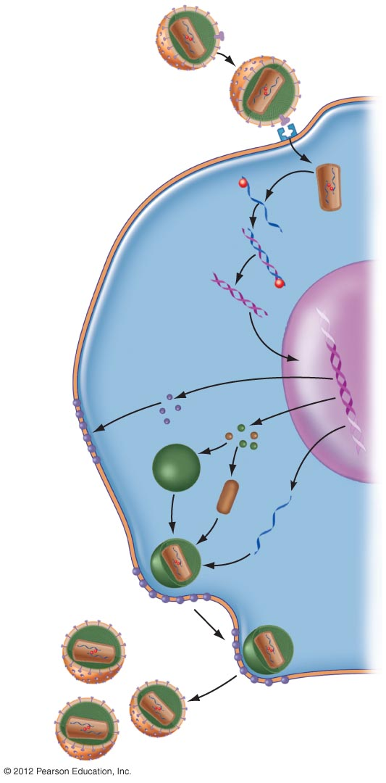
Retrovirus
Single-stranded
DNA made from
RNA template
Viral RNA
Double-stranded
DNA
Nucleus
Viral coat
Proteins
Core of virus

Slide 3
AIDS Develops Slowly: Phase I
Phase I
  May last a few weeks to a few years
  Brief period of flu-like symptoms
    Swollen lymph nodes
    Chills
    Fever
    Fatigue
    Body aches
  Most people don’t exhibit recognizable symptoms
  Virus is multiplying, antibodies are made but are ineffective for complete virus removal

Slide 4
AIDS Develops Slowly: Phase II
Phase II
  Occurs within 6 months to 10 years
  Opportunistic infections present
  Helper T cells affected, numbers are decreasing
  If untreated, 95% will progress to next phase (AIDS)

Slide 5
AIDS Develops Slowly: Phase III (AIDS)
Phase III: Clinical AIDS
  Helper T cells fall below 200 cells/mm³
  Opportunistic infections and cancers present
    Tuberculosis
    Pneumonia
    Meningitis
    Encephalitis
    Kaposi’s sarcoma
    Non-Hodgkins lymphoma
  If untreated, nearly always fatal

Slide 6
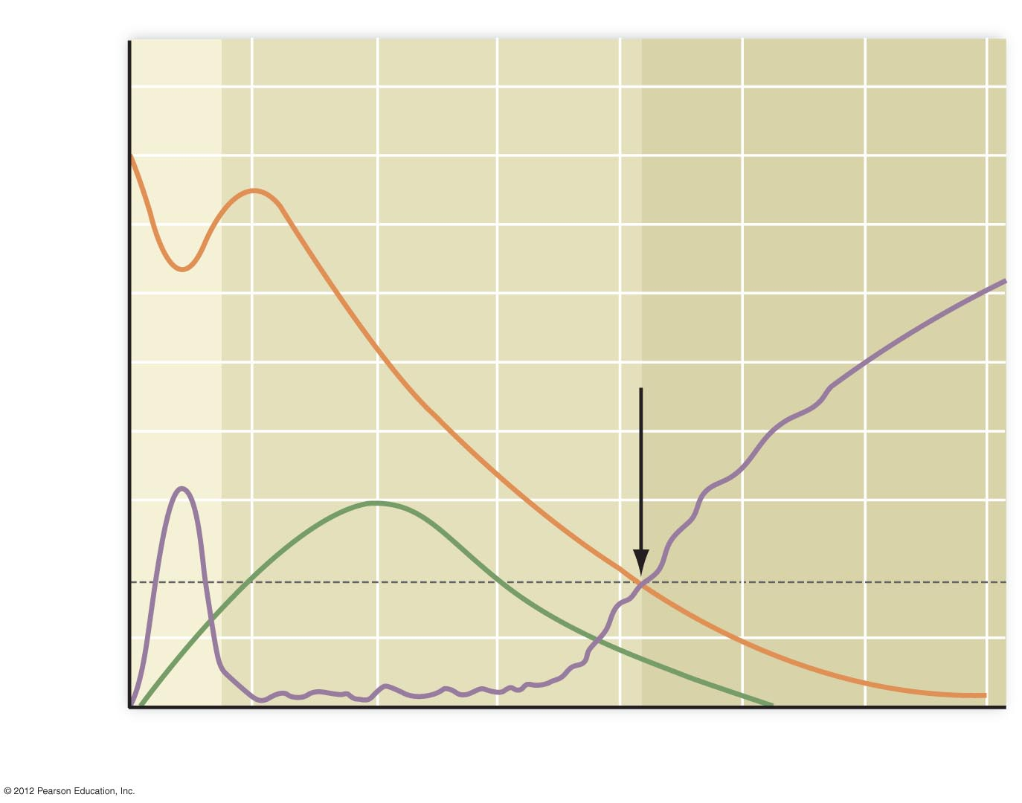
Phase I
Phase II
Phase III
900
800
700
The time of transition
from Phase II to
Phase III is highly
variable between
individuals.
600
Concentration of helper T cells in blood
(cells per mm³)
500
T cells
400
Antibodies
300
200
100
HIV in blood
0
0
1
2
3
4
5
6
7
Years after infection

Slide 7
Risky Behaviors Increase Your Chances of Getting AIDS
Males (3/4 of new cases)
  Sex with other men
  Sharing needles during intravenous drug use
  Heterosexual sex with HIV-infected female
Females (1/4 of new cases)
  Sex with HIV-infected male
  Sharing needles during intravenous drug use

Slide 8
Sex Can Be Safer
Abstinence
Reduce number of sexual partners
Choose sexual partners with low-risk behavior
Avoid high-risk sexual practices
  Anal-genital sex is a high-risk practice
Use latex or polyurethane condoms or barriers
GET TESTED

Slide 9
New Treatments Offer Hope
HIV Drugs
  Reverse transcriptase inhibitors: AZT
  Protease inhibitors: ritonavir, saquinavir
  Maraviroc: new drug
    Blocks entry of HIV into T cells
  Early treatment may delay or prevent clinical AIDS
Vaccine
  Under development and testing
  Challenge: Virus mutates rapidly

