Slide 1

Immune Memory Creates Immunity
Primary immune response
  Occurs on first exposure to antigen
  Characteristics
    Lag time of 3–6 days for antibody production
    Peak at 10–12 days
Secondary immune response
  Occurs on second and subsequent exposure to antigen
  Characteristics
    Lag time in hours
    Peak in few days

Slide 2
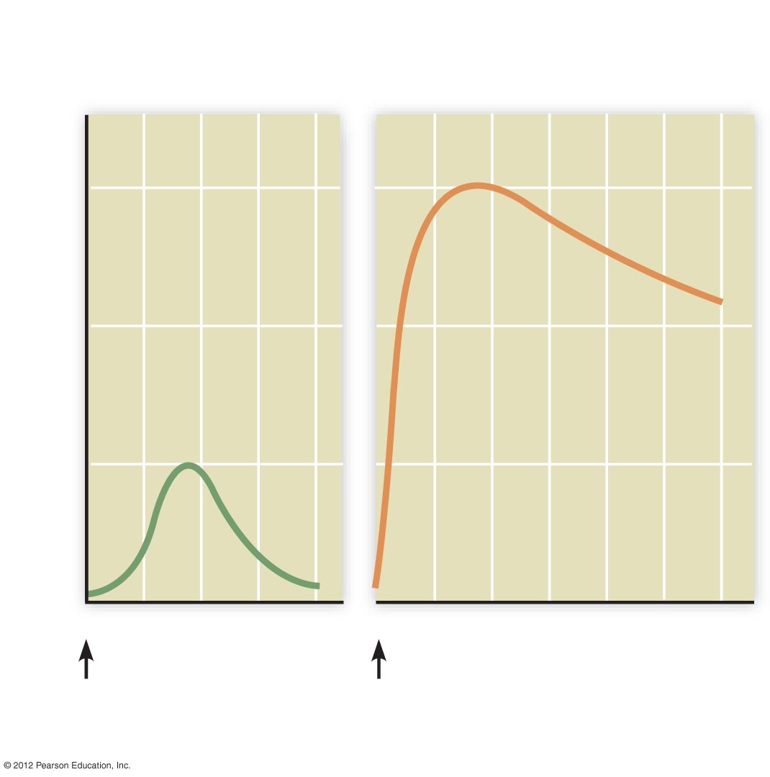
Primary immune
response
Secondary immune
response
100
10
Antibody concentration (units/ml)
1
0.1
0
7
14
21
28
0
7
14
21
28
35
42
1st exposure
2nd exposure
Time (days after exposure)

Slide 3
Medical Assistance in the War Against Pathogens: Immunization
A strategy for causing the body to develop immunity to a specific pathogen
Active immunization
  Intentionally expose individual to a form of the antigen that doesn’t produce disease
  Also known as vaccination
Passive immunization
  Administer protective antibodies to an individual

Slide 4
Medical Assistance in the War Against Pathogens: Antibiotics Combat Bacteria
Antibiotics kill bacteria or inhibit their growth
Antibiotics are selectively toxic for bacteria by targeting features of bacterial cells that are different from eukaryotic cells
Antibiotics are not effective against viruses

Slide 5
Inappropriate Immune System Activity Causes Problems: Allergies
Allergies are hypersensitivity reactions
  Inappropriate response to an allergen
Treatment of allergies
  Antihistamines – treatment of mild to moderate reactions
  Epinephrine injection – treatment of anaphylactic shock
  Allergy shots

Slide 6
Inappropriate Immune System Activity Causes Problems: Autoimmune Disorders
Inability of immune system to distinguish “self” from “nonself”
Autoantibodies and cytotoxic T cells target the body’s own tissues
Examples
  Lupus erythematosis (LE or lupus)
    Inflamed connective tissue
  Rheumatoid arthritis
    Inflamed synovial membrane

