Slide 1

Nonspecific Defenses:
Phagocytes Engulf Foreign Cells
Phagocytic cells
  white blood cells that surround and engulf invading bacteria
  Neutrophils, macrophages, eosinophils
Inflammation
  Redness, warmth, swelling, pain
Natural killer cells
  a type of lymphocyte that attacks tumor cells and virus-infected cells

Slide 2
Nonspecific Defenses:
Phagocytes Engulf Foreign Cells
Complement proteins
  lyse invading bacteria

Slide 3
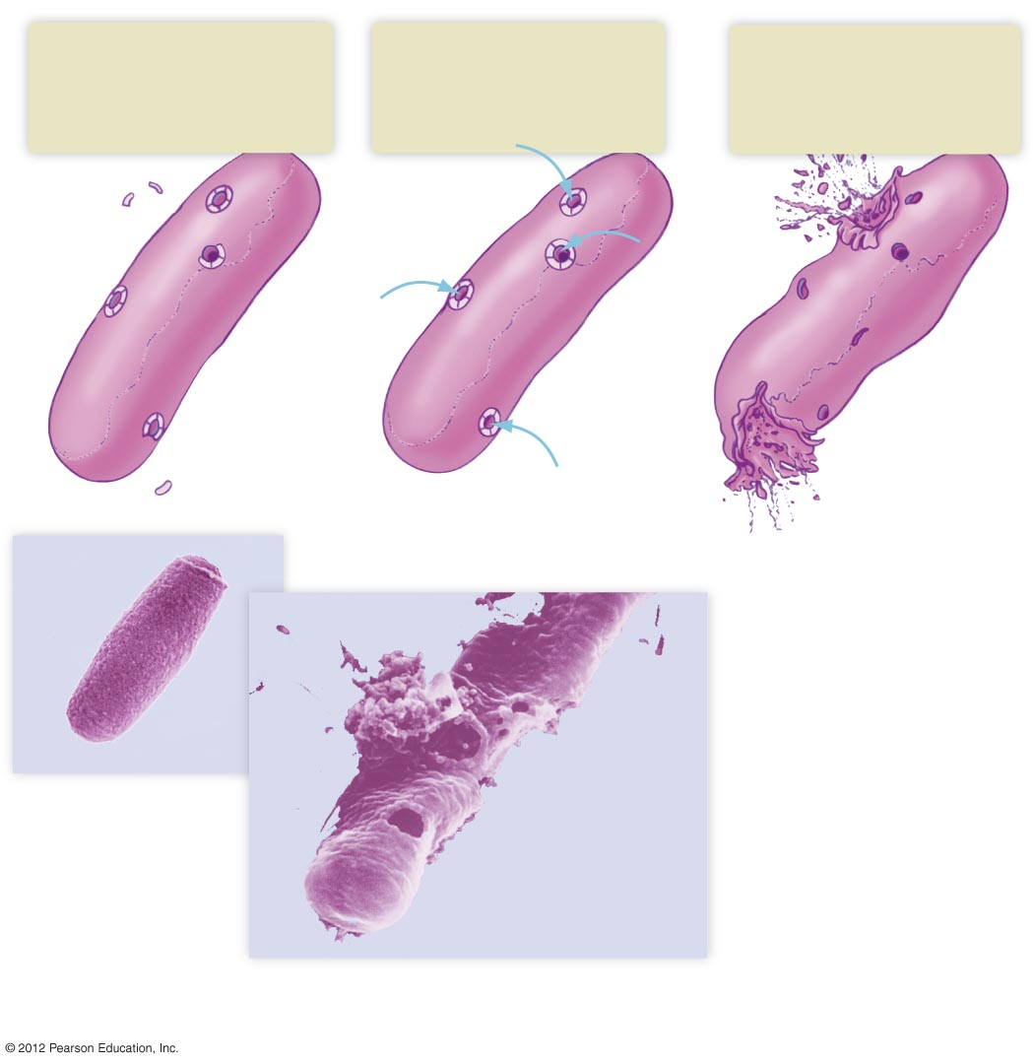
1
2
3
Activated complement
proteins form complexes of
proteins that create holes
in the bacterial cell wall.
Water and salts diffuse
into the bacterium
through the holes.
The bacterium swells
and eventually bursts.
Water
and
salts
Complement
proteins
Bacterium
Cell wall of
bacteria
Complement Proteins
Photomicrograph of
an intact bacterium
A bacterium after lysis by activated
complement proteins

Slide 4
Nonspecific Defenses:
Phagocytes Engulf Foreign Cells
Complement proteins
  lyse invading bacteria
Interferons
  antiviral proteins
Fever response

Slide 5
Specific Defense Mechanisms: Third Line of Defense (The Immune Response)
Characteristics
  Recognizes and targets specific pathogens and foreign substances
  Has “memory” – “remembers” initial exposure and responds more quickly and aggressively on subsequent exposures
Able to distinguish between
  Self cells and foreign invaders
  Healthy cells and abnormal (tumor) cells

Slide 6
Specific Defense Mechanisms:
Immune Response Targets Antigens
Antigen
  any substance that triggers an immune response
  MHC (major histocompatibility complex) proteins
    Self-antigens that are on human cell surfaces enabling recognition of “self”
    Enable immune system to distinguish “self” from “nonself”

Slide 7
Specific Defense Mechanisms: Lymphocytes Are Central to Specific Defenses
B lymphocytes
  Antibody-mediated immunity
    Antibodies: proteins made by B lymphocytes that bind with and neutralize specific antigens
  Active against viruses, bacteria, and soluble foreign molecules
  B cells activated when they recognize an antigen

Slide 8
Specific Defense Mechanisms: Lymphocytes Are Central to Specific Defenses
T lymphocytes
  Cell-mediated immunity
  Directly attack foreign cells
  Coordinate the immune response
  Active against parasites, viruses, fungi, intracellular bacteria, cancer cells, cells with “nonself” MHC

Slide 9
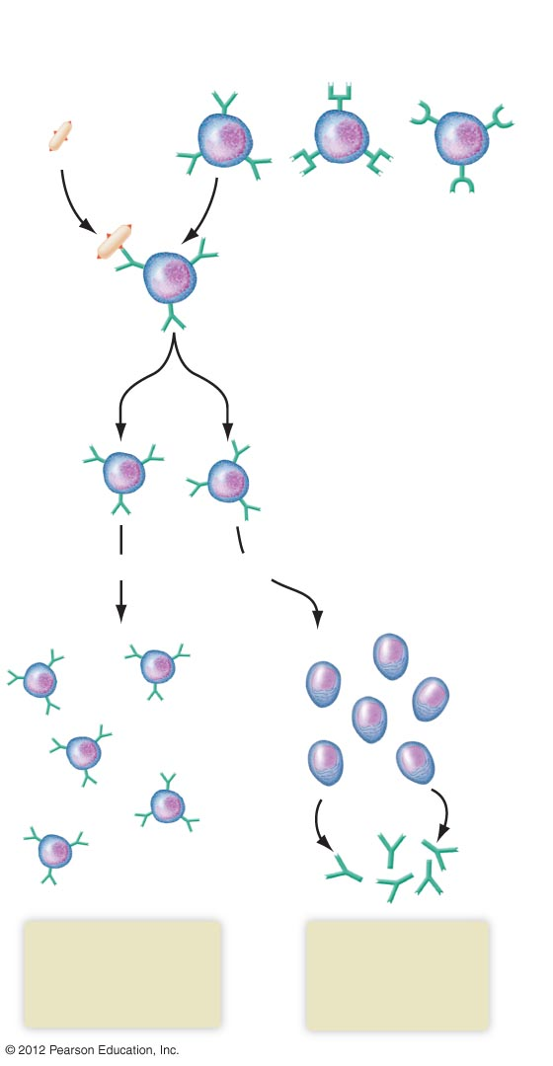
Bacterium
with surface
antigens
Mature inactive B cells specific for different
antigens, found in lymphatic tissue
Binding, activation
Clone formation
Memory cells
Plasma cells
Antibodies
Key idea
Memory cells store
information until the
next exposure to
the same antigen.
Plasma cells
secrete antibodies
into circulation.
Key idea

Slide 10
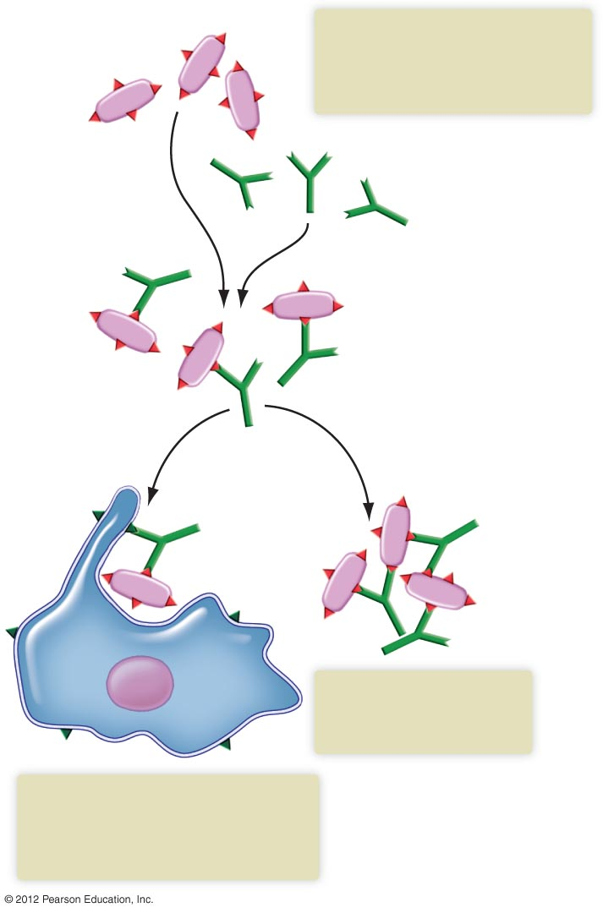
Pathogens
When antibodies encounter a
pathogen with the right surface
antigen, they bind to it, forming
an antigen-antibody complex.
Antibody
Antigen-antibody
complex
Some antibodies cause
pathogens to agglutinate
(clump together).
The formation of an antibody-
antigen complex marks the
pathogen for attack by phagocytes
or complement proteins.

Slide 11
T Cells: Cell-Mediated Immunity
Helper T cells
  Secrete cytokines, which stimulate other immune system cells
  Play a key role in directing the immune response
Cytotoxic T cells
  Directly attack and destroy abnormal (tumor or viral-infected) cells and foreign cells
Memory T cells
  Reactivate during later exposures

Slide 12
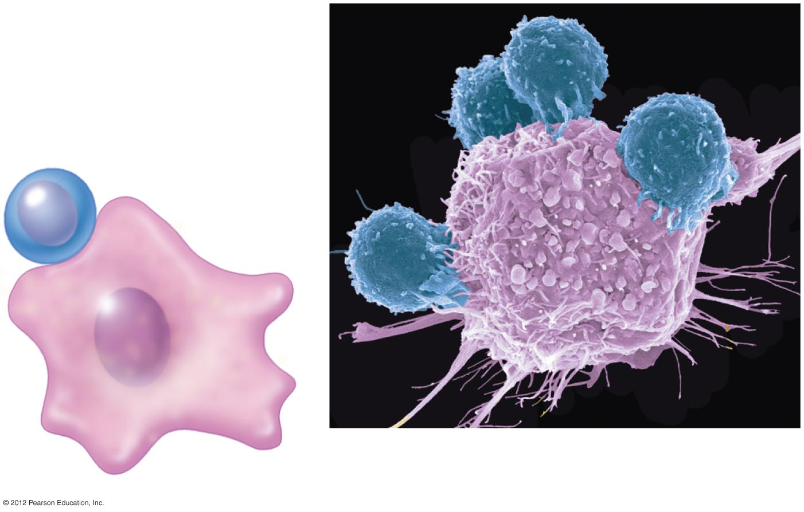
Cytotoxic T cell
Target cell
a) Cytotoxic T cells (blue) attaching
to a target cell (pink).

