Slide 1

Lymphatic System Defends the Body
Functions
  Maintenance of blood volume in cardiovascular system
  Transport of fats and fat-soluble material from digestive system
  Filtration of foreign material to defend against infection

Slide 2
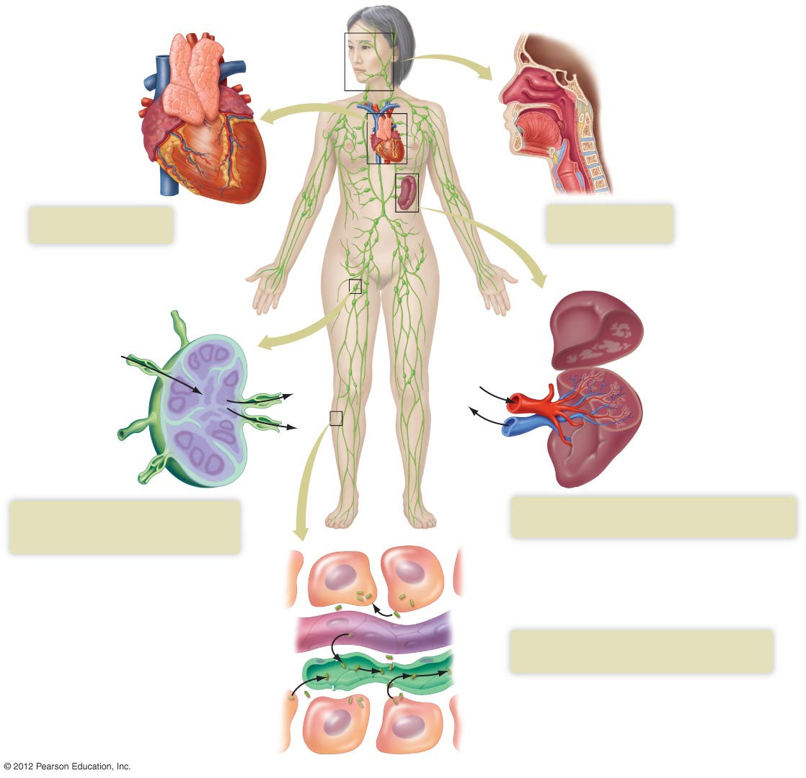
Thymus gland
Nasal passages
Adenoids
Tongue
Heart
Tonsils
Trachea
Lymphocytes
mature in thymus.
Tonsils protect
the throat.
Lymph flow
Red pulp
Lymph node
Blood
flow
White pulp
Lymph
vessels
Spleen
Macrophages cleanse lymph;
lymphocytes activate defense
mechanisms.
Spleen removes damaged blood
cells and microorganisms from blood.
Blood
capillary
Lymphatic vessels transport fluid,
bacteria, and viruses.
Lymphatic
capillary
Cells

Slide 3
Keeping Pathogens Out: The First Line of Defense
Skin, an effective deterrent
Tears and saliva – contain lysozyme (antibacterial enzyme)
Ear wax – entraps microorganisms
Mucus – entraps microorganisms
Stomach – highly acidic, inhibits microorganisms
Vagina – slightly acidic, inhibits some microorganisms
Vomiting, urination, and defecation – remove microorganisms
Resident bacteria – outcompete pathogens

Slide 4
Nonspecific Defenses:
Phagocytes Engulf Foreign Cells
Phagocytic cells
  white blood cells that surround and engulf invading bacteria
  Neutrophils, macrophages, eosinophils

Slide 5
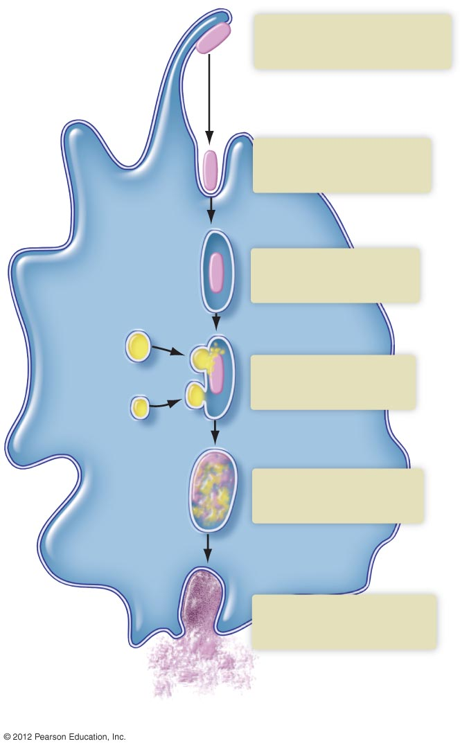
Phagocytes Engulf Foreign Cells
1
Phagocyte approaches
and captures bacterium.
2
Phagocyte surrounds
bacterium.
Bacterium
Vesicle
3
Bacterium becomes
enclosed in vesicle.
Lysosome
4
Vesicle fuses with
lysosomes.
5
Lysosomal enzymes
digest bacterium.
Cytoplasm
of phagocyte
6
Wastes and debris are
discarded.
b) Steps in the process.

Slide 6
Nonspecific Defenses:
Phagocytes Engulf Foreign Cells
Phagocytic cells
  white blood cells that surround and engulf invading bacteria
  Neutrophils, macrophages, eosinophils
Inflammation
  Redness, warmth, swelling, pain

Slide 7
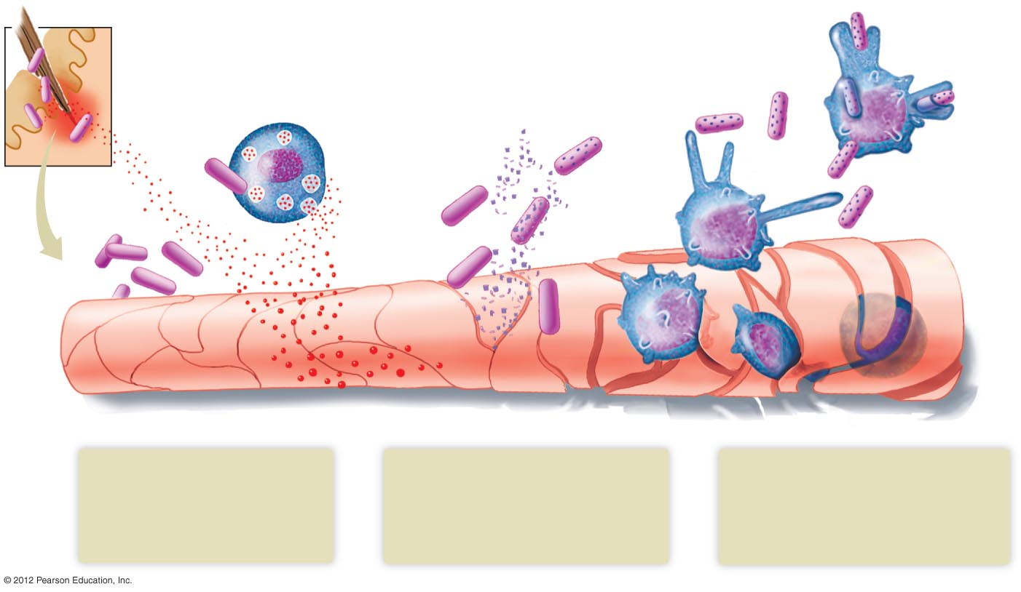
Inflammation Response
Site of injury
Phagocyte
Mast cell
Complement
protein
Bacteria
Histamine
1
2
3
Damaged cells and mast cells
in the area release histamine
and other substances.
Histamine dilates blood
vessels and makes them leaky.
Complement proteins from plasma
diffuse out of leaky capillaries.
They mark the bacteria for
destruction and sometimes kill
them.
Attracted by histamine and
other chemicals, phagocytes
squeeze through the leaky
capillary walls and begin attacking
and engulfing bacteria and debris.

