Slide 1
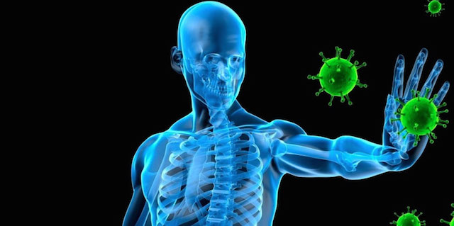

The Immune System and Defenses

Slide 2
Overview of the Body’s Defense Mechanisms
Defense mechanisms include
  Barriers to entry of pathogens
    (Pathogens = disease-producing microorganisms)
    Skin, stomach acid, tears, vomiting
  Nonspecific defense mechanisms
    Phagocytosis, inflammation
  Specific defense mechanisms
    Immune response
      antibodies
      T cells

Slide 3
Pathogens Cause Disease
Disease-causing agents include
  Living organisms
    Bacteria
      unicellular prokaryotes
    Fungi
      unicellular and multicellular eukaryotes
    Parasites
      unicellular and multicellular eukaryotes
  Nonliving infectious “particles”
    Viruses
    Prions

Slide 4
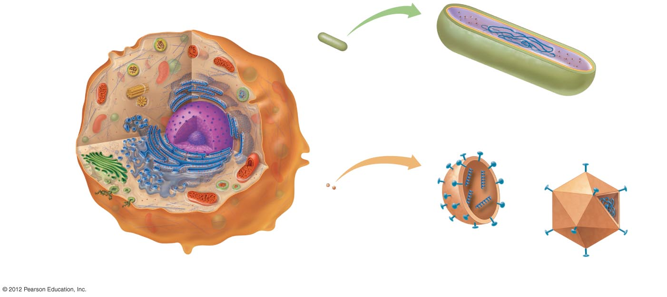
Ribosomes
DNA
Cell wall
Relative size
of a bacterium
Plasma
membrane
Mitochondrion
b) Bacterial cell. Bacteria have a single strand of DNA
and free-floating small ribosomes within their
cytoplasm. Their plasma membrane is surrounded by
a rigid cell wall.
Nucleus
Golgi
apparatus
RNA
Plasma
membrane
Relative size
of a virus
DNA
Endoplasmic
reticulum
Protein
coat
a) Eukaryotic cell. Eukaryotic cells have a membrane-bound
nucleus and well-defined membrane-bound organelles.
c) Viruses. Viruses consist of a protein coat
surrounding either RNA or DNA.

Slide 5
Bacteria: Single-celled Living Organisms
Characteristics
  Prokaryotic
  Single-celled
  Use a variety of resources for growth and reproduction
Infections
  Pneumonia, tonsillitis, tuberculosis, botulism, toxic shock syndrome, syphilis, Lyme disease, etc.
Generally treated with antibiotics

Slide 6
Viruses: Tiny Infectious Agents
Extremely small, much smaller than bacteria
Living? Open to debate
  Unable to reproduce outside of a host cell
  No metabolic activity
Structure
  Contain DNA or RNA, not both
  DNA/RNA is surrounded by a protein coat
Diseases
  AIDS, hepatitis, encephalitis, rabies, influenza, colds, warts, chicken pox

Slide 7
Prions: Infectious Proteins
Infectious proteins
Normal brain proteins that are not folded correctly
  The mis-folding becomes self-propagating, filling and disabling the cell with protein debris
Resist cooking, freezing, drying
Diseases
  Bovine spongiform encephalitis (BSE, “mad cow disease”)
  Creutzfeldt-Jakob disease (CJD)

Slide 8
Transmissibility, Mode of Transmission, and Virulence Determine Health Risk
Transmissibility
  How easily a pathogen is passed from person to person
Mode of transmission
  Respiratory, fecal–oral, body fluids
Virulence
  How much damage is caused by the infection

