Slide 1

Cardiovascular Disorders
Angina pectoris
  narrowed coronary arteries impair blood flow
Congestive heart failure
  decrease in pumping efficiency
Embolism
  blockage of blood vessels
Stroke
  impaired blood flow to the brain

Slide 2
Heart Attack
Also known as myocardial infarction
  Permanent damage to myocardium
Symptoms
  Intense chest pain, nausea, heaviness in the chest, difficulty breathing, pain radiating to left arm, jaw, back, upper abdomen
Diagnosis
  EKG
  Blood test for cardiac enzymes
Prevention/Treatment
  Clot-busting medications
  CABG

Slide 3
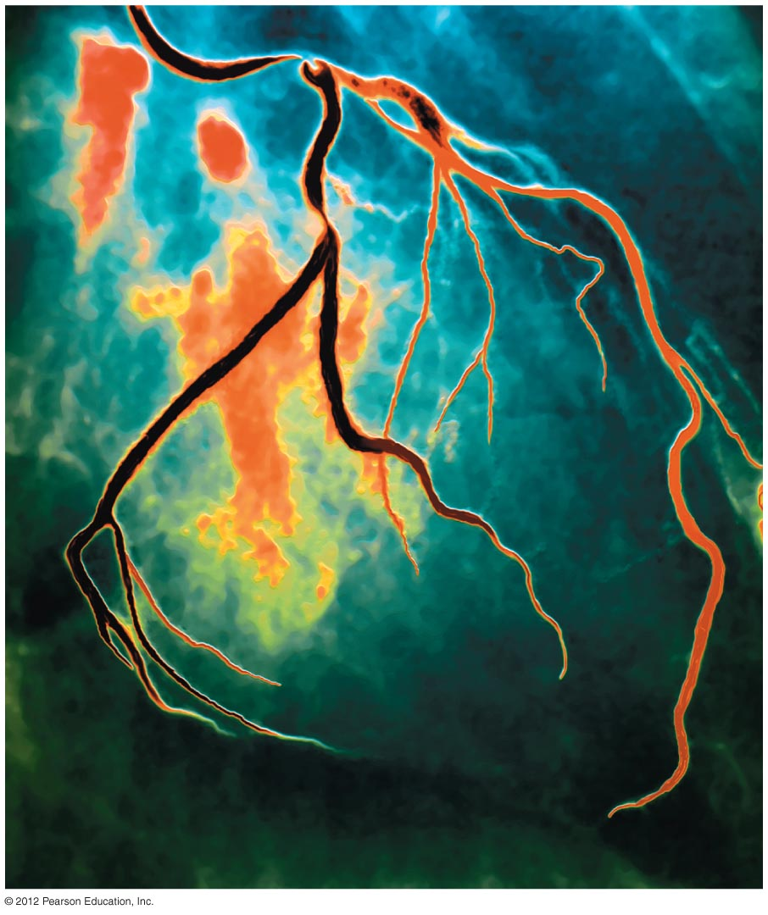
Coronary Angiogram

Slide 4
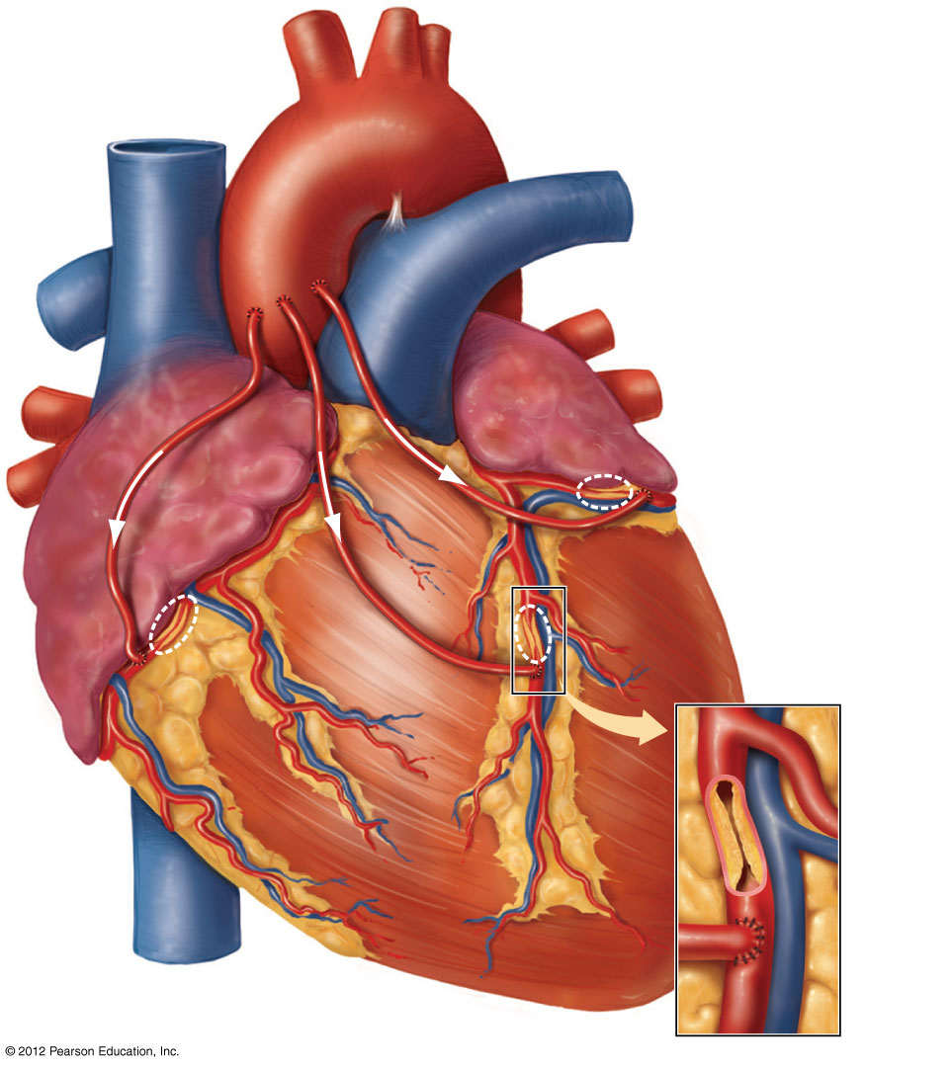
Aorta
Vein
grafts
Plaque
blocking
blood flow

Slide 5
Reducing the Risk of Cardiovascular Disease
Smoking – don’t (see link in learning module)
Blood lipids – monitor cholesterol levels
Exercise – regular and moderate
Blood pressure – treat hypertension

Slide 6
Reducing the Risk of Cardiovascular Disease
Weight – being overweight increases risk of heart attack and stroke
Control of diabetes mellitus – early diagnosis and treatment delays onset of related problems
Stress – avoid chronic stress

