Slide 1

Blood Pressure
The force that the blood exerts on the wall of the blood vessels
  Systolic pressure – highest pressure, as blood is ejected during ventricular systole
  Diastolic pressure – lowest pressure, during ventricular diastole
Measurement
  Sphygmomanometer – measures pressure
  “Normal” readings
    Systolic pressure <120 mmHg
    Diastolic pressure <80 mmHg

Slide 2
Blood Pressure (cont.)
Hypertension: high blood pressure
  The silent killer
Hypotension: blood pressure too low
  Clinical signs – dizziness, fainting
  Causes of hypotension – orthostatic, severe burns, blood loss

Slide 3
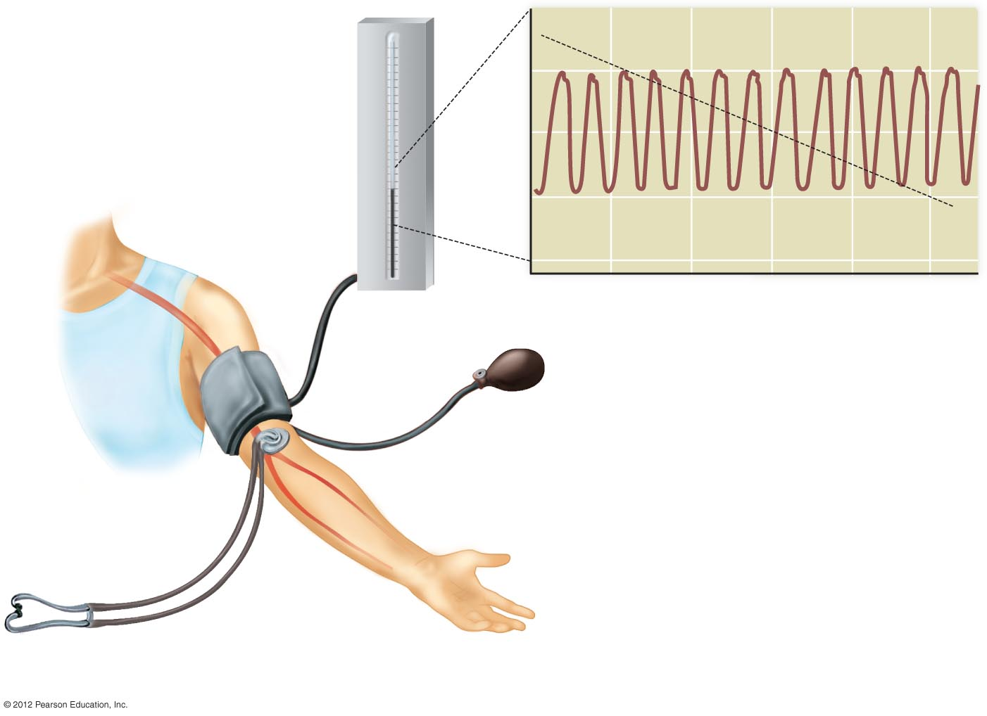
140
Cuff pressure
Blood pressure
300
1
280
120
260
240
220
200
100
Column of mercury
indicating pressure
in mm Hg
180
160
Blood presure (mm Hg)
140
120
100
80
2
80
60
40
20
60
0
0
2
4
6
8
10
Sphygmomanometer:
Time (seconds)
Squeezable bulb
b) A schematic representation of the pulses of arterial
blood pressure superimposed over the steadily
declining cuff pressure. Systolic pressure is recorded
at cuff pressure 1 when sounds are first heard. Diastolic
pressure is recorded at cuff pressure 2 when sounds
cease.
Inflatable
rubber cuff
Air valve
Artery
Stethoscope
a) A clinician inflates the cuff with air and then allows the pressure in the
cuff to fall gradually while using a stethoscope to listen for the sounds
of blood movement through the artery.

