Slide 1

Cardiac Cycle – The heart contracts and relaxes
Atrial systole
  Both atria contract
  AV valves open, semilunar valves are closed
  Ventricles fill
Ventricular systole
  Both ventricles contract
  AV valves close, semilunar valves open
Diastole
  Both atria and ventricles relax
  Semilunar valves close

Slide 2
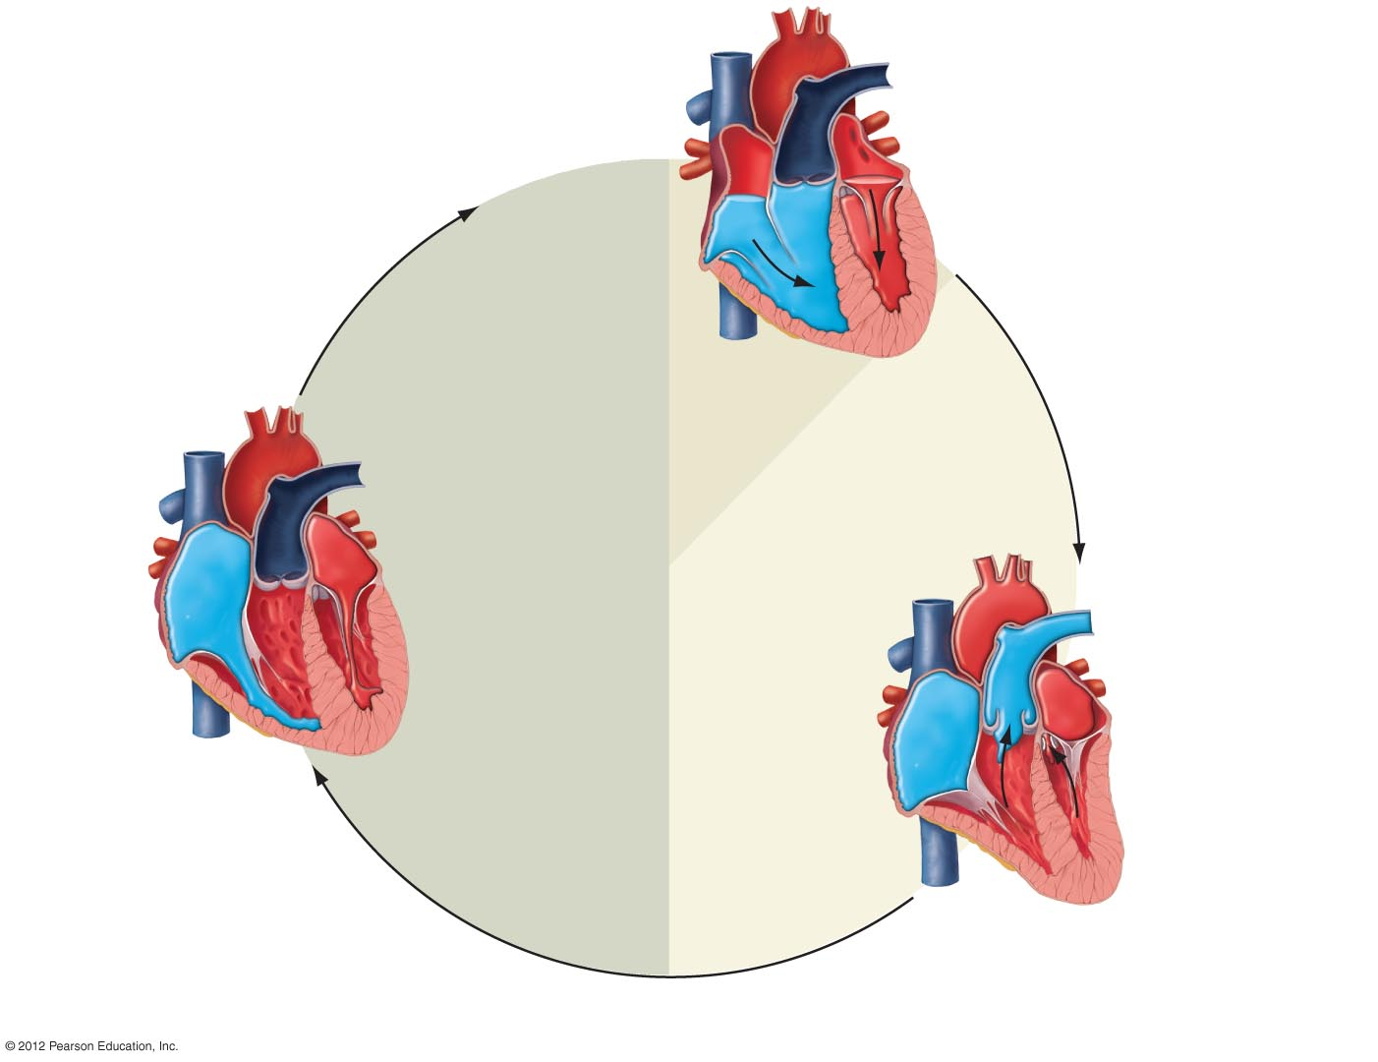
Right atrium
Left atrium
Pulmonary
semilunar valve
Aortic semilunar valve
Left AV valve
Right AV valve
Left ventricle
Right ventricle
a) Atrial systole. Both atria contract,
forcing blood into the ventricles.
The AV valves are open, and the
semilunar valves are closed.
0.1 second
Diastole
Systole
0.4 second
Aorta
Pulmonary trunk
0.3 second
c) Diastole. The ventricles relax
and begin to fill passively with
blood through the open AV valves.
The semilunar valves are closed,
and the atria remain relaxed.
b) Ventricular systole. Both ventricles
contract, causing the AV valves to close
and the semilunar valves to open. Blood
is ejected into the pulmonary trunk and
aorta. The atria relax.

Slide 3
Heart Sounds and Heart Valves
Lub-dub heart sound
  Lub: closing of both AV valves during ventricular systole
  Dub: closing of both semilunar valves during ventricular diastole
Heart murmurs
  Caused when blood flow is disturbed
  May be a sign of a defective valve

Slide 4
Cardiac Conduction System Coordinates Contraction
SA node
  Cardiac pacemaker
  Initiates the heartbeat
  Pace can be modified by nervous system
AV node
  Relays impulse
AV bundle and Purkinje fibers
  Carry impulse to ventricles

Slide 5
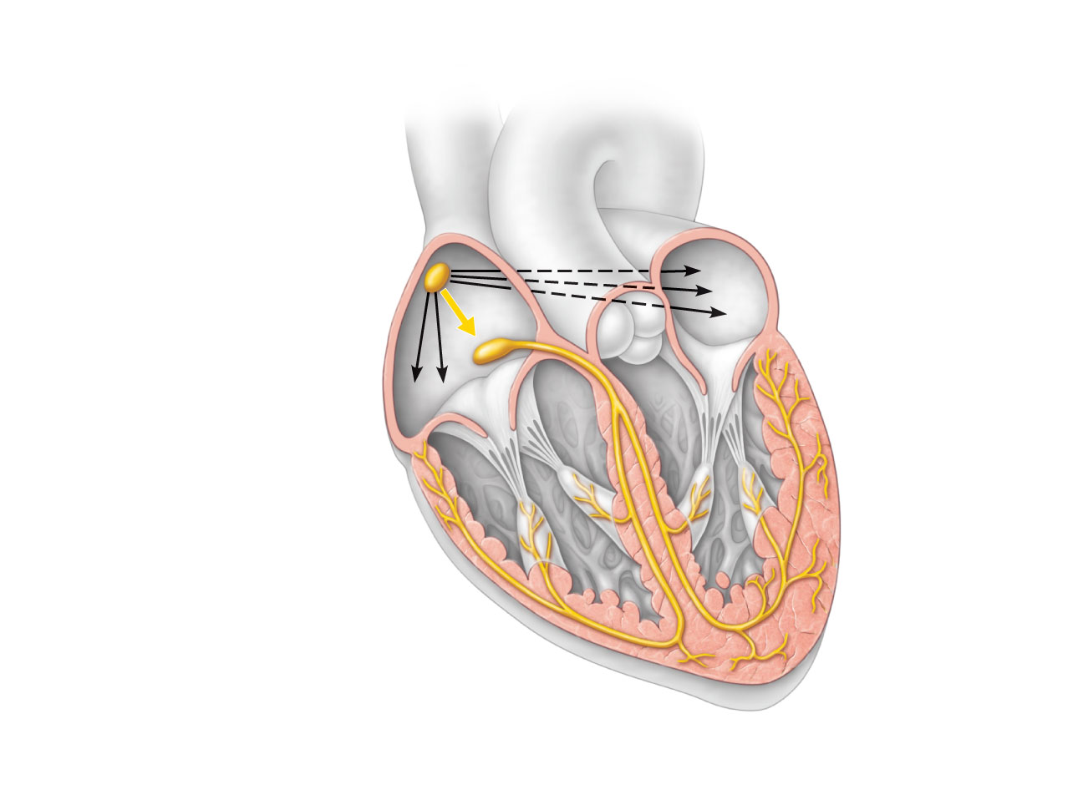
Superior vena cava
Right atrium
The sinoatrial (SA)
node (pacemaker)
generates impulses.
1
Internodal pathway
2
Left atrium
The impulses
pause (0.1 s) at the
atrioventricular
(AV) node.
The atrioventricular
(AV) bundle
connects the atria
to the ventricles.
Purkinje
fibers
3
The bundle branches
conduct the impulses
through the
interventricular septum.
4
Inter-
ventricular
septum
The Purkinje fibers
depolarize the contractile
cells of both ventricles.
5
Anatomy of the intrinsic conduction system showing the sequence of electrical excitation

Slide 6
Electrocardiogram (EKG/ECG)
Tracks the electrical activity of the heart
A healthy heart produces a characteristic pattern
Three formations
  P wave: impulse across atria
  QRS complex: spread of impulse down septum, around ventricles in Purkinje fibers
  T wave: end of electrical activity in ventricles
EKGs can detect
  Arrhythmias
  Ventricular fibrillation

Slide 7
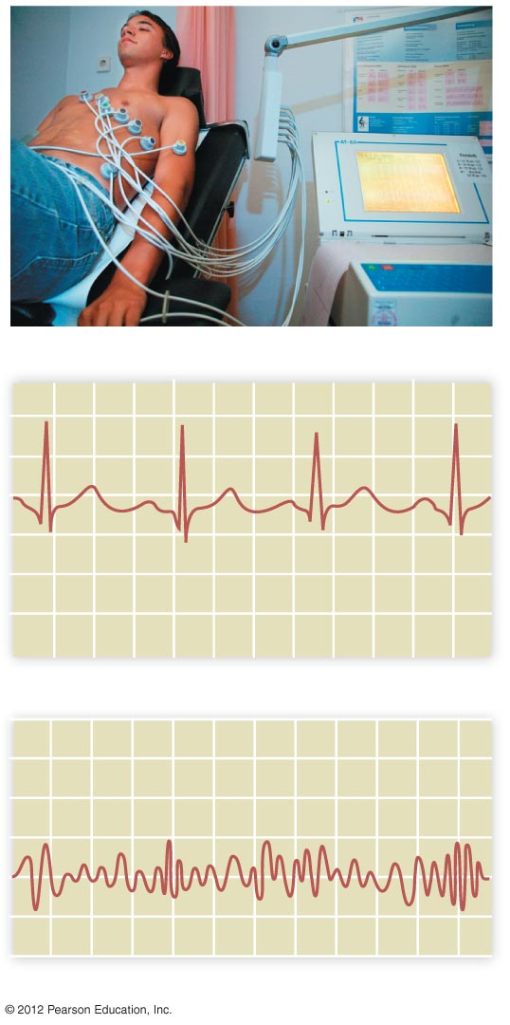
a) An ECG being recorded.
R
P
T
Q
S
b) A normal ECG recording.
c) Ventricular fibrillation.

