Slide 1
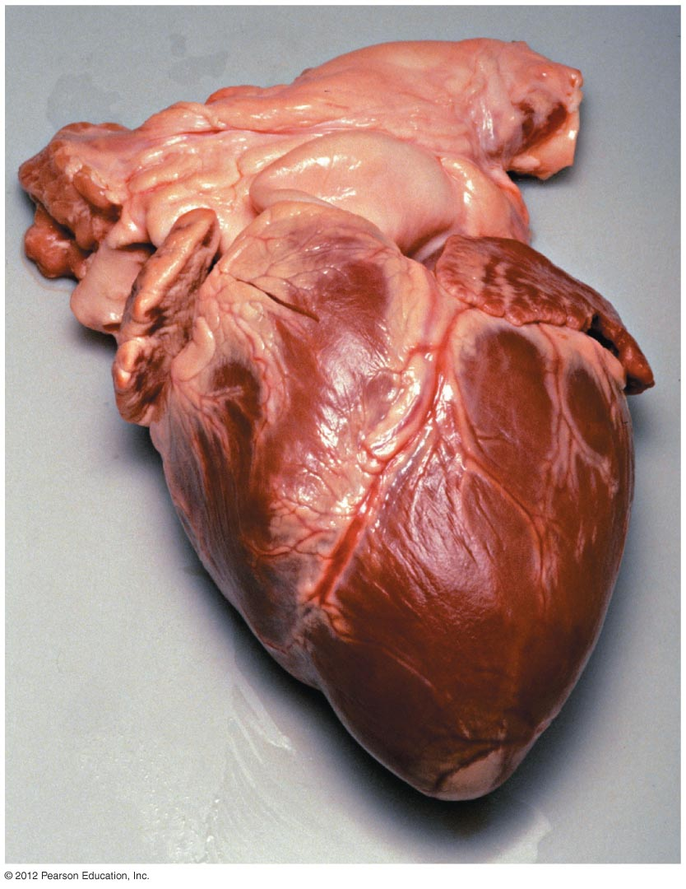


Slide 2
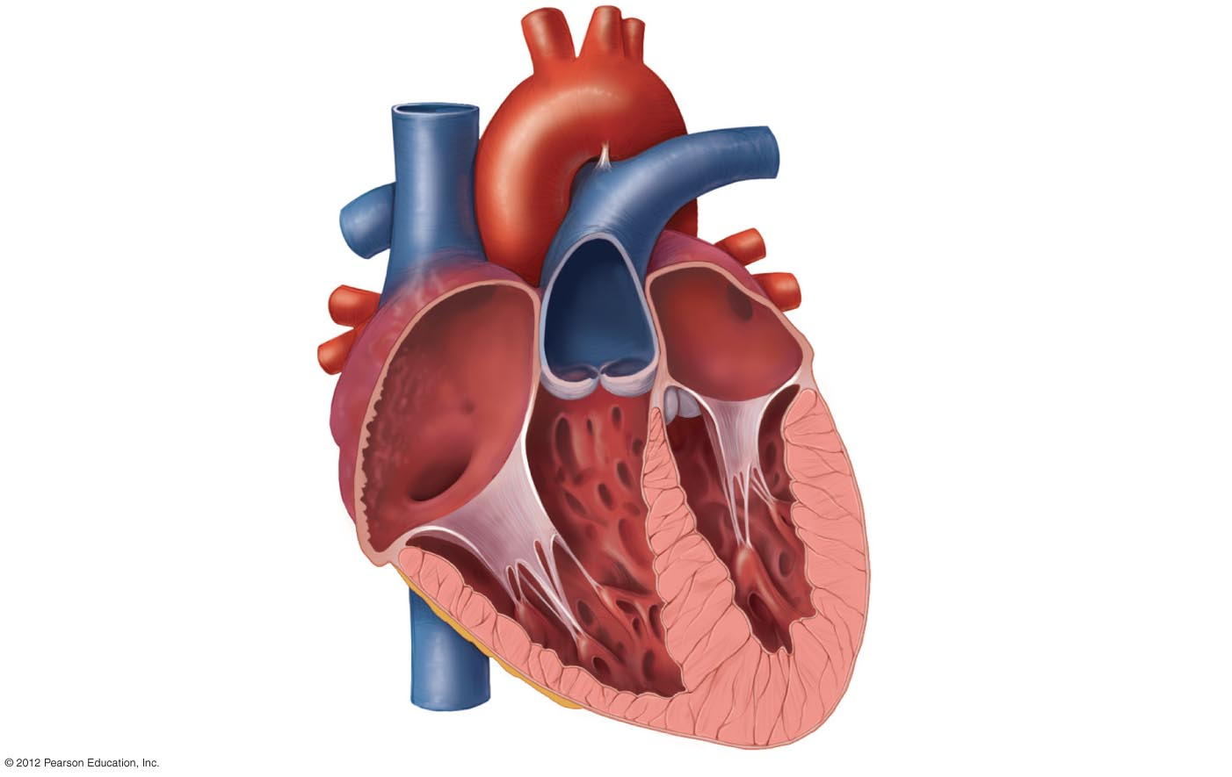
Aorta
Superior vena cava
Left pulmonary artery
Right pulmonary artery
Pulmonary trunk
Left pulmonary veins
Left atrium
Pulmonary semilunar
valve
Aortic semilunar valve
Right atrium
Left atrioventricular
(AV) valve
Right atrioventricular
(AV) valve
Left ventricle
Chordae tendineae
Right ventricle
Papillary muscles
Interventricular Septum
Epicardium
Inferior vena cava
Myocardium
Endocardium

Slide 3
The Heart - Layers
Surrounded by fibrous sac
  pericardium
Layers of the heart
  Epicardium
    thin layer of epithelial and connective tissue
  Myocardium
    thick layer of cardiac muscle
  Endocardium
    thin layer of endothelial tissue

Slide 4
The Heart – Chambers and Valves
Four chambers
  Two atria
  Two ventricles
Valves – prevent backflow
  Two atrioventricular valves
    Tricuspid valve
    Bicuspid (mitral) valve
  Two semilunar valves
    Pulmonary valve
    Aortic valve

Slide 5
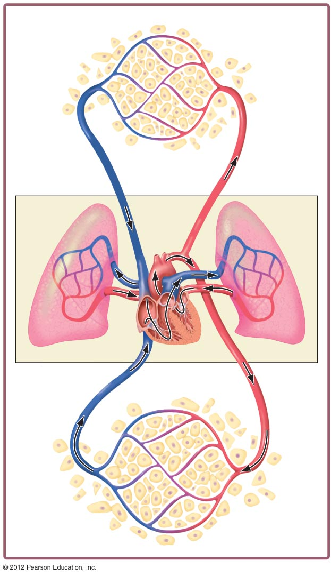
Two Circuits
Systemic Circuit
Head and
upper limbs
Lung
capillaries
Pulmonary
Circuit
Lung
capillaries
Heart
Aorta
Torso and
lower limbs

Slide 6
Pulmonary Circuit – Oxygenation of Blood
    1. Deoxygenated blood from the body travels through the vena cava to the right atrium
    2. Through the right atrioventricular valve to the right ventricle
    3. Through the pulmonary semilunar valve to the pulmonary trunk and the lungs
    4. Blood is oxygenated within pulmonary capillaries
    5. Oxygenated blood travels through the pulmonary veins to the left atrium
    6. Through the left atrioventricular valve to the left ventricle

Slide 7
Systemic Circuit – Delivery of Oxygenated Blood to Tissues
  Oxygenated blood travels from the left ventricle through the aortic semilunar valve to the aorta
  Through branching arteries and arterioles to tissues
  Through the arterioles to capillaries
  From capillaries into venules and veins
  To the vena cava and into the right atrium

Slide 8
