Slide 1
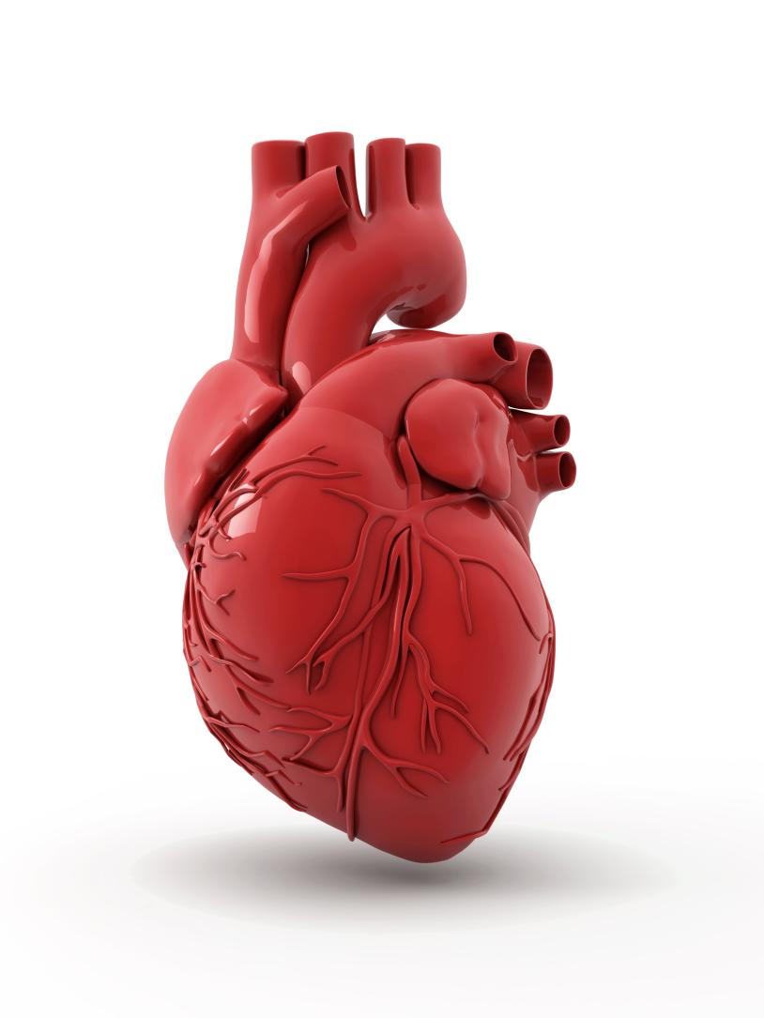

Heart and Blood Vessels

Slide 2
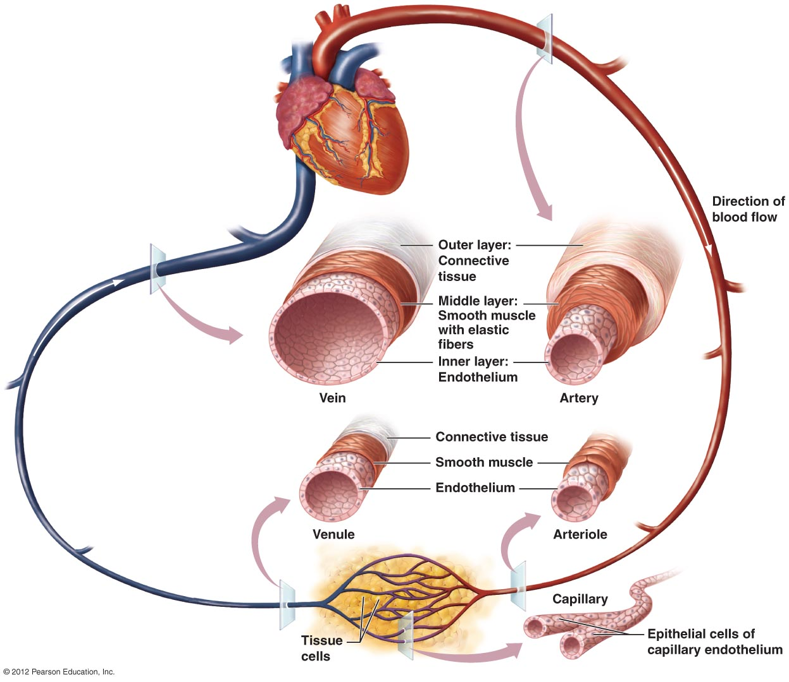
Blood Vessels Transport Blood

Slide 3
Three Types of Blood Vessels Transport Blood
Arteries
  Carry blood away from the heart
  Transport blood under high pressure
Capillaries
  Exchange solutes and water with cells of the body
Veins
  Return blood to the heart

Slide 4
Arteries
Structure
  Thick-walled, three layers
    Innermost layer: endothelium
    Middle layer: smooth muscle
    Outer layer: connective tissue
Function
  Arteries carry blood away from heart
  Carry blood under pressure
  Usually (NOT always) oxygen rich

Slide 5
Arterioles and Precapillary Sphincters
  Arterioles: smallest arteries
  Precapillary sphincters: control blood flow into capillaries
    Vasodilation: increases blood flow to capillaries
    Vasoconstriction: decreases blood flow to capillaries

Slide 6
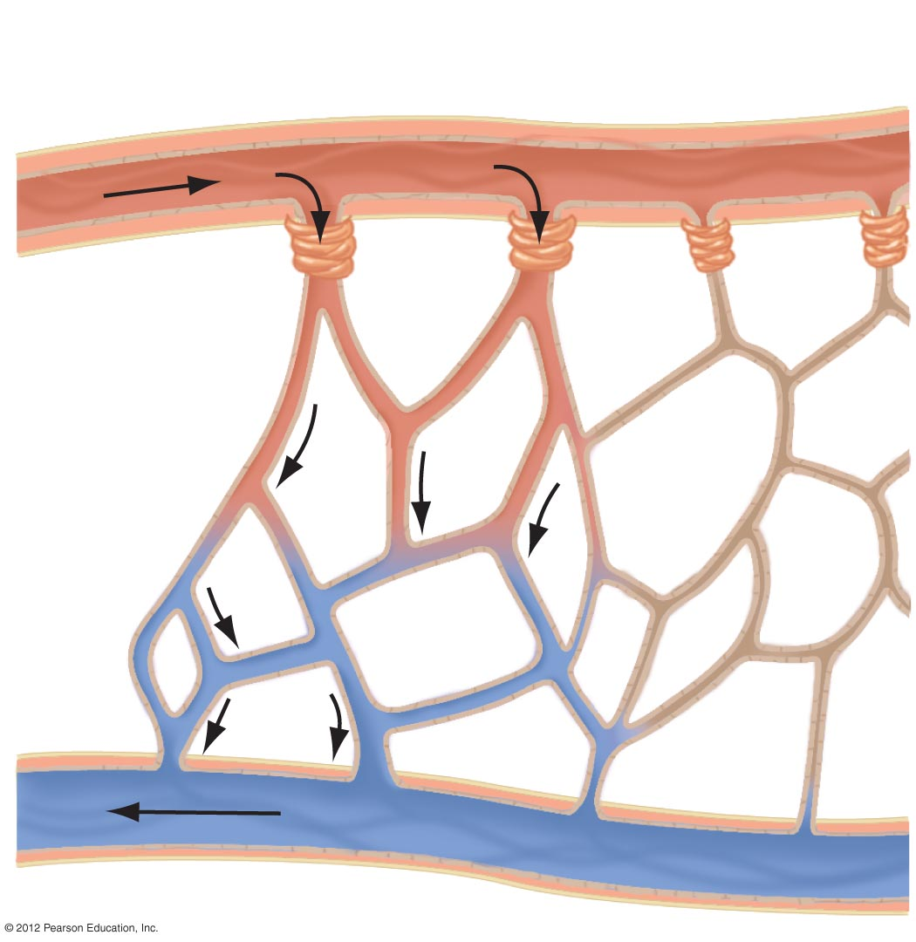
Relaxed
precapillary
sphincters
Constricted
precapillary
sphincters
Arteriole
Capillaries
Small vein (venule)

Slide 7
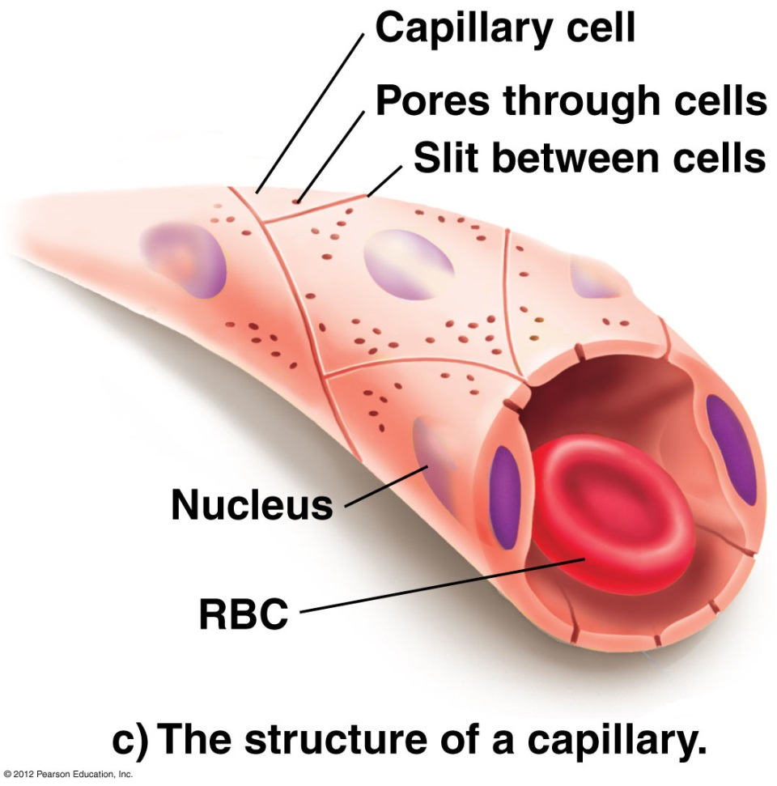
Capillaries
Structure
  Smallest blood vessels
  Thin-walled: one cell-layer thick
  Porous

Slide 8
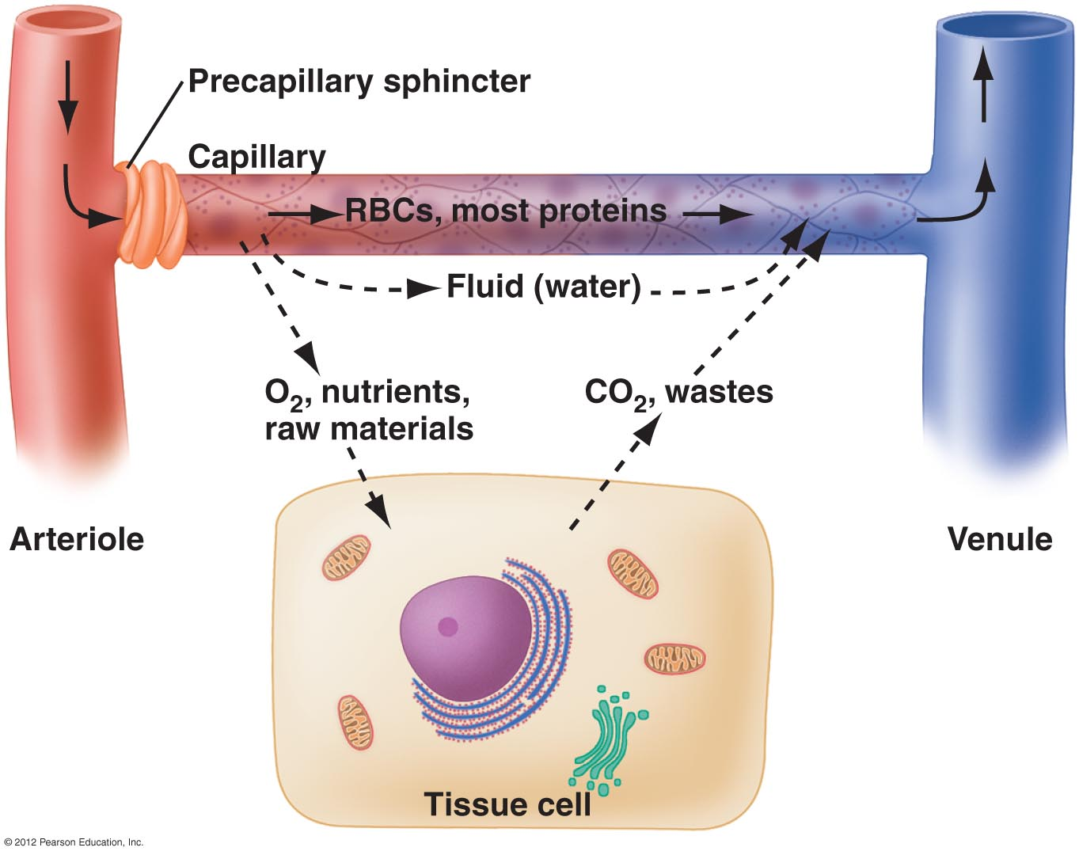
Capillaries
Capillary beds
  extensive networks of capillaries
Function
  selective exchange of substances with the interstitial fluid (fluid around cells)

Slide 9
Veins
Structure
  Three layers, thin-walled
  Larger lumen than arteries
  High distensibility (stretch)
Functions
  Carry blood toward the heart
  Serve as blood volume reservoir

Slide 10
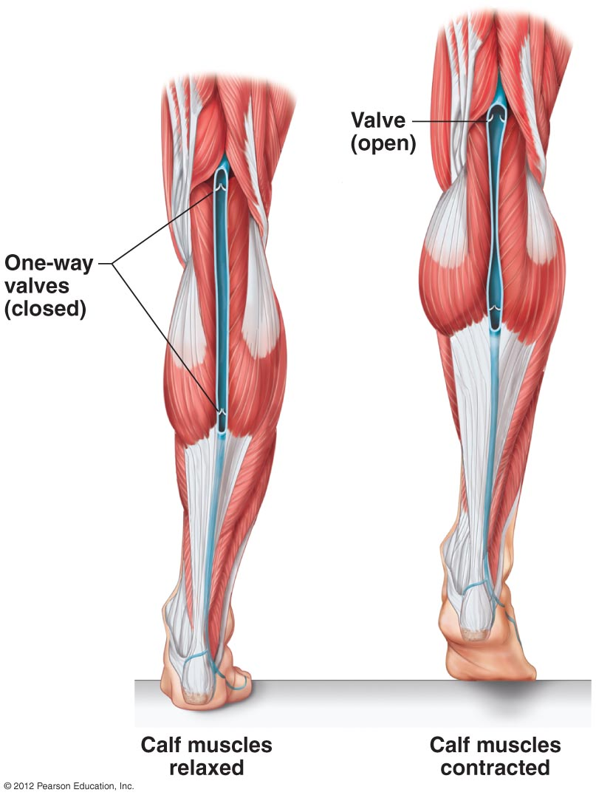
Three Mechanisms Assist Venous Return to the Heart
Mechanisms in blood return
  Contraction of skeletal muscles
  One-way valves
  Pressure changes associated with breathing

