Slide 1

Blood Typing Concepts
Antigen vs. antibody
  A and B antigens
    surface markers on red blood cells
  Antibodies
    immune system protein, detects antigens
ABO system
Rh system
  Give + / - blood

Slide 2
Blood Typing
A
A⁻
O
B⁻
AB
O⁻
B
AB⁺
Antigen: A B A & B none
Antibody: B A none A & B

Slide 3
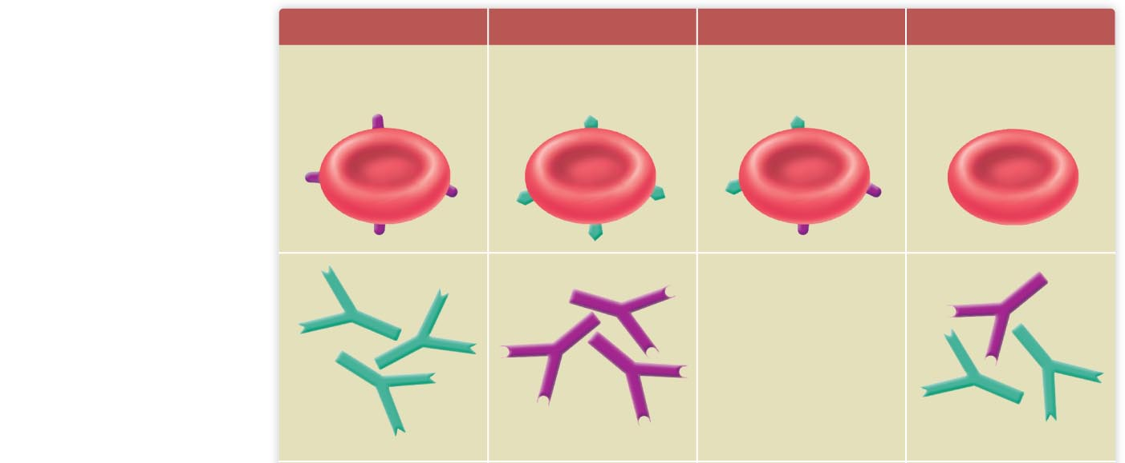
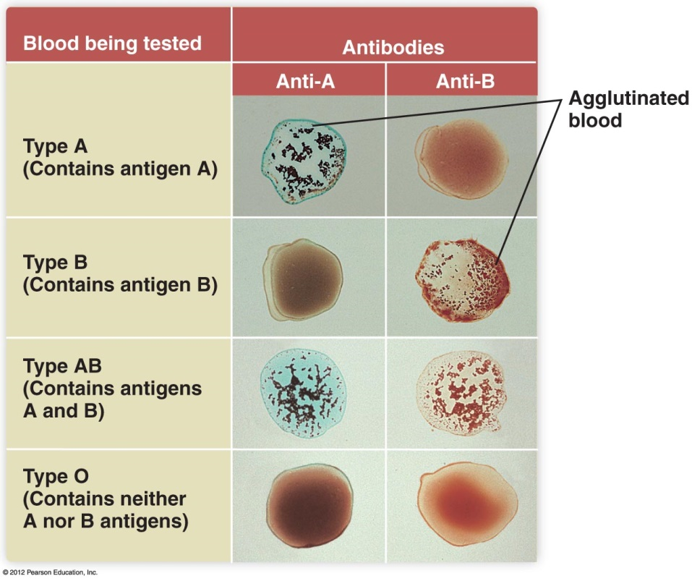
Type A
Type B
Type AB
Type O
Antigen A
Antigen B
Antigens A and B
Neither A nor
B antigens
Red blood cells
Plasma antibodies
B
A
Neither A nor B
A and B

Slide 4
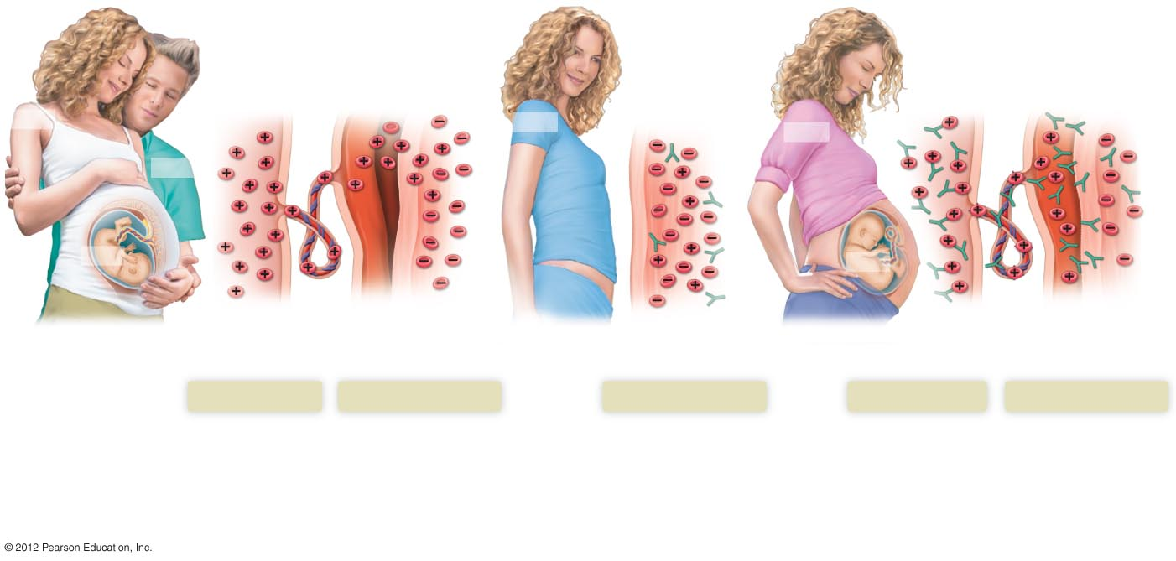
Hemolytic Disease of the Newborn
Placenta separating
from uterus
Anti-Rh
antibodies
Anti-Rh antibodies
Anti-Rh
antibodies
Placenta
Umbilical cord
Uterus
RH–
RH–
RH–
RH⁺
RH⁺
RH⁺
Fetal red blood
cells (Rh⁺)
Maternal red blood
cells (Rh–)
Blood flow after
pregnancy
Fetal circulation
Maternal circulation
Maternal circulation
Fetal circulation
Maternal circulation
When an Rh positive
man fathers a child by
an Rh negative woman,
the fetus may inherit
the Rh positive antigen.
During pregnancy or more
commonly at childbirth, a
small amount of fetal blood
enters the mother’s
circulation.
Over the next several weeks the
woman develops antibodies
and an immune memory against
the Rh antigen.
When the woman becomes pregnant
with her second Rh positive child, her
immune system quickly produces
antibodies that attack the fetus’ red
blood cells.

Slide 5
Blood Disorders – Red Blood Cells
Anemia
  reduction in oxygen-carrying capacity due to inadequate number of red blood cells or inadequate hemoglobin
    Iron-deficiency anemia: caused by inadequate intake or malabsorption of dietary iron
    Hemorrhagic anemia: caused by blood loss
    Pernicious anemia: caused by Vitamin B12 deficiency
    Hemolytic anemia: caused by destruction of red blood cells

Slide 6
Blood Disorders – White Blood Cells
Leukemia
  Forms of cancer due to proliferation of white blood cells
Mononucleosis
  Contagious Epstein-Barr virus infection of lymphocytes

Slide 7
Blood Disorders
Septicemia (blood poisoning)
  Bacteria proliferating in blood, overwhelming body’s defenses
Thrombocytopenia
  Reduction in platelet number
  Unusual bruising and bleeding

