Slide 1

Platelets
Small cell fragments derived from megakaryocytes
Important role in hemostasis (blood clotting)

Slide 2
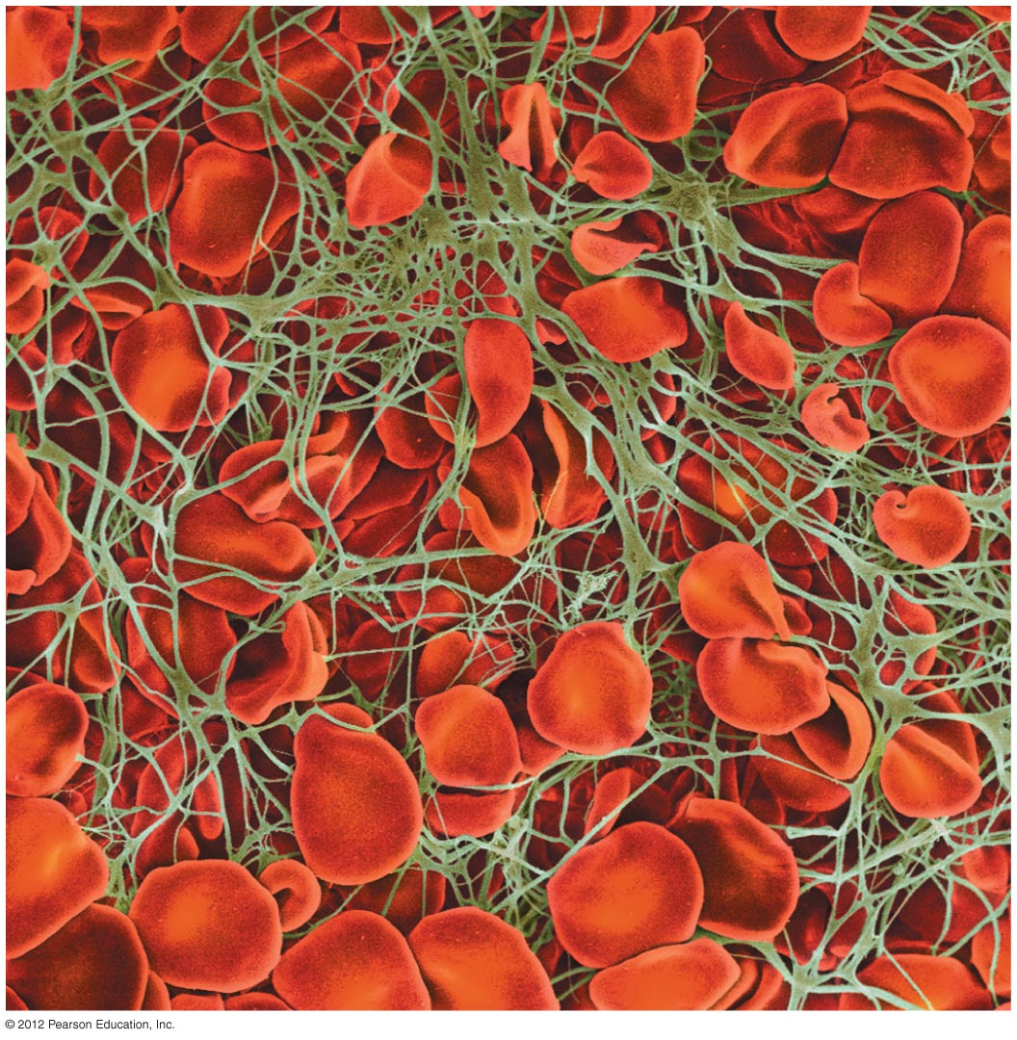
Hemostasis
Three stages
  Vascular spasm
    constriction of blood vessels to reduce blood flow
  Platelet plug formation
    sealing of the ruptured blood vessel
  Coagulation
    formation of a blood clot through series of reactions

Slide 3
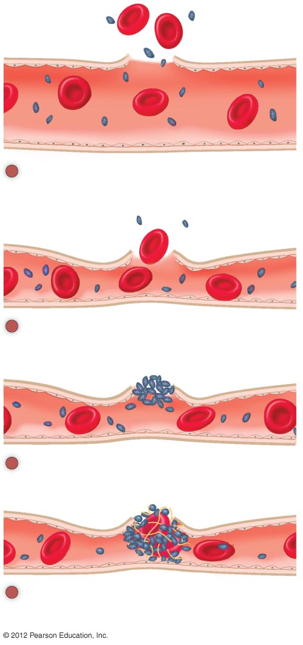
Red blood cell
1
Vessel injury. Damage to a blood vessel
exposes the vessel muscle layers and the
tissues to blood.
2
Vascular spasm. The blood vessel
contracts, reducing blood flow.
Platelets
3
Platelet plug formation. Platelets adhere
to each other and to the damaged vessel.
Fibrin strands
4
Clot formation. Soluble fibrinogen forms
an insoluble mesh of fibrin, trapping RBCs
and platelets.

Slide 4
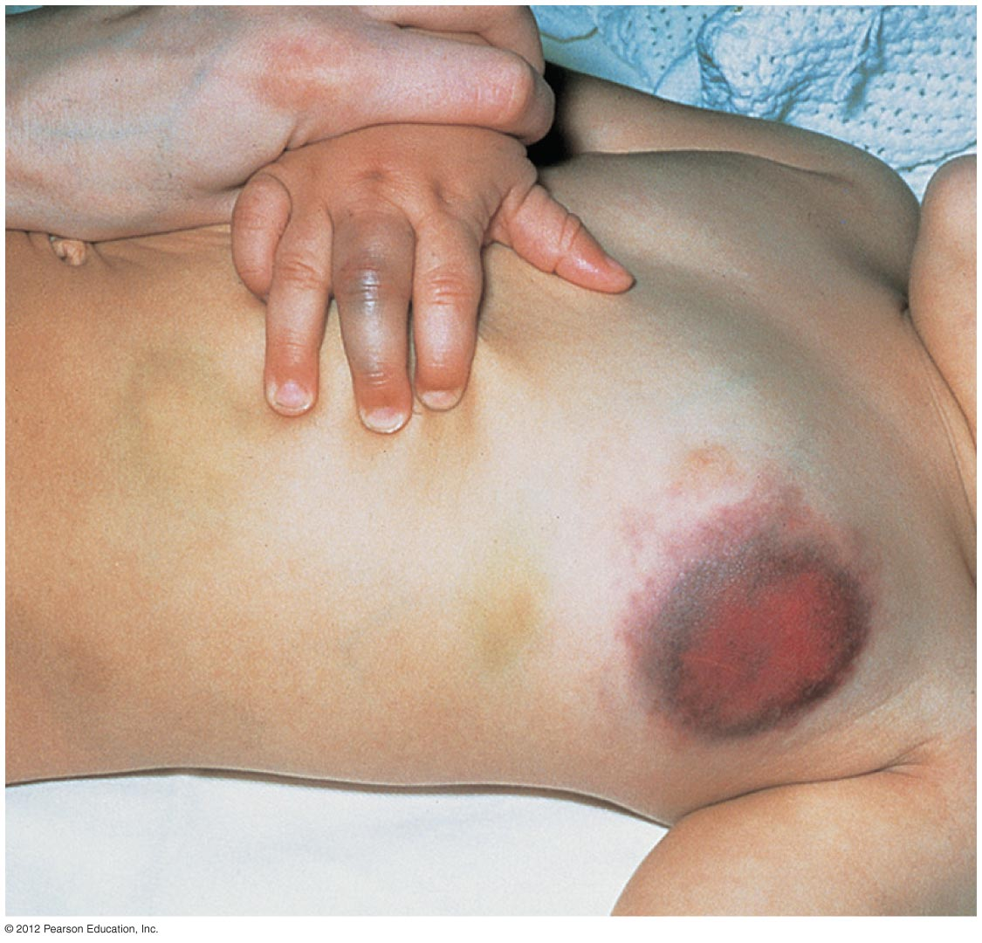
Bleeding Disorder
Hemophilia
  Genetic disorder
  Missing one or more of clotting factors

