Slide 1
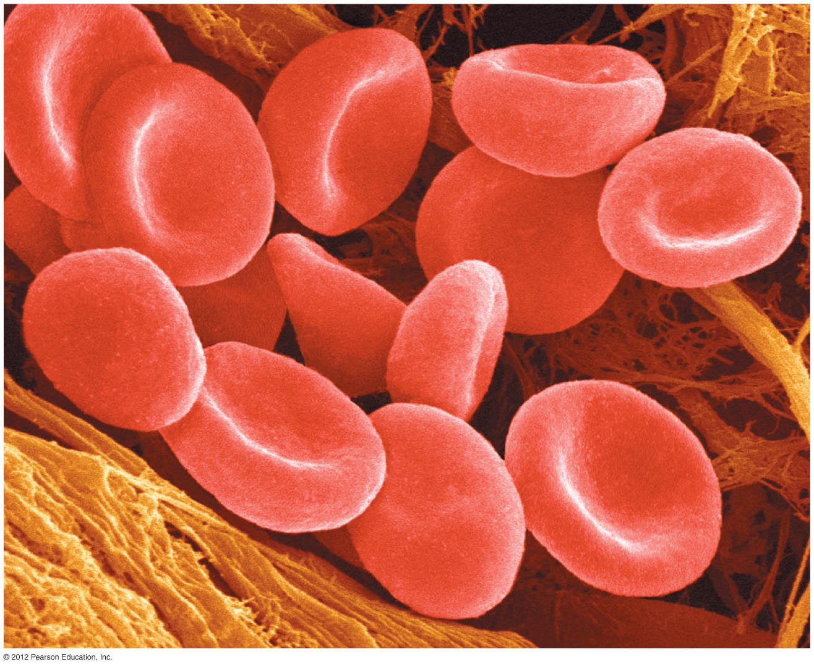
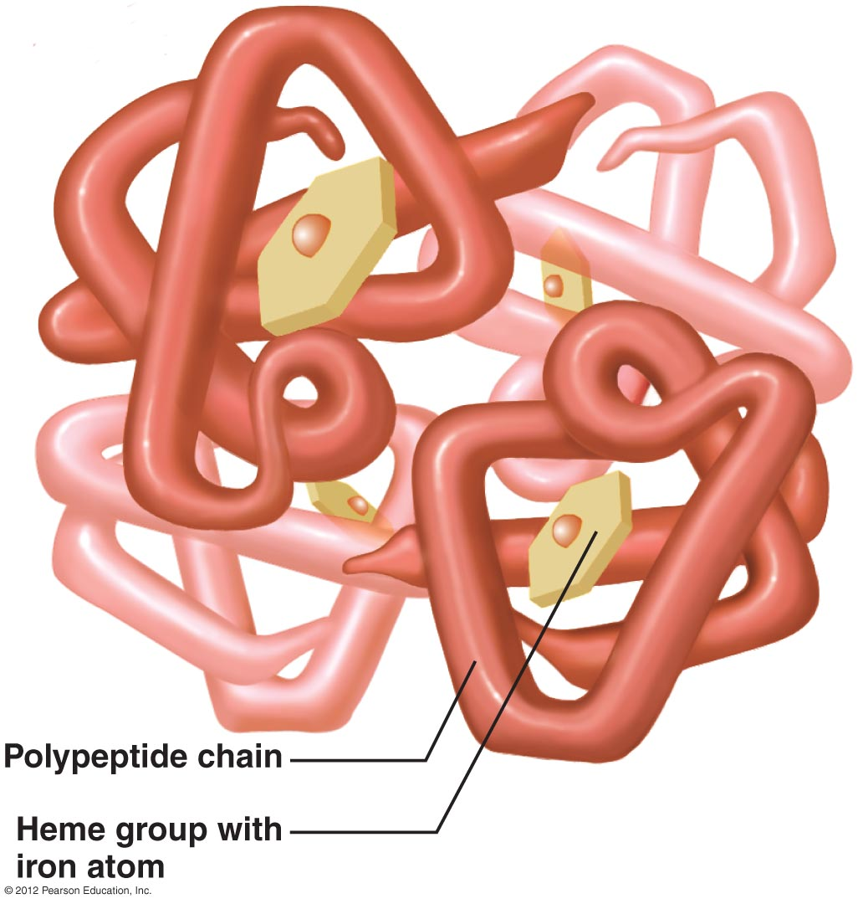

Red Blood Cells
Functions
  transport oxygen and carbon dioxide
inside

Slide 2
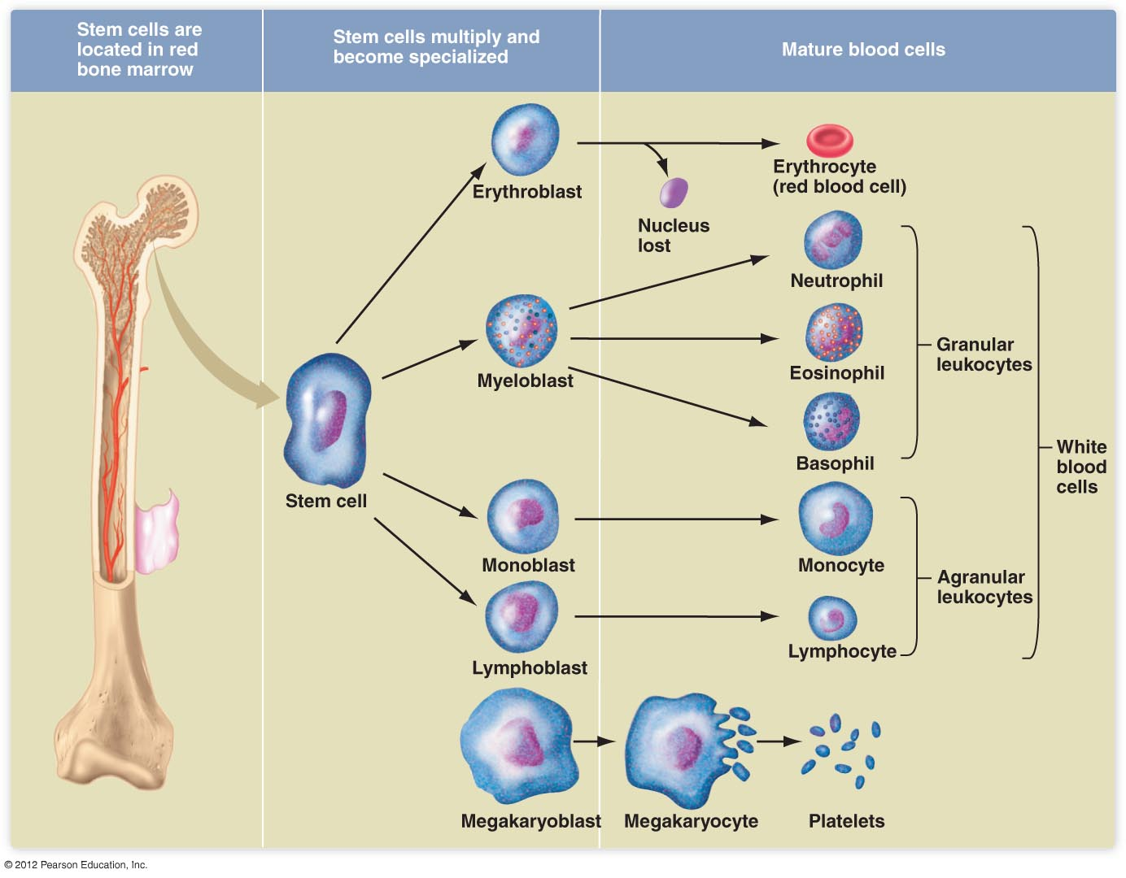
Red Blood Cells
Origin
  stem cells in the bone marrow

Slide 3
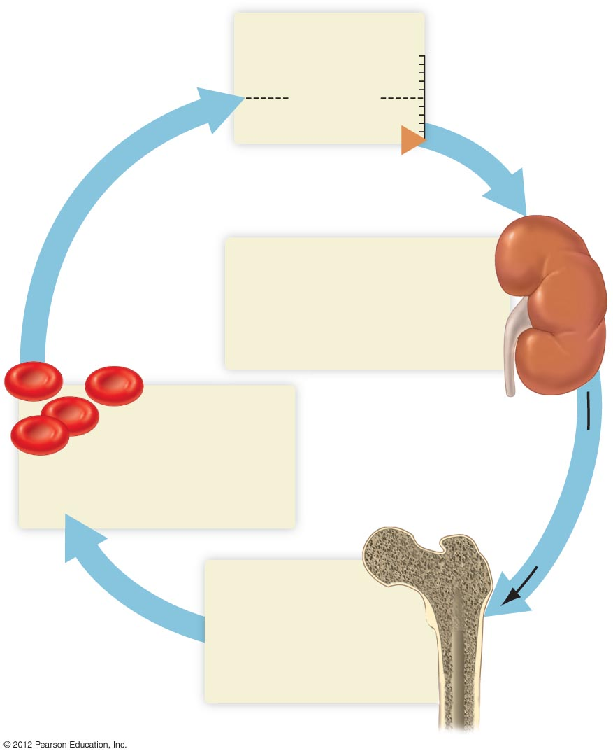
Red Blood Cells
O₂ availability
Increase
Set point
Life span
  ~120 days in humans
Control of production
  Erythropoietin (hormone from kidneys)
Decrease
O₂-sensitive cells in kidneys
respond to a decline in O₂
availability by increasing
erythropoietin production
Increased number of
RBCs returns O₂
availability to normal
Erythropoietin
Erythropoietin
stimulates increased
RBC production by
stem cells in
bone marrow

