Slide 1
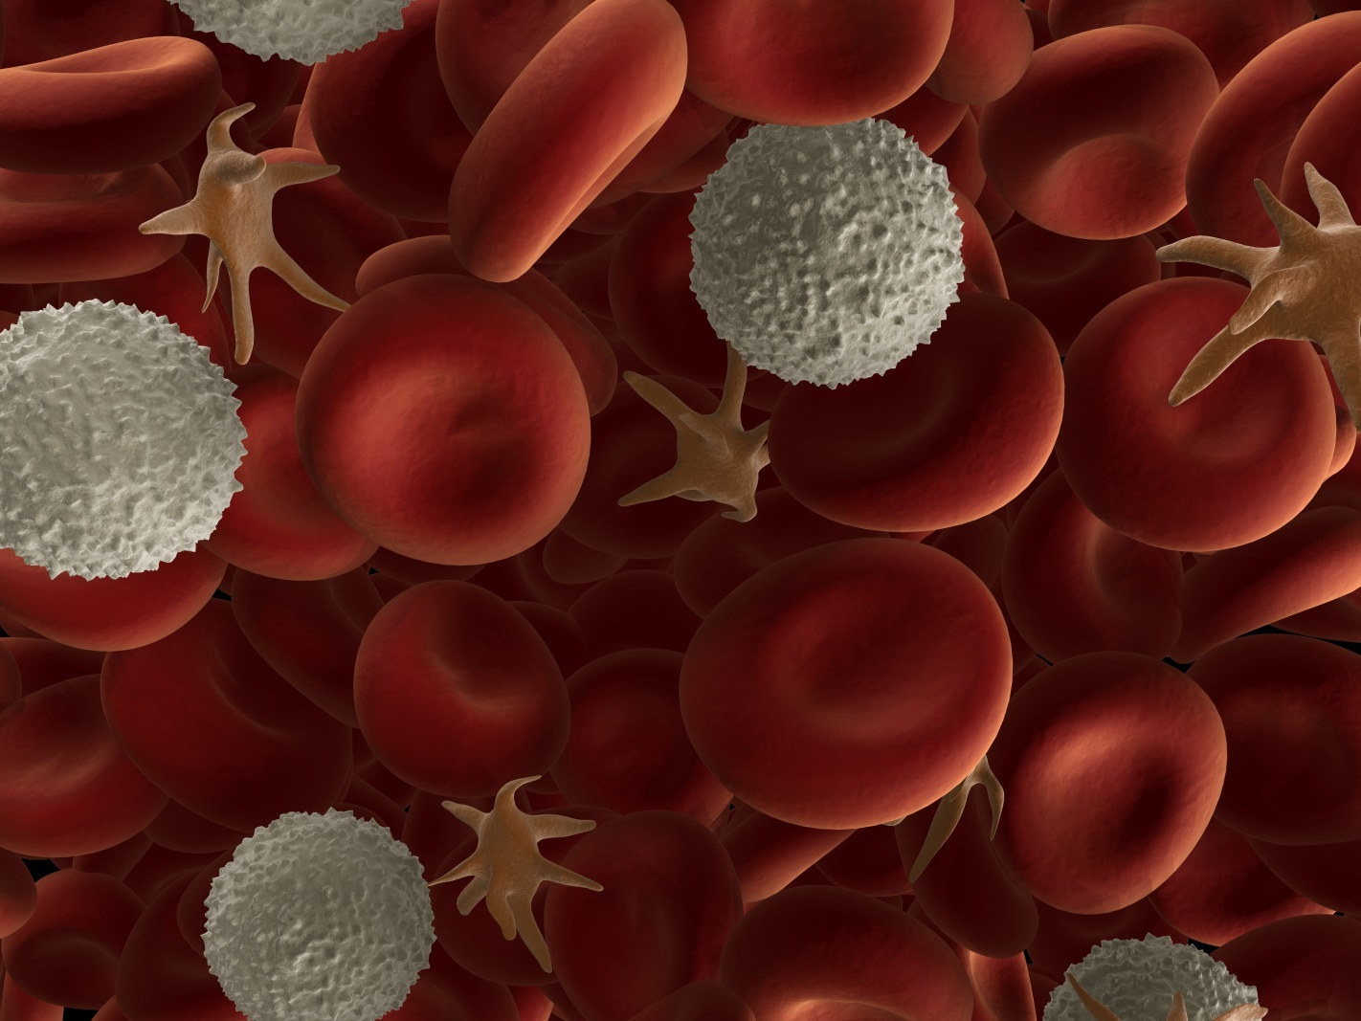

Blood

Slide 2
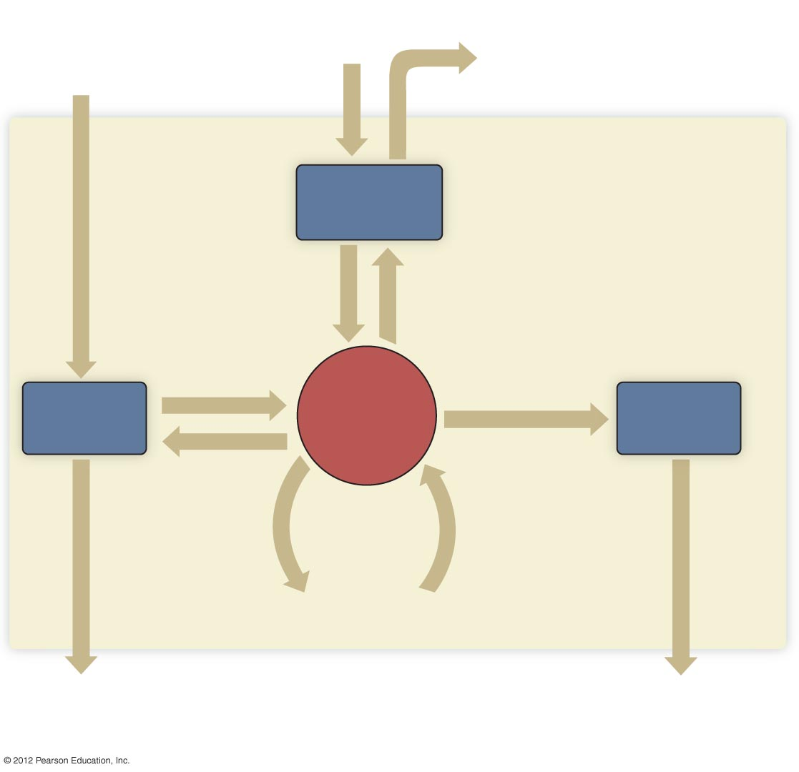
Oxygen
intake
Food and
water intake
Elimination of
carbon dioxide
The Human Body
Respiratory
system
O₂
CO₂
Nutrients,
salt, water
Water, salts,
metabolic waste
Digestive
system
Circulatory
system
Urinary
system
Metabolic
waste
Transport
to and from
all cells
Elimination of
food residues,
metabolic wastes
Elimination of
excess water, salts,
metabolic wastes

Slide 3
Three Primary Functions of the Blood
Transportation
  Nutrients, waste, hormones
Regulation
  Temperature, water volume, pH
Defense
  Against infections and bleeding

Slide 4
The Components of Blood
Plasma (55%)
  Water
  Electrolytes
  Proteins (albumins, globulins, clotting proteins)
  Hormones
  Gases
  Nutrients and wastes
Formed elements (45%)
  Red Blood Cells - RBCs - (Erythrocytes)
  White Blood Cells - WBCs - (Leukocytes)
  Platelets (Thrombocytes)

Slide 5
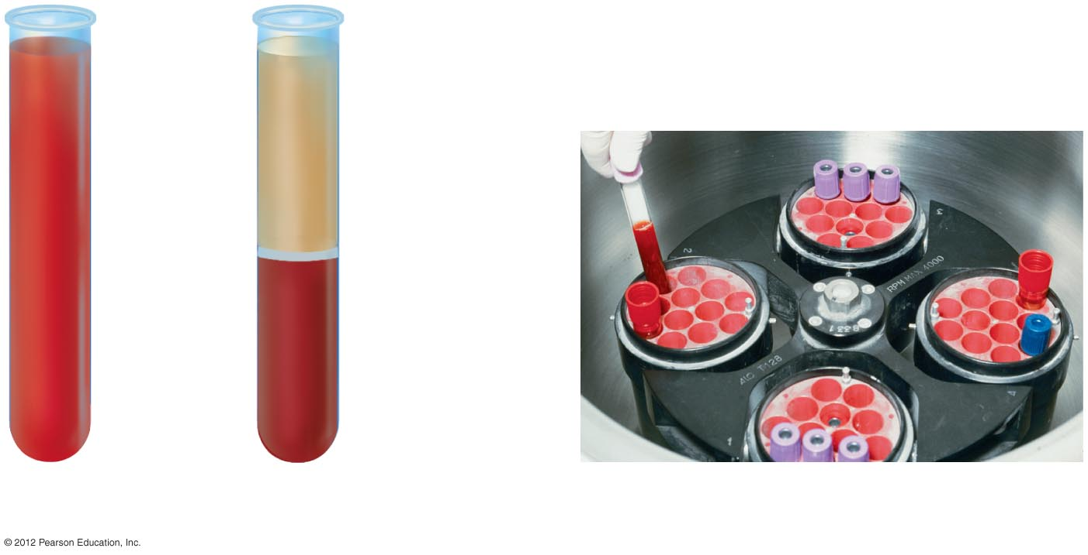
Plasma (55%)
Whole
blood
Platelets and
WBC (1%)
RBC (44%)
a) Whole blood.
b) Blood after being
spun in centrifuge.
c) A table-top centrifuge.
Centrifuge – spins at very high speed & causes particles to separate by mass (weight)

