Slide 1

Thyroid and Parathyroid Glands
Thyroid located just below larynx in neck
Parathyroid glands embedded in back of thyroid
Both thyroid and parathyroid involved in calcium balance
Thyroid also involved in regulating metabolism

Slide 2
Thyroid Gland: Thyroxine Speeds Cellular Metabolism
Secretion: mediated through hypothalamus-pituitary secretions
Steroidal hormones
  Thyroxine (T₄) and Triiodothyronine (T₃)
    Both regulate production of ATP from glucose, affect metabolic rate
  Calcitonin
    Lowers blood calcium levels
    Decreases rate of bone resorption by inhibiting osteoclasts
    Stimulates uptake of calcium by bones

Slide 3
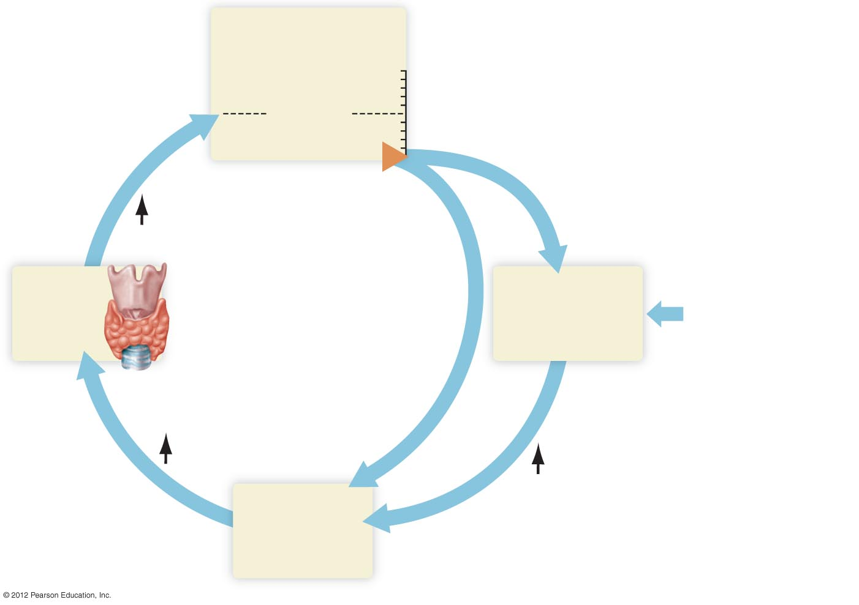
Plasma thyroxine
concentration
Increase
Set point
Decrease
Thyroxine
Thyroid
gland
Hypothalamus
Cold temperatures
TSH
Releasing hormone
Anterior
pituitary

Slide 4
Parathyroid Hormone (PTH) Controls Blood Calcium Levels
Secretion
  Response to lowered blood calcium levels
Action
  Removes calcium and phosphate from bone
  Increases absorption of calcium by the digestive tract
  Causes kidneys to retain calcium and excrete phosphate
Major regulator of blood calcium concentration in adults

Slide 5
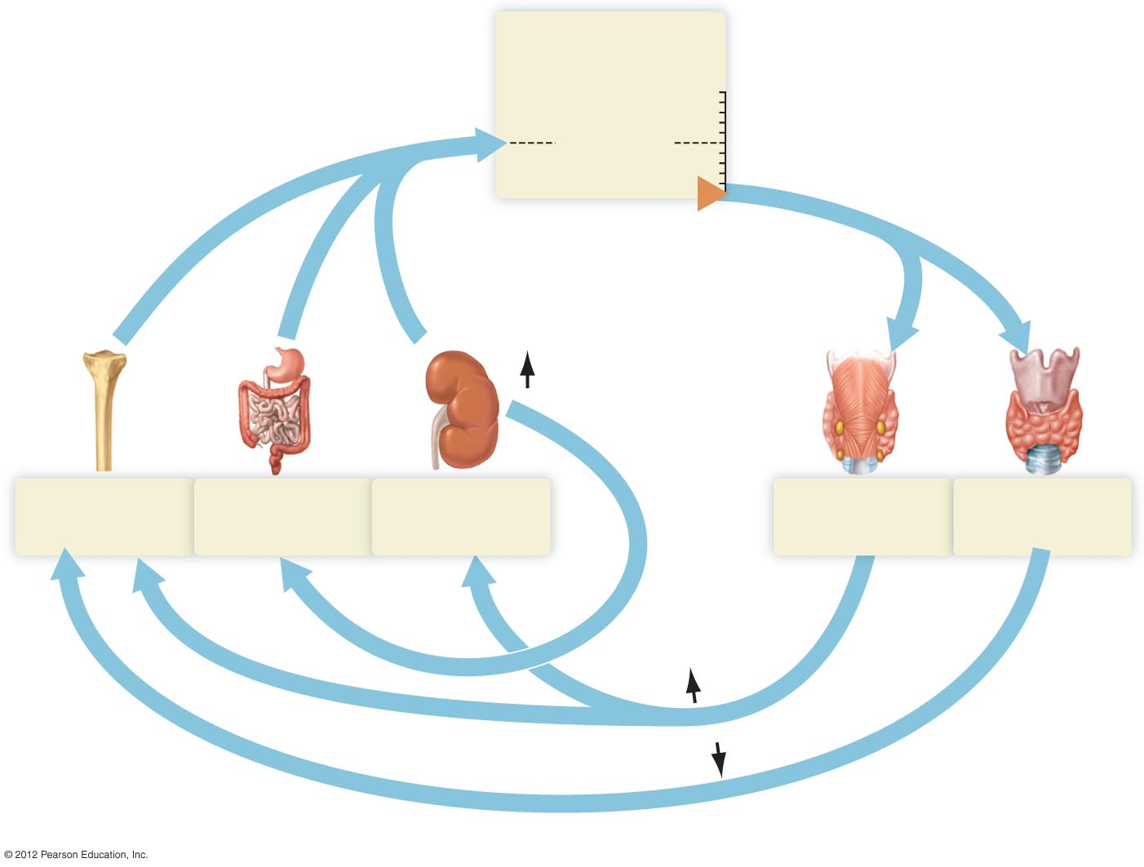
Blood Ca²⁺
concentration
Increase
Return of blood Ca²⁺
toward normal
Set point
Decrease
Vitamin D
Bones
release Ca²⁺
Digestive tract
absorbs Ca²⁺
Kidneys
save Ca²⁺
Parathyroid
gland
Thyroid
gland
PTH
Calcitonin
a) Responses to a fall in blood calcium.

Slide 6
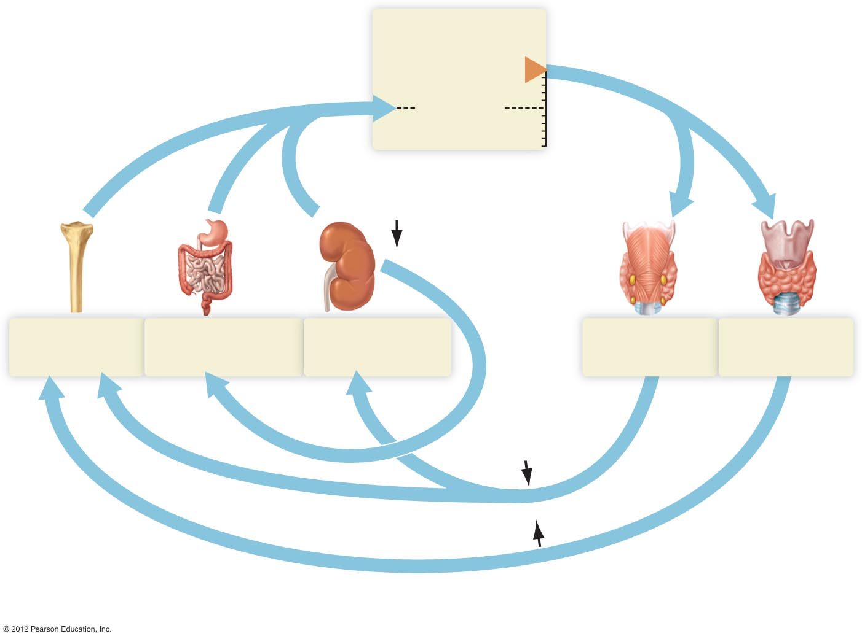
Blood Ca²⁺
concentration
Increase
Return of blood Ca²⁺
toward normal
Set point
Decrease
Vitamin D
Bones
take up Ca²⁺
Digestive tract
absorbs less Ca²⁺
Kidneys excrete
more Ca²⁺
Parathyroid
gland
Thyroid
gland
PTH
Calcitonin
b) Responses to a rise in blood calcium. The importance of calcitonin is greatest in children,
declining once adulthood is reached.

Slide 7
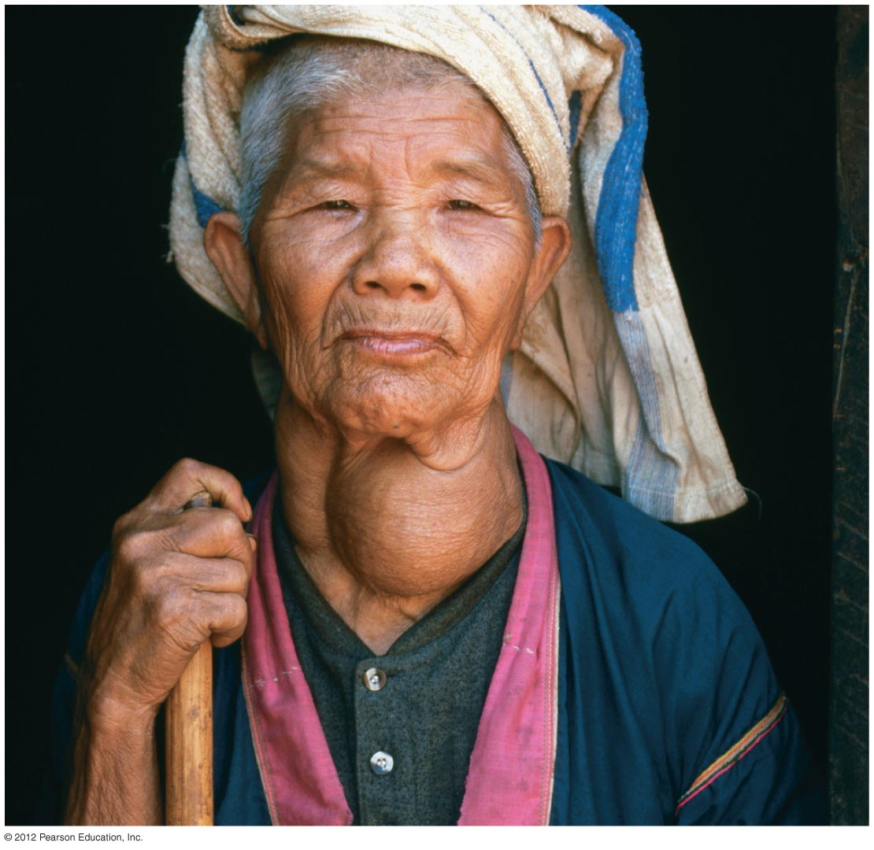
Thyroid Disorder
Goiter
  Iodine deficiency increases growth of thyroid gland

