Slide 1

Pancreas Secretes Glucagon, Insulin, and Somatostatin
Pancreas
  has both exocrine and endocrine functions
Pancreatic hormones are involved in regulating blood glucose levels
Endocrine cells in Islets of Langerhans within the pancreas secrete the following hormones:
  Alpha cells
    secrete glucagon
  Beta cells
    secrete insulin

Slide 2
Pancreas Secretes Glucagon, Insulin, and Somatostatin
Glucagon
  Raises blood sugar
  Causes breakdown of glycogen to glucose in liver
Insulin
  Lowers blood sugar
  Promotes uptake of sugar by cells in liver, muscle, and adipose tissue
  Promotes conversion of glucose into glycogen, proteins, fat,

Slide 3
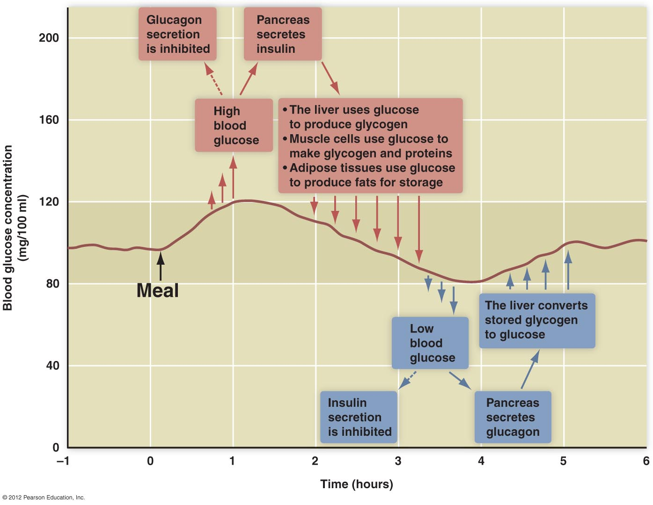

Slide 4
Adrenal Glands
Adrenal cortex
  outer layer
Adrenal medulla
  inner layer

Slide 5
Adrenal Cortex
Glucocorticoids (Cortisol is an example)
  Secretion mediated through hypothalamus-pituitary secretions
  Maintain blood glucose levels during prolonged fasting
Mineralocorticoids (Aldosterone is an example)
  Regulate sodium, potassium, water balance
  Act on kidneys, promoting sodium reabsorption and potassium excretion

Slide 6
Adrenal Medulla
Adrenal medulla
  Neuroendocrine organ
  Secretion stimulated by
    Sympathetic nervous system
  Hormones
    Epinephrine and norepinephrine
      enhance function of sympathetic nervous system (fight-or-flight response)

Slide 7
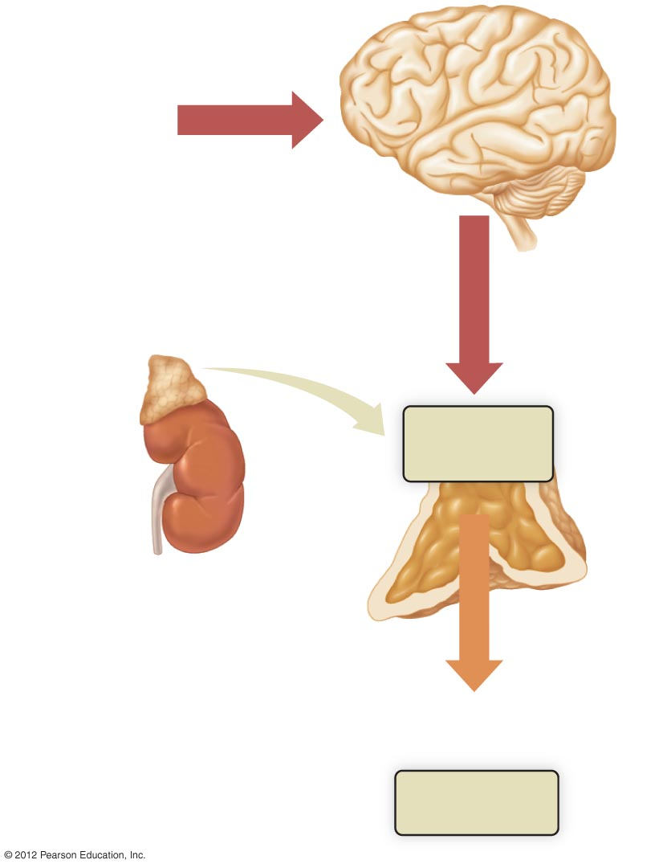
Perceived or
real threat
Brain
Activation of
sympathetic
nerves
Adrenal
medulla
Adrenal
cortex
Norepinephrine
and epinephrine
Target cells

