Slide 1

Hypothalamus and the Pituitary Gland
Hypothalamus
  Homeostatic control center of the brain
  Links nervous system and endocrine system
  Produces two hormones of its own
    Antidiuretic hormone (ADH) and Oxytocin
  Monitors and controls hormone secretions of the pituitary gland
Pituitary gland
  “Master” gland
  Secretes eight different hormones that regulate other endocrine organs
  Two lobes: posterior and anterior

Slide 2
Posterior Pituitary Stores ADH and Oxytocin
Posterior pituitary is connected to hypothalamus by neuroendocrine cells
  Hormones (ADH and oxytocin) made in cell bodies in hypothalamus are transported down axons to posterior pituitary
Posterior pituitary hormones: nonsteroidal
  Antidiuretic hormone (ADH)
    Conserves water in kidneys
    Regulates water balance in body
  Oxytocin
    Causes uterine contractions during labor and milk ejection through neuroendocrine reflex

Slide 3
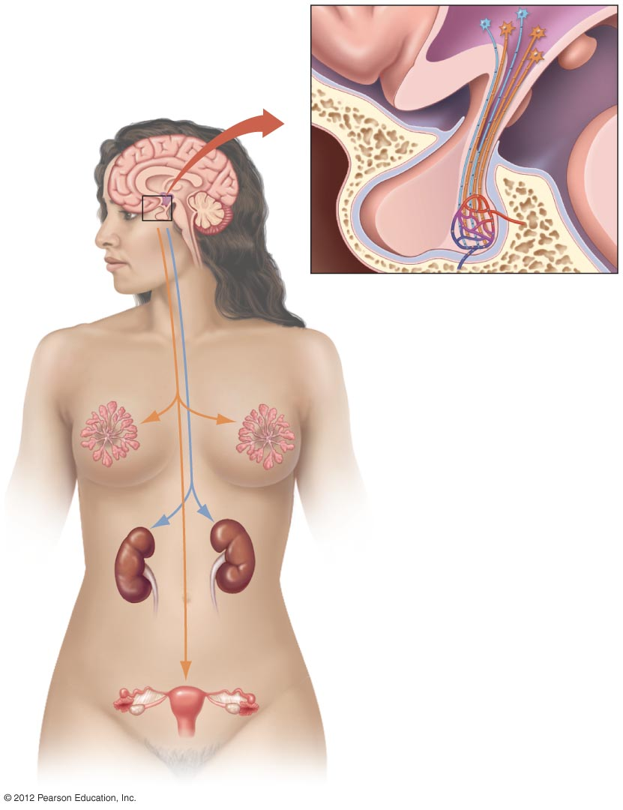
Neuroendocrine cells
Hypothalamus
Anterior
pituitary
Posterior
pituitary
Oxytocin
ADH

Slide 4
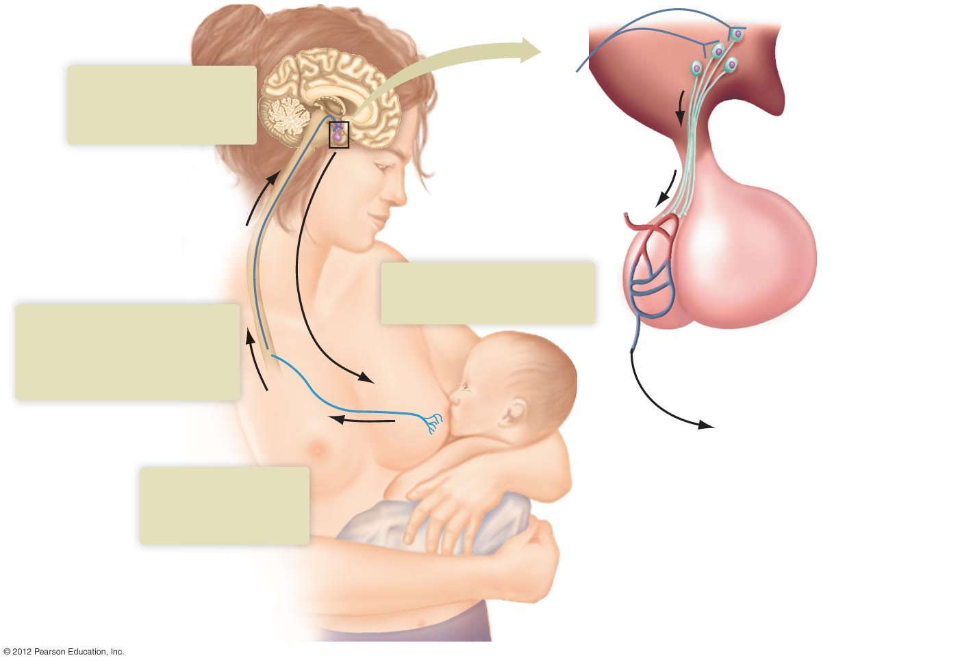
Neuroendocrine
cell
3
Neuroendocrine cells
release oxytocin
when stimulated.
Hypothalamus
Anterior
pituitary
Spinal cord
4
Oxytocin is transported by
blood to mammary glands.
2
Sensory and spinal nerves
carry impulses to the
neuroendocrine cells
of hypothalamus.
Posterior
pituitary
Milk ejected
Oxytocin
1
Nursing stimulates
nerve receptors
in nipple.

Slide 5
The Anterior Pituitary Produces Six Key Hormones
Anterior pituitary
  Controlled by hypothalamus
    Releasing and inhibiting hormones from hypothalamus travel to pituitary through pituitary portal system

Slide 6
Anterior Pituitary Hormones
ACTH (adrenocorticotropic hormone)
  Stimulates adrenal cortex to release glucocorticoids (cortisol)
TSH (thyroid-stimulating hormone)
  Acts on thyroid gland, promoting release of thyroid hormones
FSH and LH (gonadotropins)
  Stimulate growth, development, and function of ovaries and testes
  Not produced until about age 10–13 (puberty)
  Increase in production initiates sexual maturation and development at puberty

Slide 7
Anterior Pituitary Hormones
Prolactin
  Stimulates development of mammary glands and milk production
Growth hormone
  Has widespread effects on body
  Major effects on bone, muscle
  Most of its growth-promoting effects occur during childhood and adolescence

Slide 8
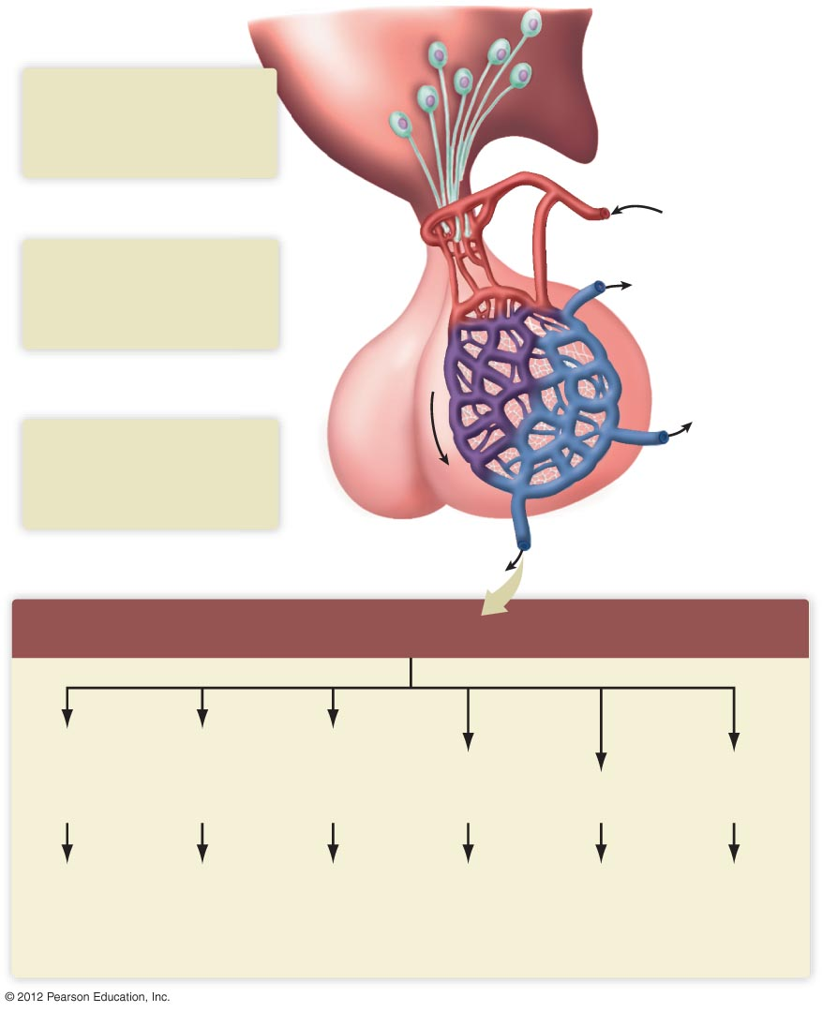
Hypothalamus
Neuroendocrine
cells
1
Neuroendocrine cells
in hypothalamus produce
and secrete releasing and
inhibiting hormones
Blood flow
2
The pituitary portal blood
system carries releasing and
inhibiting hormones directly
to the anterior pituitary
Anterior pituitary
endocrine cells
3
Posterior
pituitary
The anterior pituitary
produces six hormones
that enter the general
circulation
Anterior pituitary hormones
Adreno-
corticotropic
hormone
(ACTH)
Thyroid-
stimulating
hormone
(TSH)
Follicle-
stimulating
hormone
(FSH)
Luteinizing
hormone
(LH)
Growth
hormone
(GH)
Prolactin
(PRL)
Adrenal
cortex
Thyroid
gland
Ovaries or
testes
Ovaries or
testes
Mammary
glands
Skeletal
muscle, bone

Slide 9
Pituitary Disorders: Hypersecretion and Hyposecretion
Diabetes insipidus
  Hyposecretion of ADH results in inability to conserve water appropriately
  Causes excessive urination, dehydration, thirst
Gigantism
  Hypersecretion of growth hormone in childhood
Acromegaly
  Excessive growth hormone over a long period in adults
Pituitary dwarfism
  Hyposecretion of growth hormone
  Treated by administration of GH throughout childhood

Slide 10
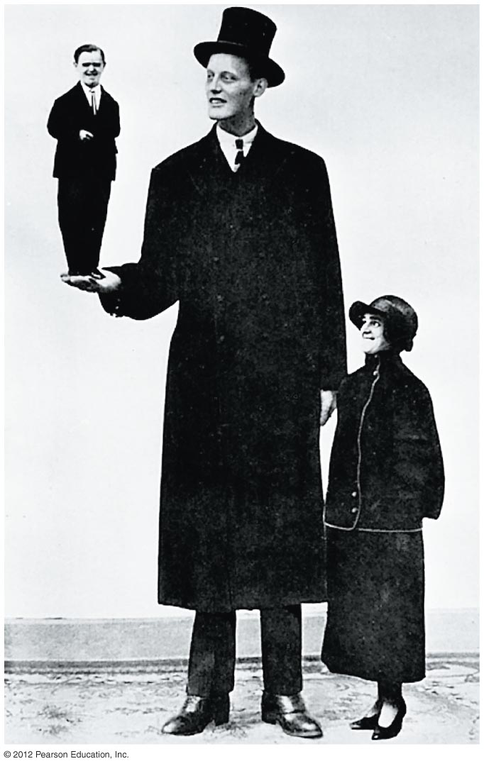
Gigantism and Dwarfism

Slide 11
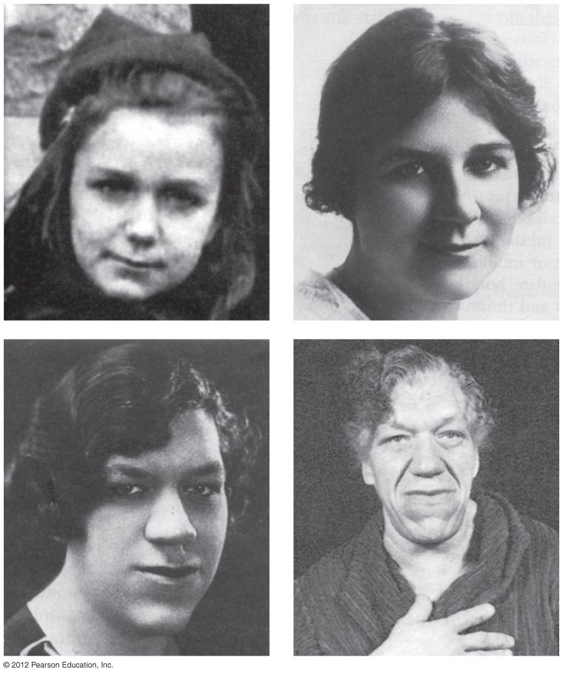
Acromegaly

