Slide 1

Hormones Are Classified as Steroid and Nonsteroid
Steroid hormones
  Structurally related to cholesterol
  Lipid soluble
Nonsteroid hormones
  Structurally related to proteins
  Water soluble (lipid insoluble)

Slide 2
Classification of Hormones: Steroid
Steroid hormones
  Lipid soluble, chemically derived from cholesterol
  Enter target cells
  Activate specific genes to produce specific proteins
  Slower acting than nonsteroid hormones; minutes to hours

Slide 3
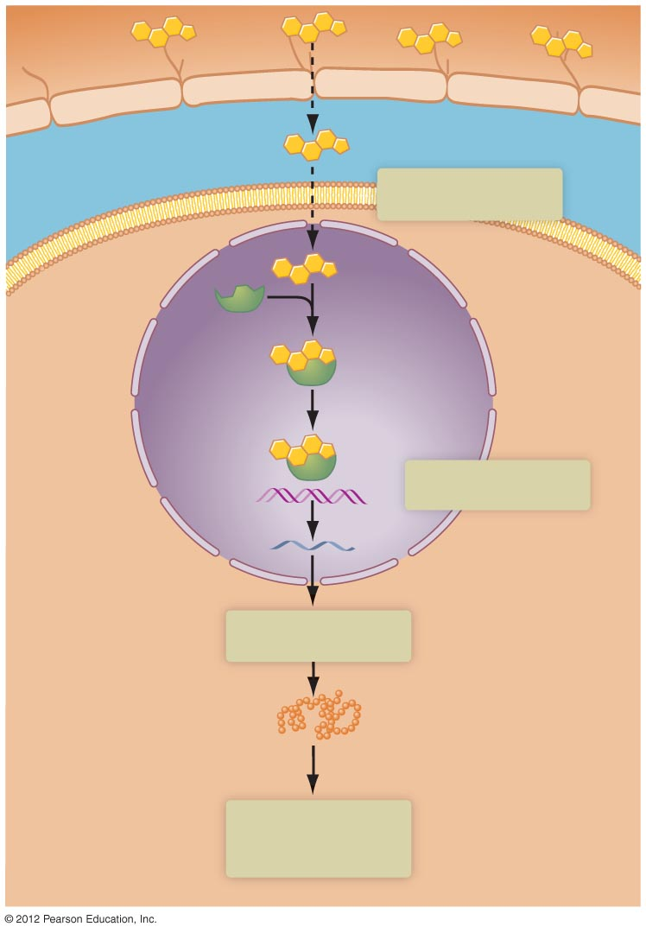
Capillary
Steroid hormone
Interstitial fluid
1
Hormone diffuses
Target cell
membrane
Hormone
receptor
Hormone-
receptor
complex
Nucleus
2
Gene activated
DNA
RNA
3
Protein synthesis
New protein
4
New protein alters
cell activity
Cell cytoplasm

Slide 4
Classification of Hormones: Nonsteroid
Nonsteroid hormones
  Water soluble
  Bind to receptors on target cell membranes
  Work through intermediate mechanisms to activate existing enzymes
  Faster action than steroid hormones; seconds to minutes

Slide 5
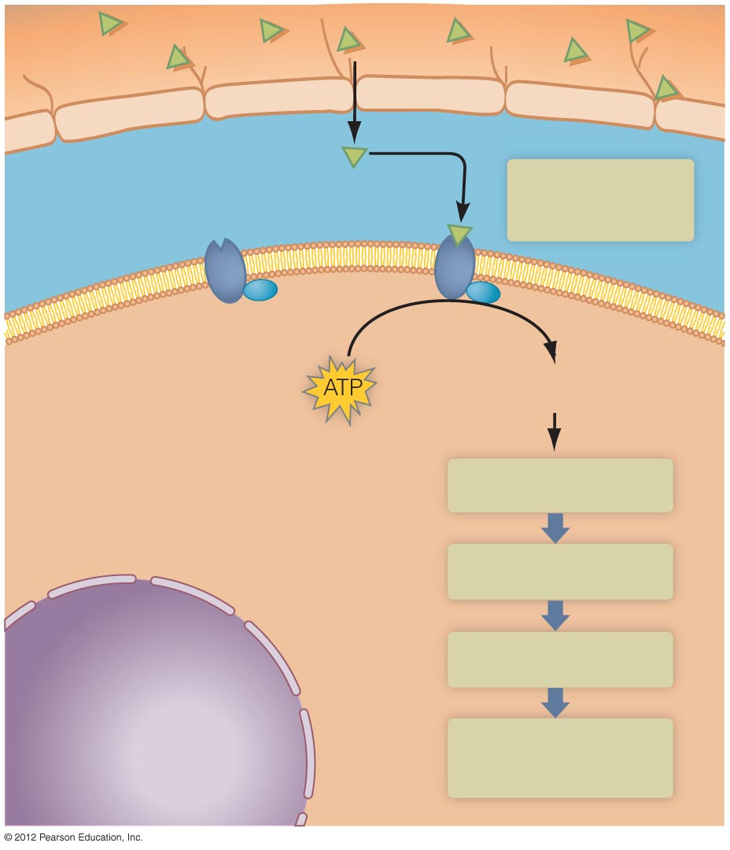
Capillary
Nonsteroid
hormone
(first messenger)
1
Interstitial fluid
Hormone binds
to receptor
Receptor
Enzyme
Target cell
membrane
Cyclic AMP
(second messenger)
2
Cell cytoplasm
Enzyme 1 activated
3
Enzyme 2 activated
4
Enzyme 3 activated
Nucleus
5
Final product alters
cell activity

Slide 6
Hormones Participate in Negative Feedback Loops
Many hormones participate in internal homeostatic control mechanisms
Negative feedback loop involving hormones includes the following:
  Endocrine gland serves as the control center
  Hormone is the pathway between the control center and the effectors
  Target tissues or organs are the effectors

Slide 7
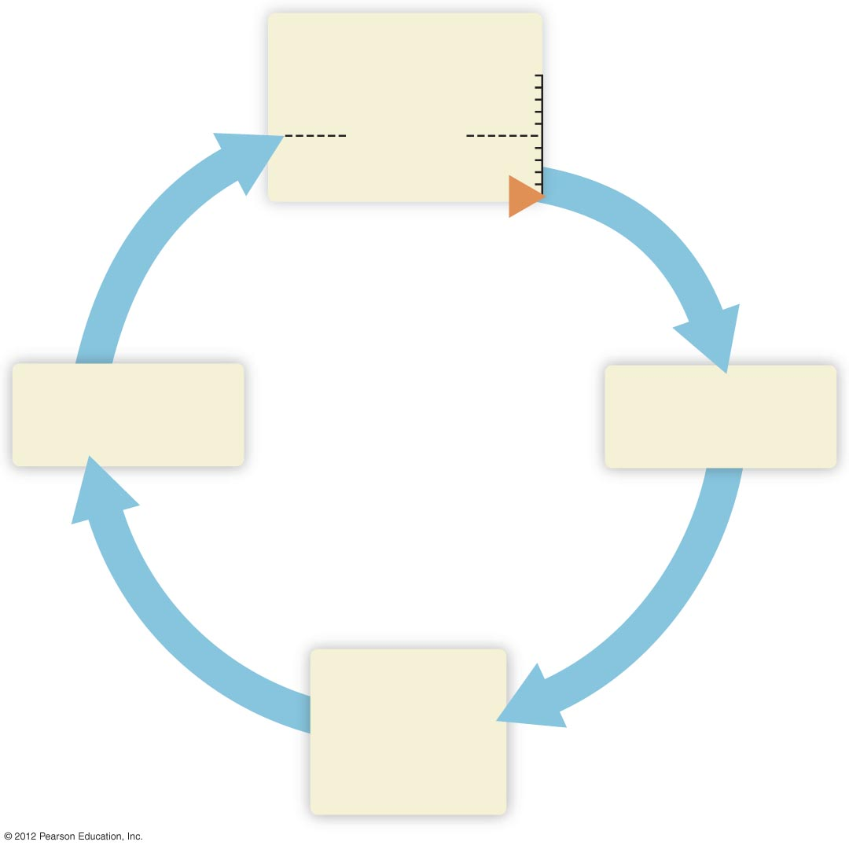
Controlled variable
Higher
Set point
Lower
(Reversal of
initial change)
Endocrine gland
(control center)
Hormone
Target cells,
tissues, and
organs
(effectors)

