Slide 1
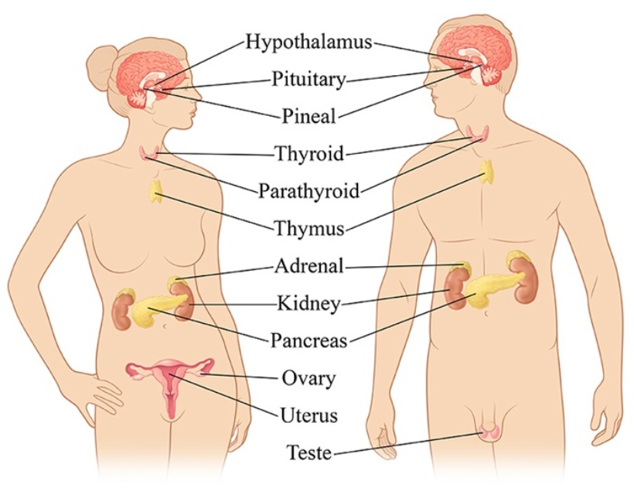

The Endocrine System

Slide 2
Endocrine System Produces Hormones
Endocrine system
  collection of specialized cells, and tissues that secrete hormones
Endocrine glands
  ductless organs that secrete hormones into blood, interstitial fluid, lymph
Hormones
  Chemical messengers secreted by endocrine glands
  Circulate in the bloodstream
  Act on specific cells in the body

Slide 3
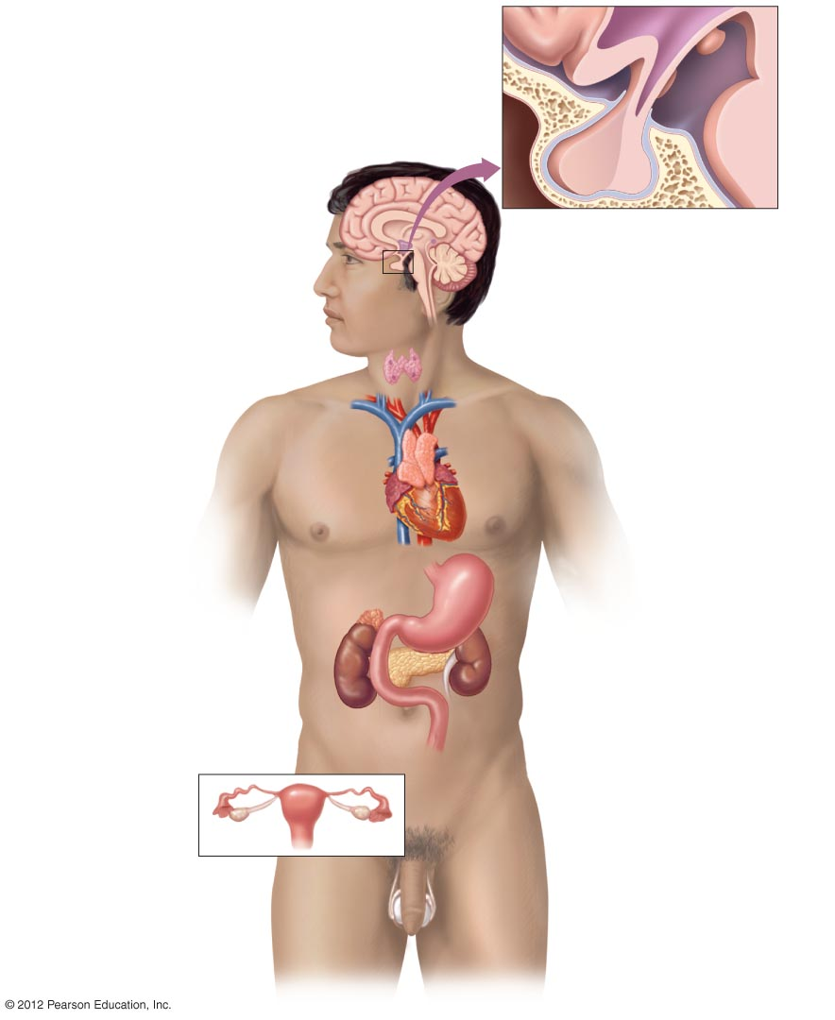
Hypothalamus
Pituitary gland
Anterior lobe
Posterior lobe
Hypothalamus
Releasing hormones
Inhibiting hormones
Pineal gland
Melatonin
Pituitary gland
Anterior lobe
  Adrenocorticotropic hormone (ACTH)
  Thyroid-stimulating hormone (TSH)
  Follicle-stimulating hormone (FSH)
  Luteinizing hormone (LH)
  Prolactin
  Growth hormone
Posterior lobe
  Antidiuretic hormone (ADH)
  Oxytocin
Thyroid gland
Thyroxine
Triiodothyronine
Calcitonin
Parathyroid glands
Parathyroid hormone (PTH)
Thymus gland
Thymosin
Thymopoietin
Heart
Atrial natriuretic hormone
Adrenal glands
Cortex
  Cortisol
  Aldosterone
Medulla
  Epinephrine
  Norepinephrine
Stomach
Gastrin
Pancreas
Glucagon
Insulin
Somatostatin
Kidneys
Erythropoietin
Renin
Intestines
Secretin
Cholecystokinin
Ovaries (Female)
• Estrogen
• Progesterone
Testes (Male)
Testosterone

Slide 4
Endocrine System Produces Hormones
Hormones have access to every cell
Each hormone acts only on specific cells (target cells)
Only specific cells have receptors for specific hormones
Endocrine control is slower than nervous system
Endocrine and nervous systems interact

