Slide 1

Psychoactive Drugs Affect Higher Brain Functions
Psychoactive drugs
  Affect states of consciousness, emotions, or behavior
Action
  Able to cross blood-brain barrier
  Influence concentrations or actions of neurotransmitters
  Affect higher brain functions

Slide 2
Psychoactive Drugs
Psychological dependence
  User craves the feeling associated with the drug
Tolerance
  Requires more of the substance to achieve the same effect
Addiction
  The need to continue obtaining and using a substance
  No free choice
Withdrawal
  Physical symptoms that occur upon stopping the drug

Slide 3
Disorders of the Nervous System
Trauma
  Physical injury to brain or spinal cord
  Concussion
    Blow to the head may lead to unconsciousness
    Disruption of electrical activity in the brain
    Risk of subdural hematoma
  Spinal cord injuries
    Impairment of sensation and function below site of injury

Slide 4
Disorders of the Nervous System
Infections: Caused by viruses or bacteria that manage to pass through the blood-brain barrier
  Encephalitis
    Inflammation of the brain caused by viral infection
  Meningitis
    Inflammation of the meninges caused by viral or bacterial infection
  Rabies
    Infectious viral disease
    Spread by bite or saliva of infected animal
    Virus spreads from bite to brain via sensory neurons
Brain tumors: abnormal growth in or on the brain

Slide 5
Disorders of the Nervous System
Disorders of neural and synaptic transmission
  Epilepsy
    Recurring episodes of abnormal electrical activity (seizures)
  Alzheimer’s disease
    Shortage of acetylcholine
    Accumulation of abnormal protein, beta amyloid
    Progressive memory lapses and dementia
  Parkinson’s disease
    Loss of dopamine-releasing neurons
    Progressive degenerative disorder affecting motor activity

Slide 6
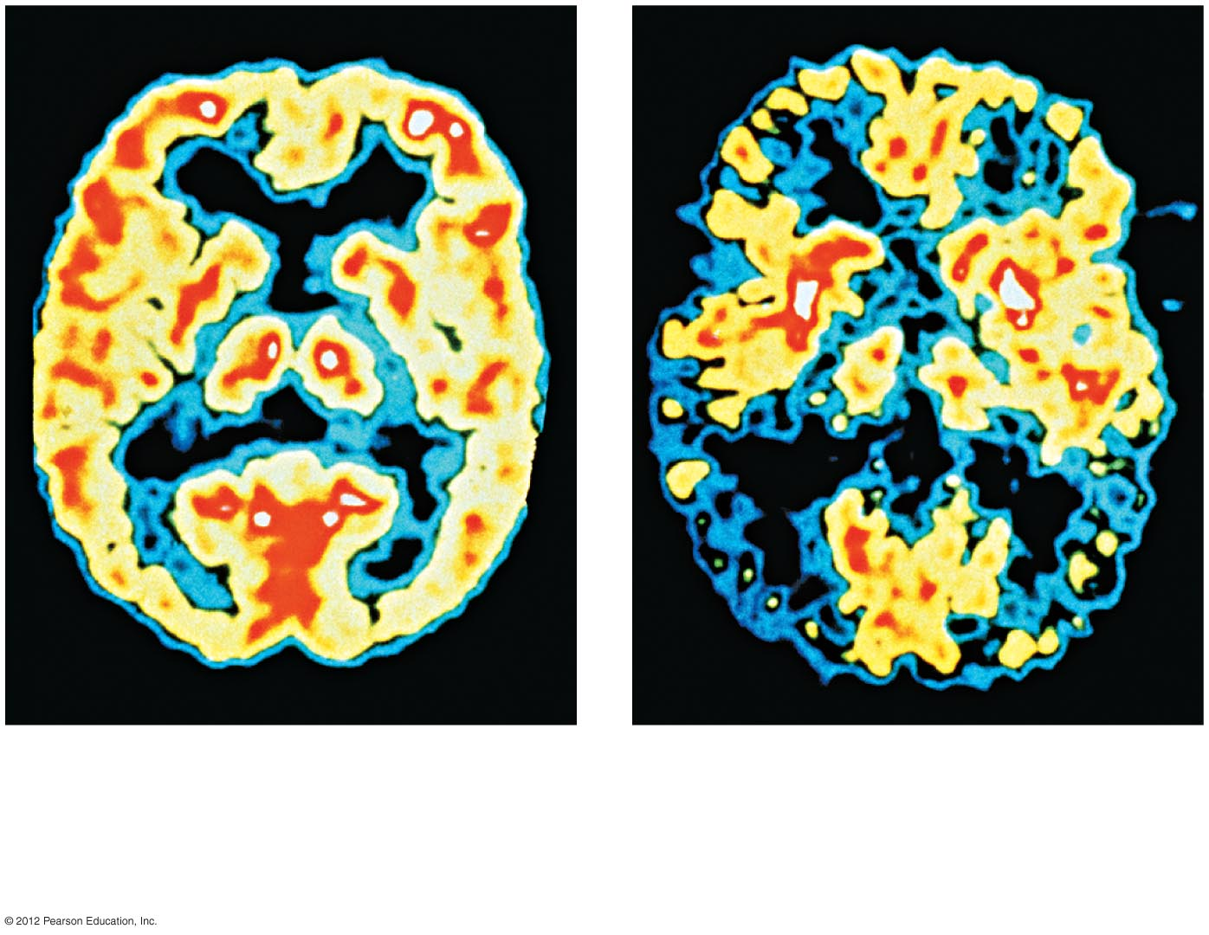
a) A PET scan of a healthy brain.
b) A PET scan of a patient with
Alzheimer’s disease, showing
decreased activity and an
irregular pattern.

