Slide 1

A Closer Look at the Cerebral Cortex
Functions
  memory storage
  abstract thought
  conscious awareness
  conscious control of skeletal muscle

Slide 2
A Closer Look at the Cerebral Cortex
Divided into four lobes
  Occipital lobe
    processes visual information
  Temporal lobe
    interprets auditory information, comprehends spoken/written language
  Parietal lobe
    receives and interprets sensory information from the skin
  Frontal lobe
    initiates motor activity, responsible for speech, conscious thought
All four lobes: memory storage

Slide 3
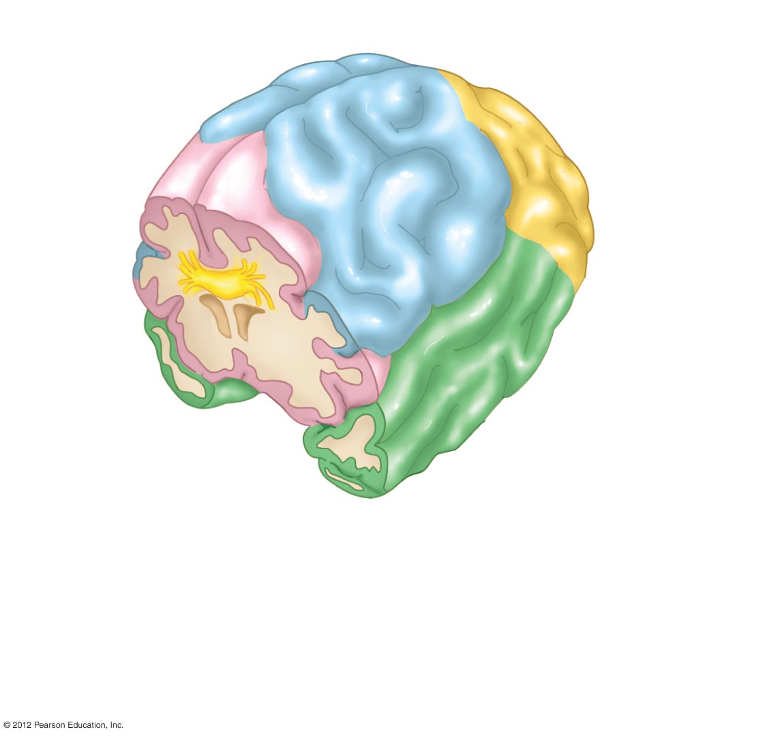
Right cerebral
hemisphere
Posterior
Corpus
callosum
Anterior
Cerebral
white
matter
Left
cerebral
hemisphere
Cerebral cortex
(gray matter)
a) The cerebral cortex (gray matter; outer layer, shown in four colors)
consists of interneurons that integrate and process information.
White matter (inner core) consists of ascending and descending
nerve tracts. The two separate hemispheres are joined by the
corpus callosum.

Slide 4
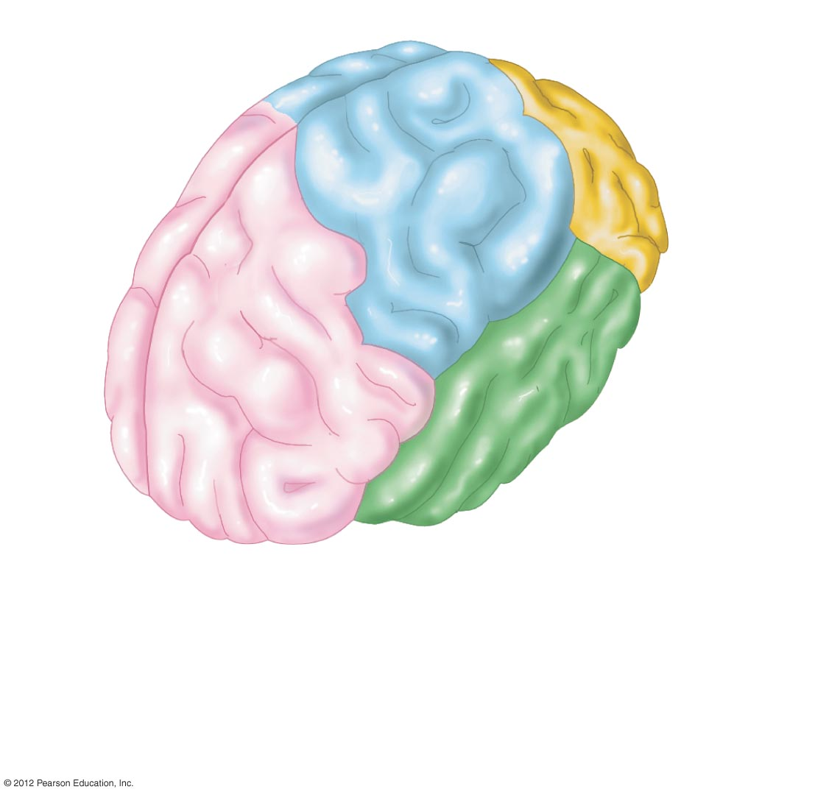
Parietal lobe
Interprets sensory
information from skin
Occipital lobe
Processes visual
information
Frontal lobe
Initiates motor activity
Responsible for speech
Conscious thought
Temporal lobe
Interprets auditory
information
Comprehends language
Perceptual judgment
b) The functions of the four lobes of the cerebral cortex are
location-specific.

Slide 5
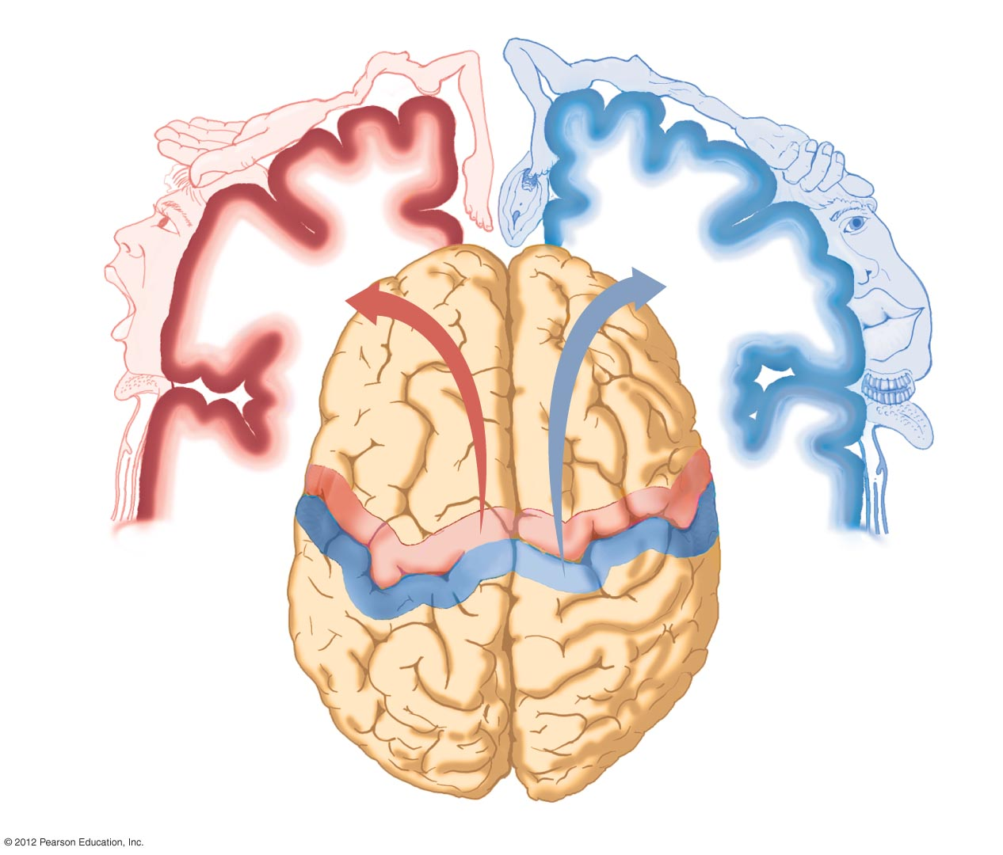
Trunk
Leg
Arm
Hip
Hip
Trunk
Neck
Elbow
Arm
Hand
Wrist
Elbow
Fingers
Forearm
Thumb
Fingers
Neck
Brow
Toes
Genitals
Thumb
Eye
Eye
Face
Primary
motor
area
Primary
somatosensory
area
Nose
Lips
Face
Jaw
Tongue
Lips
Teeth
Swallowing
Frontal
lobe
Gums
Tongue
Pharynx
Left
hemisphere
Right
hemisphere
Parietal lobe
Posterior

Slide 6
Limbic System: Site of Emotions and Basic Behaviors
Includes all neuronal structures that together control emotional behavior and motivational drives
Hypothalamus serves as a gateway to and from limbic system
Emotions
  Fear, anger, sorrow, love, etc.
Basic behavior
  Seeking food, satisfying thirst
  Sexual gratification
Behaviors modified by cerebrum
Short-term memory

Slide 7
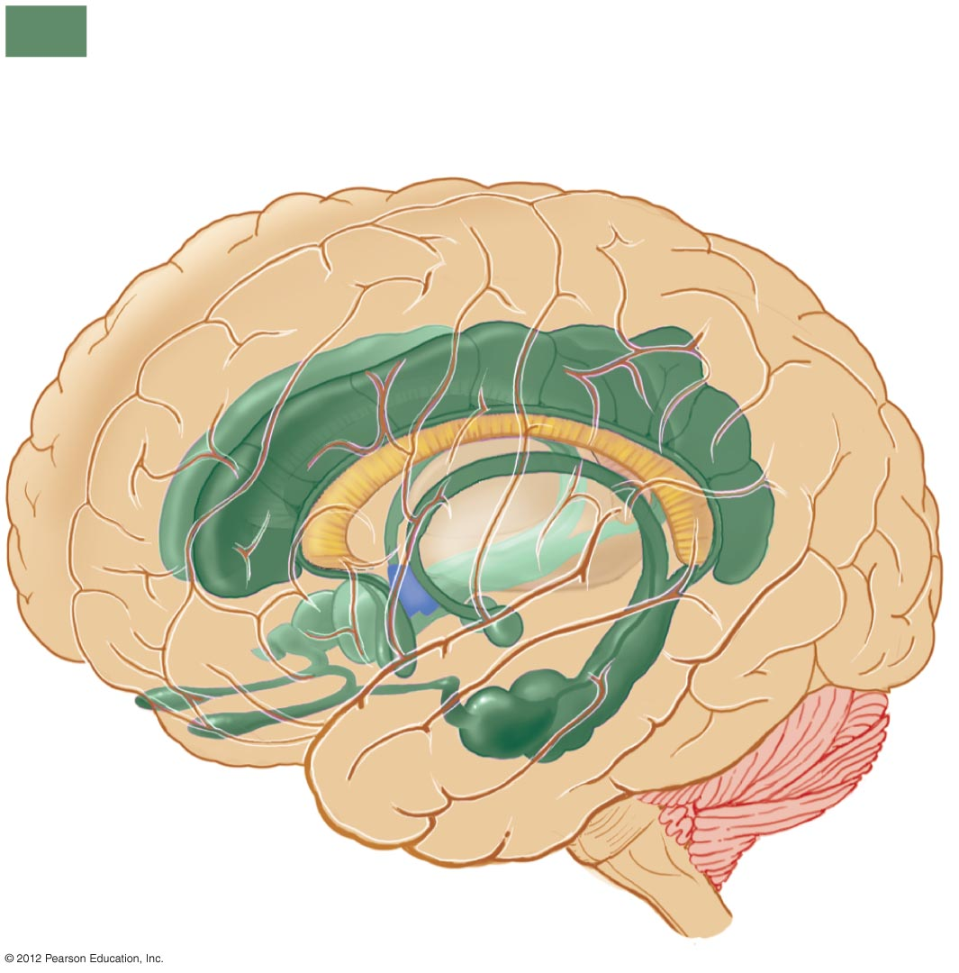
Limbic system
Cerebrum
Thalamus
Corpus
callosum
Hypothalamus
Cerebellum

Slide 8
Memory: Storing and Retrieving Information
Short-term
  Working memory
  Information from previous few hours
  Stored in the limbic system
Long-term
  Information from previous days to years
  Involves permanent changes in neurons and synapses in the cerebral cortex

