Slide 1

Brain and Spinal Cord Constitute the CNS
CNS protection
  Bone: skull and vertebrae
  Meninges: protective membranes
    Dura mater, arachnoid, and pia mater
  Cerebrospinal fluid: bathes the brain, spinal cord
    Shock absorber
    Produced within the ventricles of the brain
  Blood-brain barrier: prevents entry of certain chemicals and pathogens

Slide 2
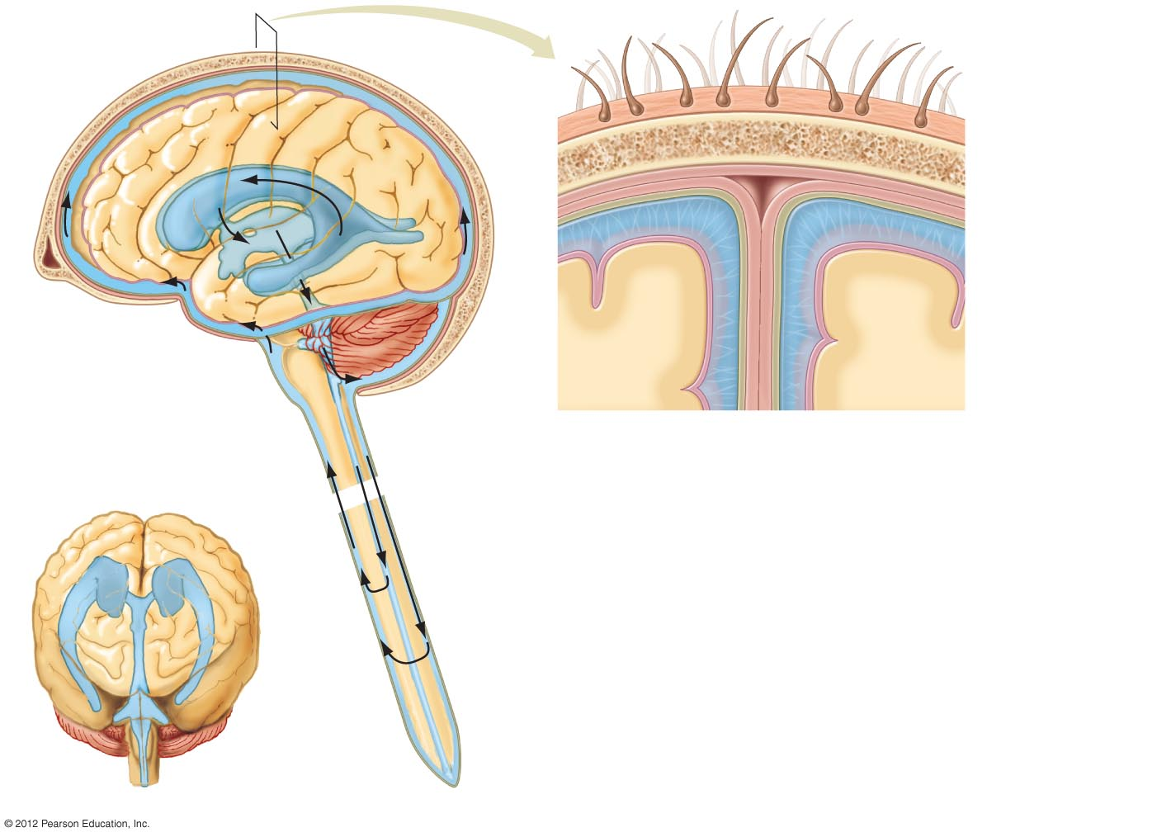
Right ventricle
Skull
Hair
Left ventricle
Scalp
Skull
Dura mater
Arachnoid
Meninges
Pia mater
Brain tissue
Third ventricle
Cerebrospinal
fluid
Cerebrospinal fluid
Meninges
Fourth ventricle
Spinal canal
Spinal cord
Right ventricle
Left ventricle
Third
ventricle
Fourth
ventricle
a) Anterior view.
b) Sagittal view.

Slide 3
The Spinal Cord Relays Information
Spinal cord is a superhighway for action potentials between the brain and the rest of the body
White matter
  Outer portion of spinal cord
  Consists of myelinated ascending (sensory) and descending (motor) nerve tracts
Gray matter
  Center portion of spinal cord
  Contains cell bodies, dendrites

Slide 4
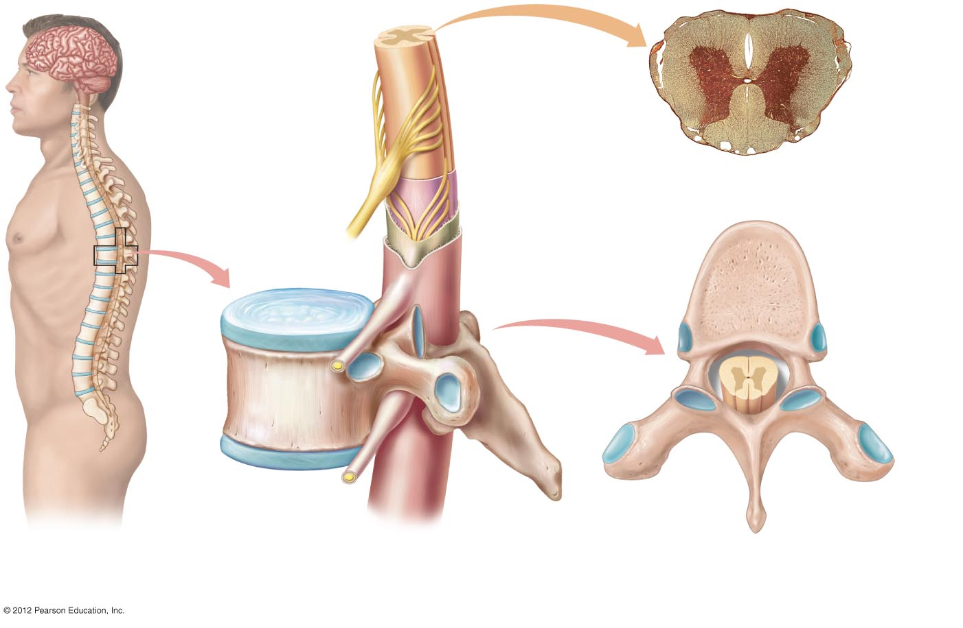
Gray matter
Spinal cord
Central canal
White matter
Ganglion
c) A transverse slice of the cord,
showing white and grey matter.
Nerve
Pia mater
Arachnoid
Meninges
Intervertebral disc
Dura mater
Spinal cord
Vertebra
a) The spinal cord
lies within the
vertebral column.
b) A closer look at the spinal cord and
its relationship with a vertebra.
d) Superior view of vertebra.

Slide 5
The Brain Processes and Acts on Information
Brain: command center of the body
Three major anatomical/functional divisions
  Hindbrain: coordinates basic, automatic, and vital tasks
  Midbrain: coordinates muscle groups and responses to sight and sound
  Forebrain: receives, integrates sensory input, determines complex behavior

Slide 6
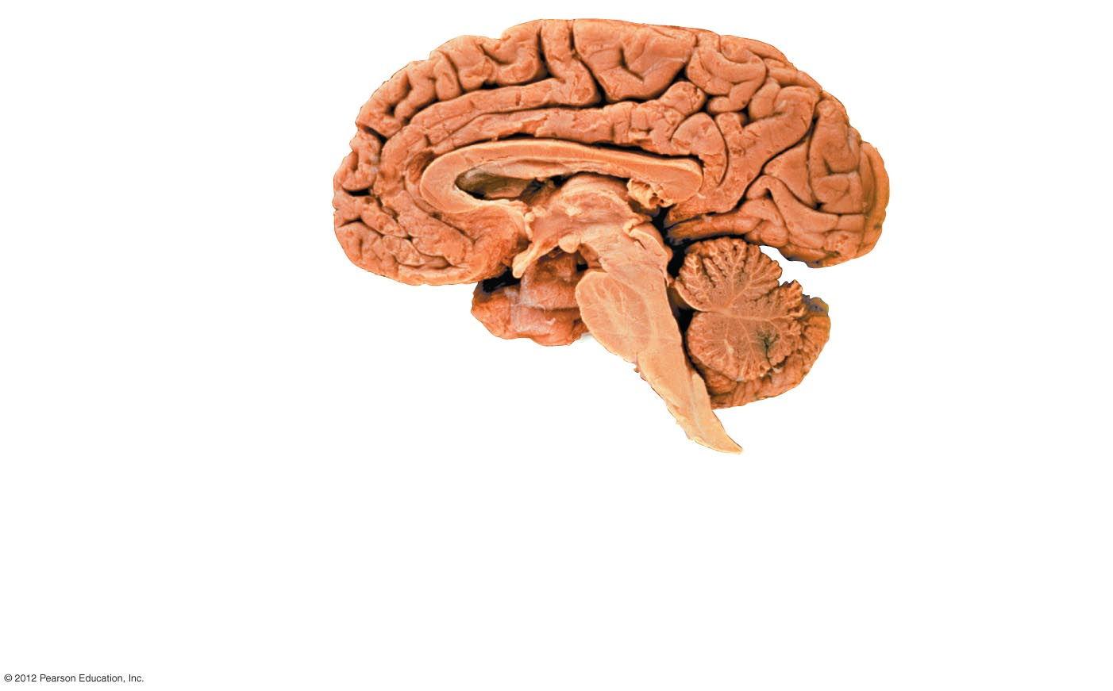
FOREBRAIN
Cerebrum
Coordinates language
Controls decision making
Produces conscious
thought
MIDBRAIN
Relays visual
and auditory
inputs
Coordinates
movement
Corpus callosum
Bridges the
two cerebral
hemispheres
Thalamus
Receives, processes
and transfers
information
HINDBRAIN
Pons
Medulla oblongata
Cerebellum
• Connects cerebellum, spinal cord
with higher brain centers
Aids medulla in regulating
respiration
• Controls automatic
functions of
internal organs
• Controls basic
and skilled
movements

Slide 7
Hindbrain: Medulla Oblongata
Connects to spinal cord
Controls vital automatic functions of internal organs
  Cardiovascular center: regulates heart rate and blood pressure
  Respiratory center: adjusts respiration in response to CO₂ and O₂ levels
Motor nerves cross over in medulla oblongata
  Right forebrain controls left side of body
  Left forebrain controls right side of body

Slide 8
Hindbrain: Cerebellum
Coordinates basic body movements
Stores and replicates sequences of skilled movements
  Examples
    Tying a shoe
    Swinging a bat
    Using a keyboard

Slide 9
Hindbrain: Pons
Connects higher brain centers and the spinal cord
Coordinates the flow of information between the cerebellum and higher brain centers
Aids medulla oblongata in regulating respiration

Slide 10
Midbrain: Vision and Hearing
Coordinates movements of the head related to vision and hearing
Controls movement of eyes and size of pupils

Slide 11
Forebrain: Emotions and Conscious Thought
Receives and integrates information concerning emotions and conscious thought
Hypothalamus
  Helps regulate homeostasis
Thalamus (“Grand Central Station”)
  Receiving, processing, and transfer center
Limbic system
  Pathways involved in emotions and memory
Cerebrum
  Language, decision making, conscious thought

Slide 12
Forebrain: Cerebrum
Structure
  Right and left hemispheres
  Hemispheres connected by corpus callosum
    Nerve tracts in corpus callosum allow two hemispheres to share information
  Cerebral cortex
    gray matter, the outer layer of the cerebrum

