Slide 1

Peripheral Nervous System Relays Information Between Tissues and CNS
Nerve
  contains axons of many neurons wrapped together in a protective sheath
  Carries information to and from the CNS
Cranial nerves
    12 pairs
    Connect directly to brain
Spinal nerves
    31 pairs
    Connect to spinal cord

Slide 2
Sensory Neurons Provide Information to the CNS
Provide information for both the somatic and autonomic motor divisions of the PNS
Incoming information arrives at the CNS as action potentials from sensory neurons located throughout the body

Slide 3
Somatic Division Controls Skeletal Muscles
Functions
  Voluntary
    Conscious control of skeletal muscles
  Involuntary (Reflexes)
    Spinal reflexes: Involuntary responses mediated primarily by spinal cord and spinal nerves, with little brain involvement
      flexor (withdrawal) reflex
      crossed extensor reflex
      stretch reflex: important in maintaining upright posture, movement

Slide 4
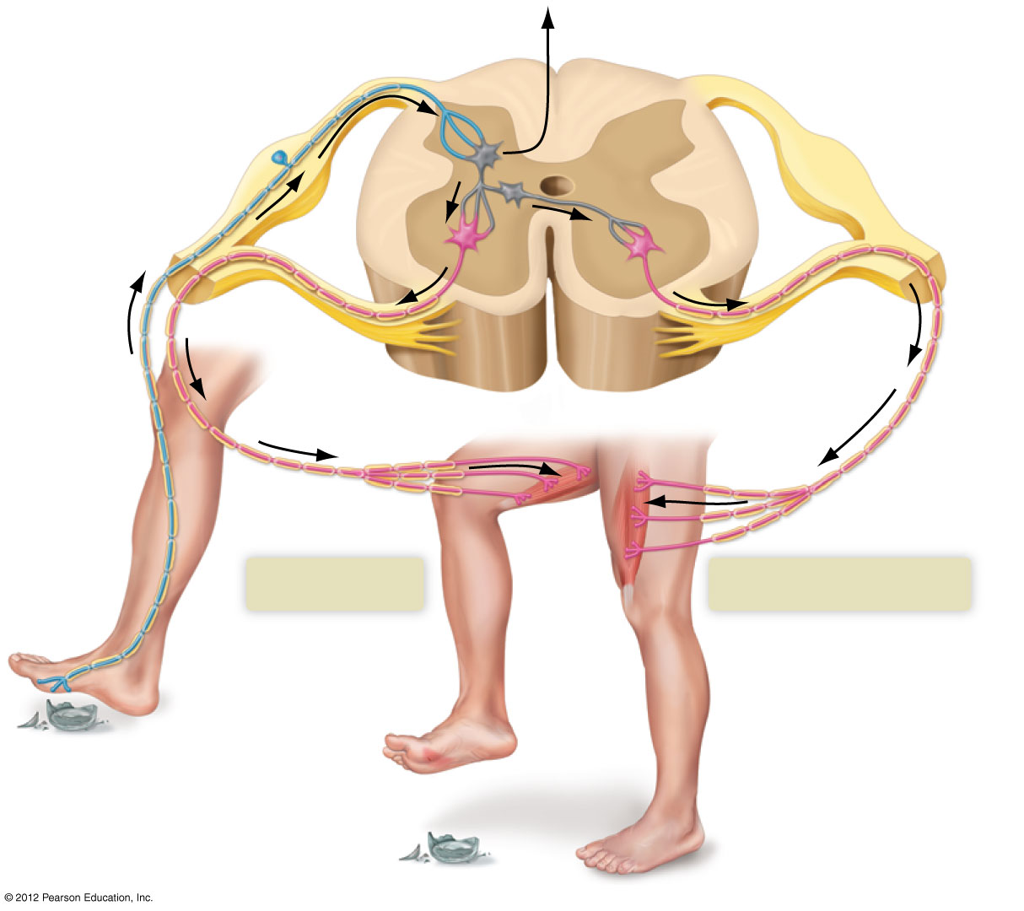
To brain
Dorsal root (sensory)
White matter
Gray matter
Cell body of
sensory neuron
Interneurons
Ventral root
(motor)
Spinal cord
Motor neuron
Motor neuron
Flexor reflex
Effector
muscles
(thigh)
Crossed extensor reflex

Slide 5
The Autonomic Division
Part of the motor output of the PNS
Controls automatic body functions of many internal organs
Consists of two divisions
  Sympathetic division
  Parasympathetic division
Both sympathetic and parasympathetic neurons enervate each organ

Slide 6
The Sympathetic and Parasympathetic Autonomic Divisions Oppose Each Other
Sympathetic division
  Prepares the body for emergencies
  Norepinephrin is the key neurotransmitter
  Produces fight-or-flight response
    Increases heart rate and respiration
    Raises blood pressure
    Dilates pupils
    Slows digestion and urine production
  Generally produces a unified response in all organs at once
  Opposes parasympathetic division

Slide 7
The Sympathetic and Parasympathetic Autonomic Divisions Oppose Each Other
Parasympathetic division
  Relaxes the body
  Opposes sympathetic division
  Acetylcholine is the key neurotransmitter
  Actions:
    lowers heart rate and respiration
    increases digestion
    permits defecation and urination
Sympathetic and parasympathetic divisions work antagonistically to maintain homeostasis

Slide 8
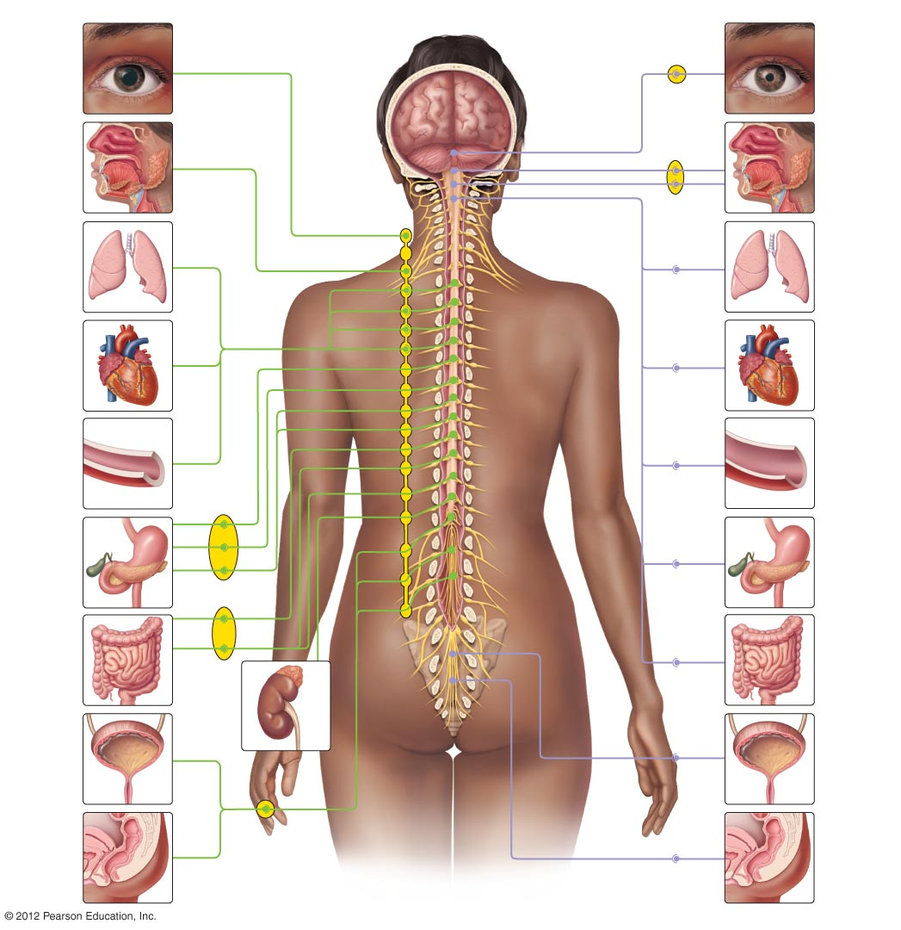
SYMPATHETIC DIVISION
PARASYMPATHETIC DIVISION
Dilates
pupil
Constricts
pupil
Decreases
salivation
Increases
salivation
Cranial
nerves
Increases
respiration
rate
Decreases
respiration
rate
Increases
heart rate
Thoracic
nerves
Decreases
heart rate
Constricts
blood
vessels
Dilates
blood
vessels
Inhibits
digestive
processes
Stimulates
digestive
processes
Lumbar
nerves
Inhibits
digestive
processes
Stimulates
digestive
processes
Sacral
nerves
Relaxes
bladder
muscles
Stimulates
secretion of
epinephrine
and nor-epinephrine
Contracts
bladder
muscles
Inhibits
defecation
Causes salt and
water retention
Stimulates
defecation
Ganglion
Synapse between neurons

Slide 9
