Slide 1

Demyelinating Diseases
Disorders associated with degeneration of myelin sheaths
  Multiple sclerosis (MS)
    Progressive damage to myelin sheaths in brain and spinal cord
    Weakness, visual impairment, incontinence
  Amyotrophic lateral sclerosis (ALS)
    Lou Gehrig's disease
    Progressive damage to myelin sheaths in motor area of spinal cord
    Progressive weakening and wasting of skeletal muscle

Slide 2
Information Is Transferred from Neuron to Target
Targets
  another neuron, muscle cell, or gland
Synapse
  special junction between axon terminus and target cell
Synaptic transmission
  Process of transmission of impulse from sending (presynaptic neuron) across synaptic cleft to receiving (postsynaptic) target
  Involves release and diffusion of chemical neurotransmitter

Slide 3
Synaptic Transmission: Neurotransmitter Release
Action potential arrives at axon terminus, causing Ca²⁺ to diffuse into axon bulb
Ca²⁺ causes release of neurotransmitter from vesicles
Neurotransmitter diffuses across synaptic cleft
Neurotransmitter binds to receptors on target (postsynaptic) membrane and opens gated channels

Slide 4
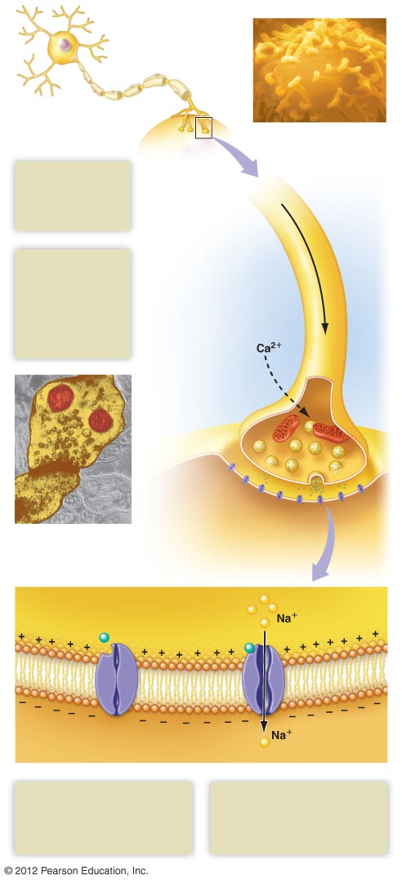
Axon bulbs form synapses
with a postsynaptic neuron
1
An action potential
arrives, causing
Ca²⁺ to diffuse
into the axon bulb.
2
Action potential
Ca²⁺ causes
vesicles containing
neurotransmitter
to fuse with the
cell membrane,
releasing
neurotransmitter.
Axon of
presynaptic
neuron
Mitochondrion
Axon
bulb
Vesicles containing
neurotransmitter
Presynaptic
neuron
Synaptic cleft
Dendrite or cell body
of postsynaptic neuron
Close-up of a synapse
Presynaptic membrane
Postsynaptic membrane
Synaptic cleft
Neurotransmitter
Na⁺
Na⁺
Cytoplasm of postsynaptic cell
3
4
Neurotransmitter binds to
receptors on chemically gated
sodium channels, causing the
channels to open.
Diffusion of sodium produces
a graded potential in the
local region of the synapse.

Slide 5
Neurotransmitters Exert Excitatory or Inhibitory Effects
Response of postsynaptic target cell depends on
  Type of neurotransmitter (>50 types)
  Type of receptors
  Type of gated ion channels

Slide 6
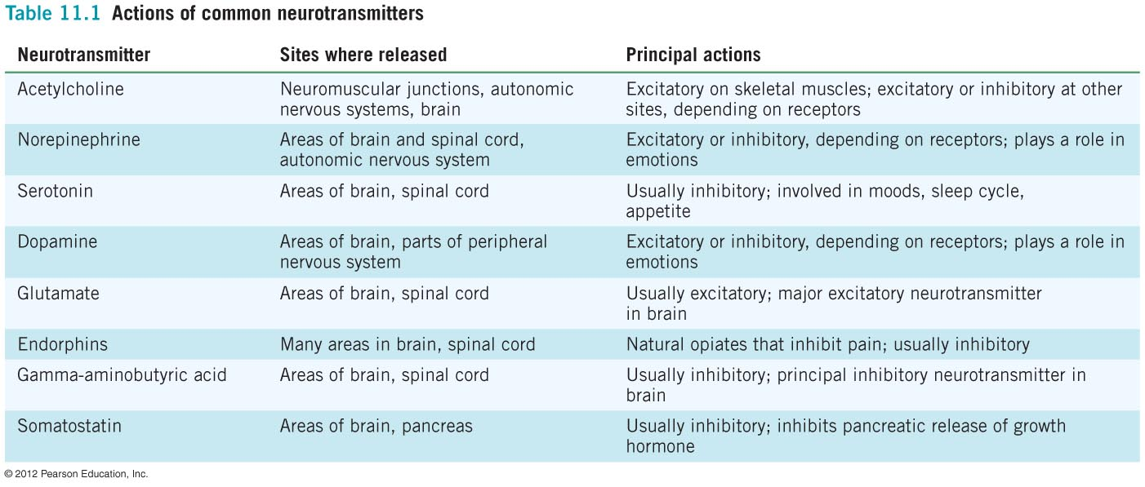
This is just to show the names of some neurotransmitters
  Do not worry about the ‘site where released’ or ‘principal actions’

Slide 7
Postsynaptic Neurons Integrate and Process Information
Response in postsynaptic cell depends on
  How many neurons are forming synapses
  with it
  Whether the neurons forming synapses with
  it are excitatory or inhibitory

Slide 8
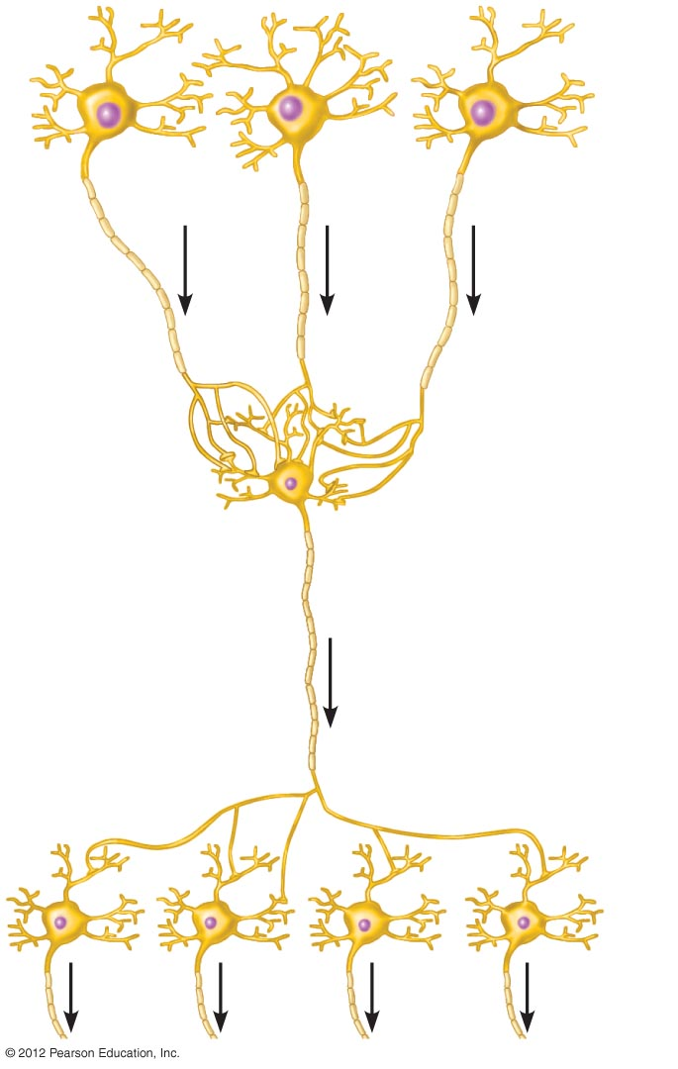
Postsynaptic Neurons Integrate and Process Information
Convergence
  occurs when one neuron receives input from many others
Divergence
  occurs when one neuron sends action potentials to multiple other neurons
Convergence
Divergence

