Slide 1
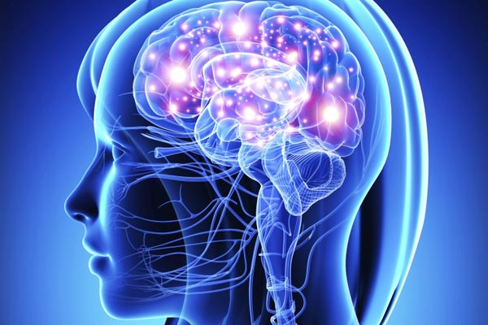

The Nervous System

Slide 2
Nervous System Has Two Principal Parts
Central nervous system (CNS)
  Components: brain and spinal cord
  Functions: receives, processes, and transfers information
Peripheral nervous system (PNS)
  Components: nerves outside CNS
  Sensory division: carries information toward the CNS
  Motor division: carries information away from CNS

Slide 3
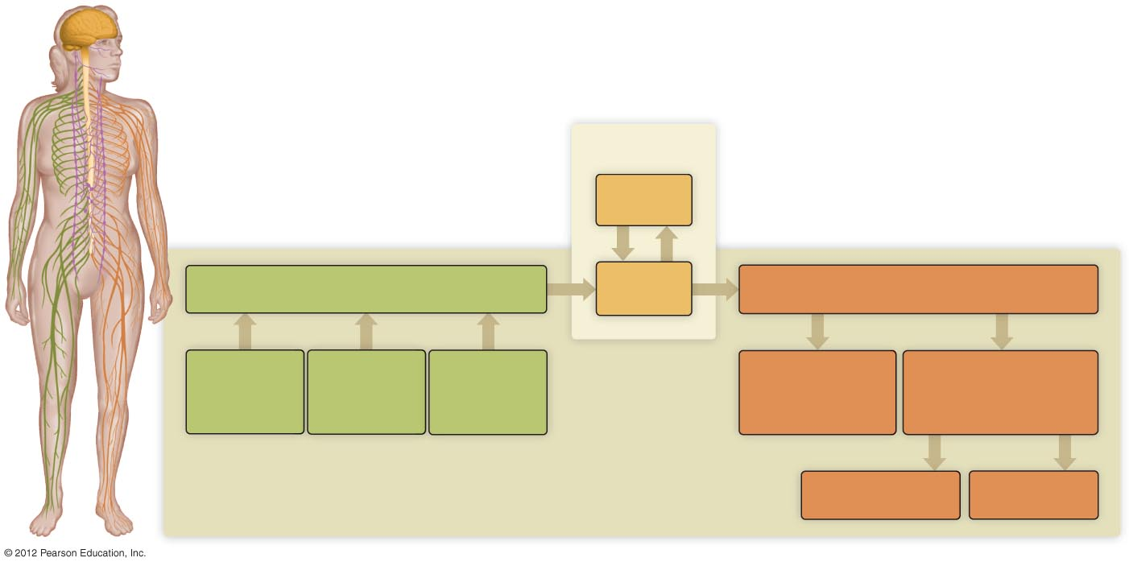
CNS
Brain
Sensory (input)
Spinal
cord
Motor (output)
Signals
from external
environment
Signals from
skin, tendons,
and muscles
Signals from
internal
organs
PNS
Somatic division
(control of skeletal
muscle)
Autonomic division
(autonomic control of
smooth muscle, cardiac
muscle, and glands)
Parasympathetic
Sympathetic

Slide 4
Neurons: Communication Cells of the Nervous System
Neurons are specialized cells for communication
  Generate and conduct electrical impulses
Types of neurons
  Sensory neurons: neurons found in the PNS that receive stimuli and transmit information to the CNS
  Interneurons: transmit information between components of the CNS
  Motor neurons: neurons found in the PNS that transmit information away from the CNS

Slide 5
Neurons: Cell Structure
Three parts of the neuron
  Cell body: main part of the cell, has the nucleus and most of the cytoplasm and organelles
  Dendrites: small slender extensions of the cell body, receive incoming information
  Axon: long slender extension, specialized to conduct electrical impulses away from the cell body

Slide 6
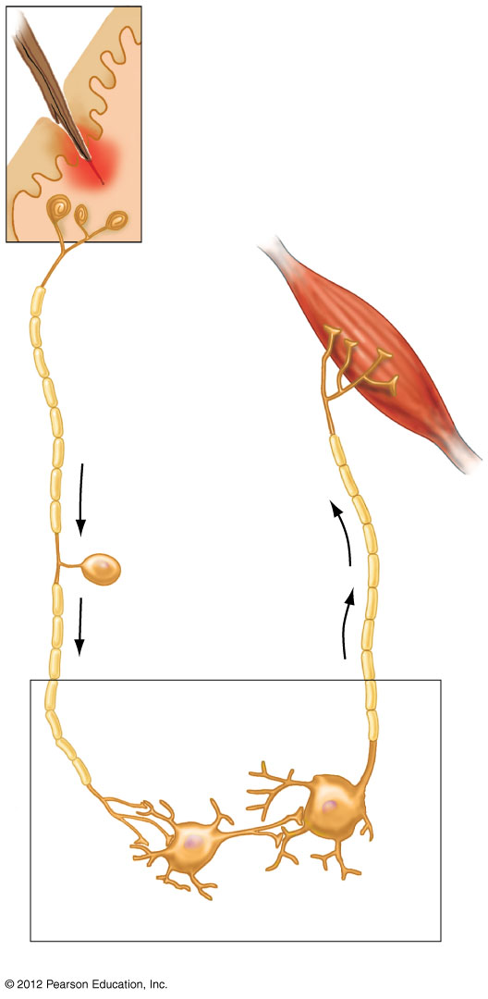
Skin
Receptor
Dendrite
Axon
Muscle
Axon
bulb
Sensory
neuron
Cell body
Axon
Impulse direction
Motor
neuron
Dendrites
Interneuron
Cell
body
Dendrites
Axon
Cell body
Brain and spinal cord

Slide 7
Neurons Initiate Action Potentials
Neurons generate and transmit action potentials
An action potential is basically an electrical impulse
Primary means of communication throughout the nervous system

Slide 8
Neuroglial Cells Support/Protect Axons
Neuroglial cells make up 80% of nervous system
  Function
    Support
    Protection
    Do NOT transmit action potentials
  Two types
    Schwann cells
    Oligodendrocytes

Slide 9
Neuroglial Cells: Form Myelin Sheath on Neurons
Schwann cells
  Form myelin sheath in PNS
  Save the neuron energy
  Speed up the transmission of impulses
    Saltatory conduction: leaping pattern of action potential conduction
  Help damaged or severed axons regenerate
Oligodendrocytes
  Form myelin sheath in CNS

Slide 10
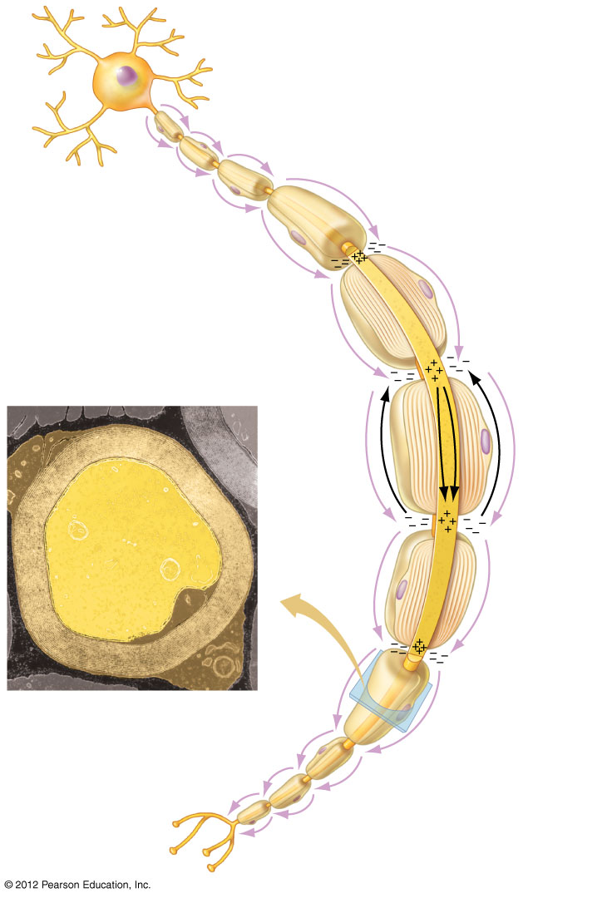
In saltatory conduction,
the nerve impulse jumps
from node to node.
a) A myelinated
motor neuron
of the peripheral
nervous system.
Node of Ranvier
Schwann cell
Myelin
sheath
Neuron
axon
b) TEM cross section of
part of an axon (yellow)
and its surrounding
myelin sheath
(beige).

